Slide 1
Winter extreme snowfall events along the coast of Northeast United States and the associated large-scale circulations
Wei-Chyung Wang, Lijun Tao and Guoxing Chen
Atmospheric Sciences Research Center
University at Albany, State University of New York
(Collaborator: Huang-Hsung Hsu & ChiaYing Tu, RCEC; and
Chao-Tzuen Cheng, NCDR)
U.S. NSF’s Partnerships for International Research and Education (PIRE)
“Building Extreme Weather Resiliency Through Improved Weather and Climate Prediction and Emergency Response Strategies”

Slide 2

Building Extreme Weather Resiliency Through Improved Weather and Climate Prediction and Emergency Response Strategies
U.S. National Science Foundation: Partnerships for International Research and Education (PIRE)

Slide 3
Regional Climate Modeling
Task 1: “Diagnostics” of observations and global model simulated “climate regimes” associated with extreme precipitation events over Taiwan and NEUS;
Task 2: WRF model “Simulations” of extreme precipitation intensity and variation focusing on the role of cloud microphysics
(NCU) Meiyu; cold surge over EA
(RCEC & NCDR) Extreme winter snowstorm Events over NEUS

Slide 4
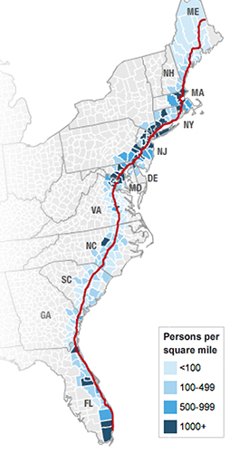
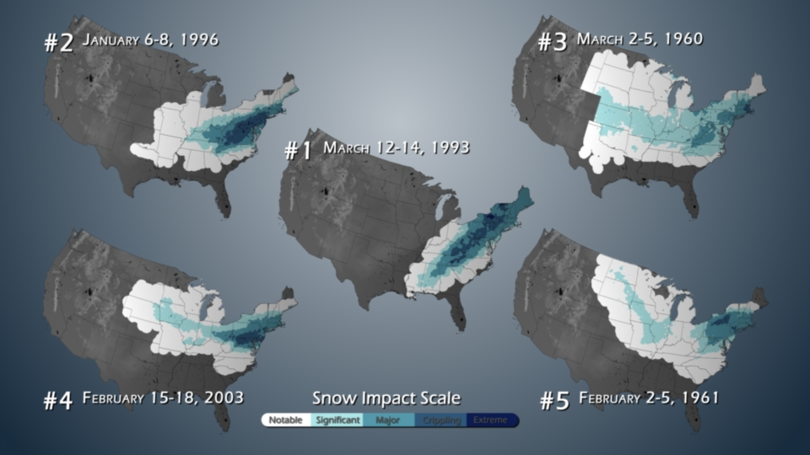
The Northeast Snowfall Impact Scale
(www.ncdc.noaa.gov/snow-and-ice/rsi/nesis)
the social, economic, and transportation impacts, factoring in the storm intensity and, and populations affected.
Interstate-95
Boston
NYC
Philly
DC
650 km
Notes:
Feb 07, 2011
The Worst Snow Storms in History
Tornadoes, hurricanes, earthquakes...they all have scales that measure their intensity. And determining how intense they are is somewhat simple – the intensity is highest around a central point, such as an eye or epicenter, and diminishes as it radiates from the “origin.” But what about winter snow storms? After storms, like the Groundhog Day blizzard of 2011, it is natural to reflect back on what were the worst snow storms in memory. Characterizing their intensity, though, can be difficult - they are often amorphous in shape, extremely large in area, and have tremendous spatial variability in their intensity.
Scientists at NOAA have developed a system for ranking these storms that relies less on a single variable, but a rather complex calculation of several storm characteristics. The Northeast Snowfall Impact Scale ranks the social, economic, and transportation impacts of winter storms, factoring in how large the storm was, how much snow fell, and what populations were affected. Using a Category 1-5 ranking, the top Northeast U.S. storms are shown in this image. The darkest blue areas represent the most impacted areas of a storm system. Interestingly, as large and intense as the recent winter 2010-2011 storms have been, none (preliminarily) have made it into the Top 10 storms list. In fact, the Groundhog Day storm is currently ranked at #19. To have a significant statistical weight, a storm must produce 20-30" of snow and occur over highly populated areas. Since the Midwest is not as densely populated as the DC through Boston corridor, storms that peak in the Northeast will typically have a higher intensity on the NESIS Scale. The Groundhog Day 2011 storm, though severe in many places, did not have a wide-scale impact (e.g., 30 inches of snow) on major cities, and thus does not rank up with the storms of 1993, 1996, 1960, 2003, and 1961.

Slide 5
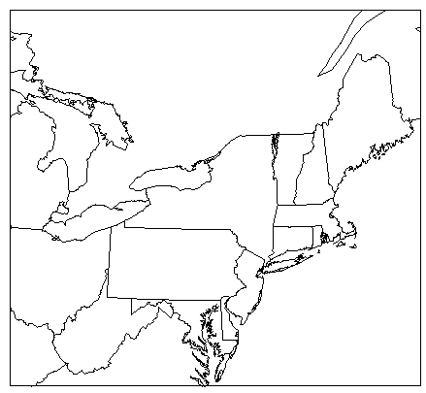
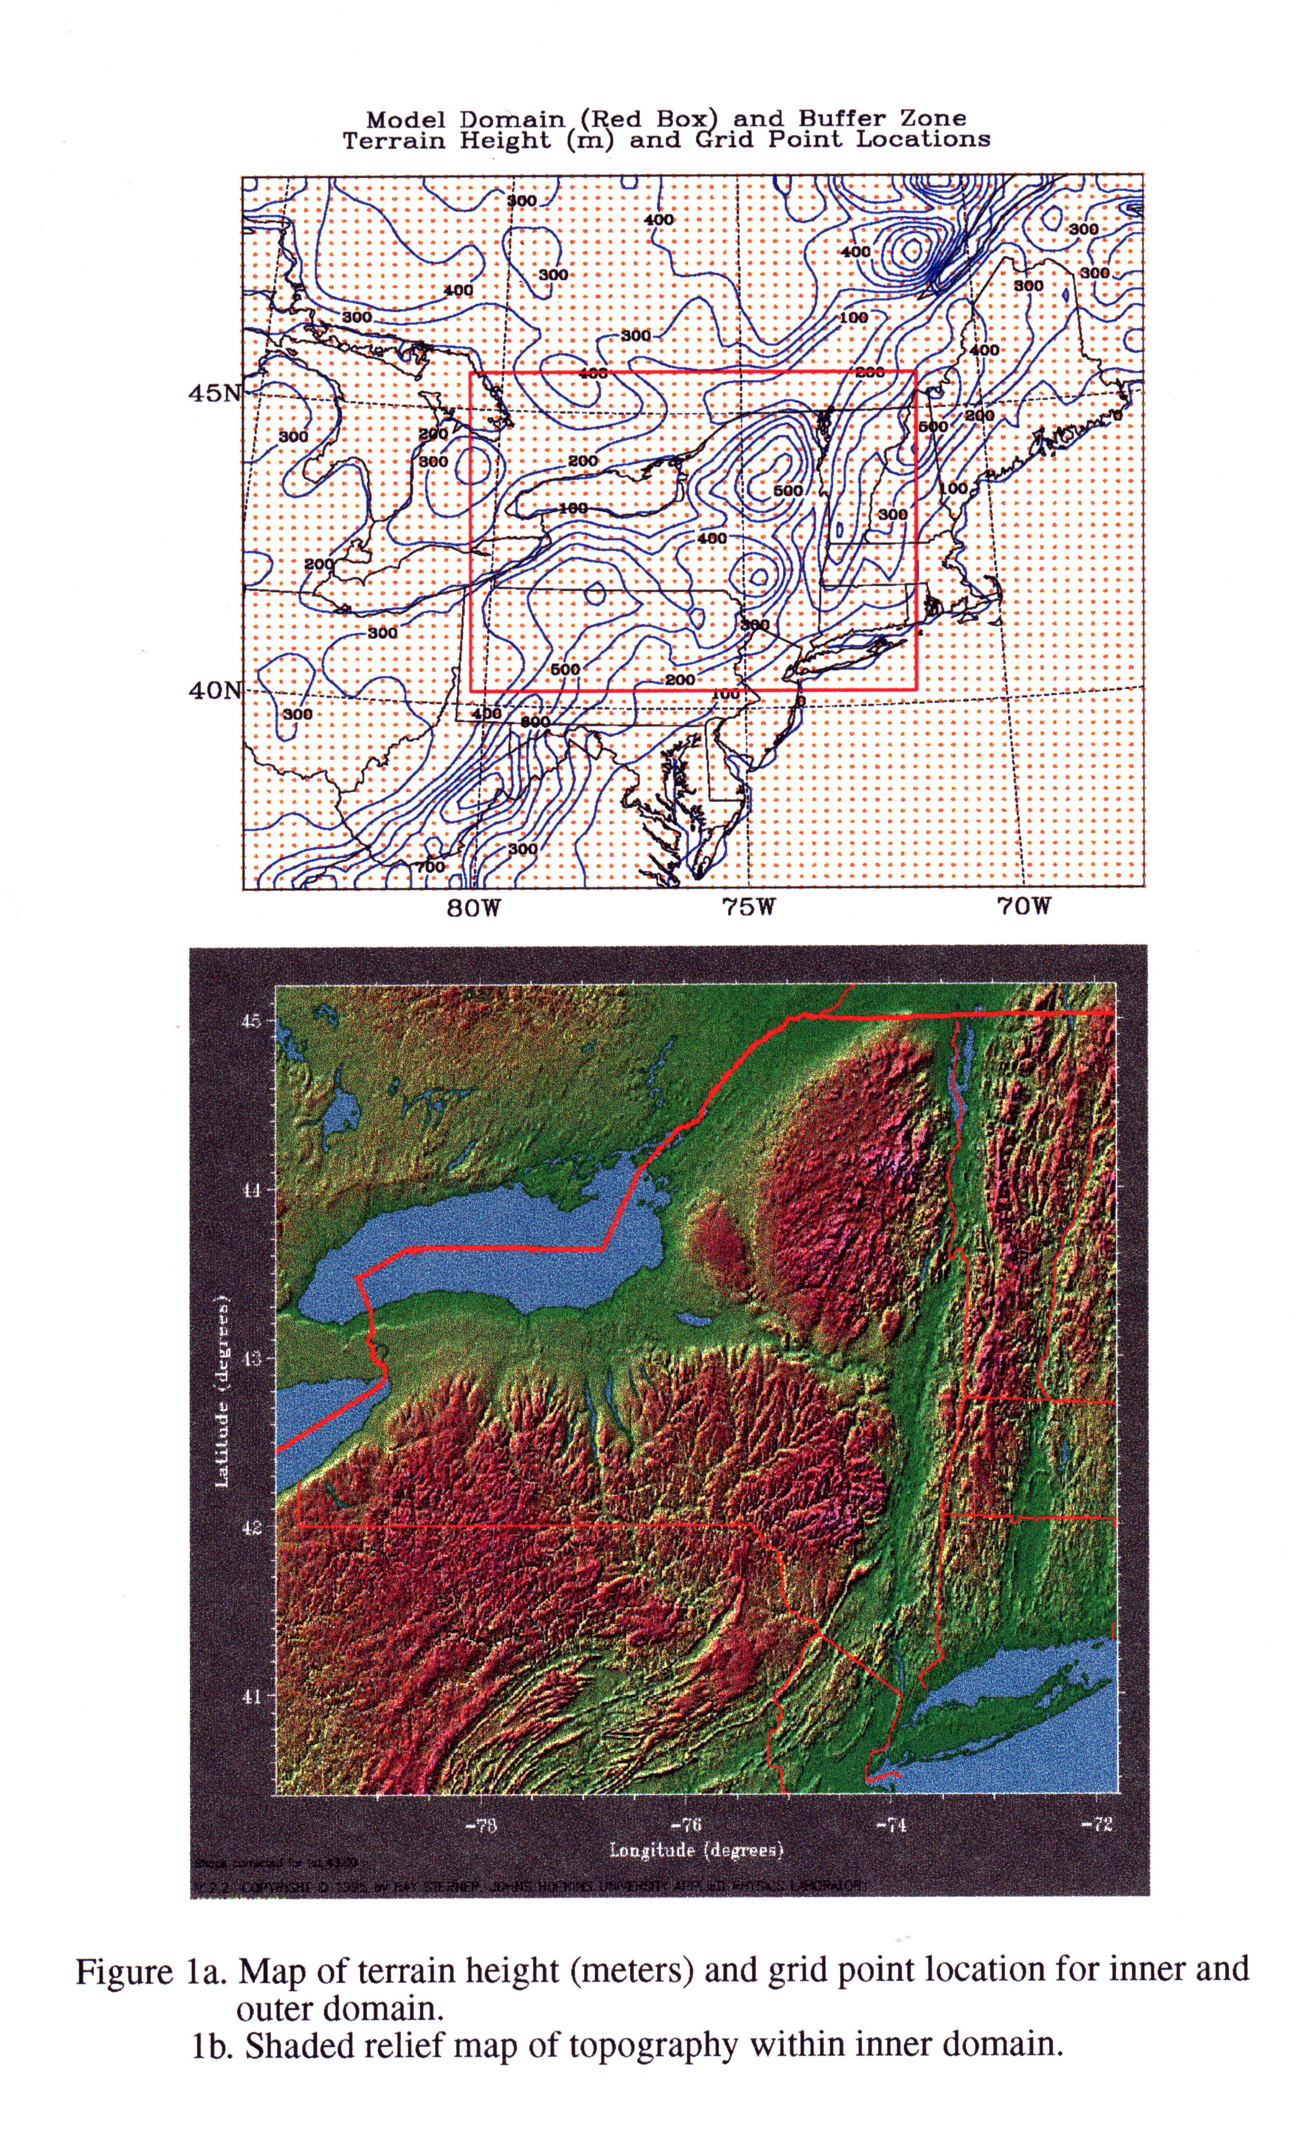
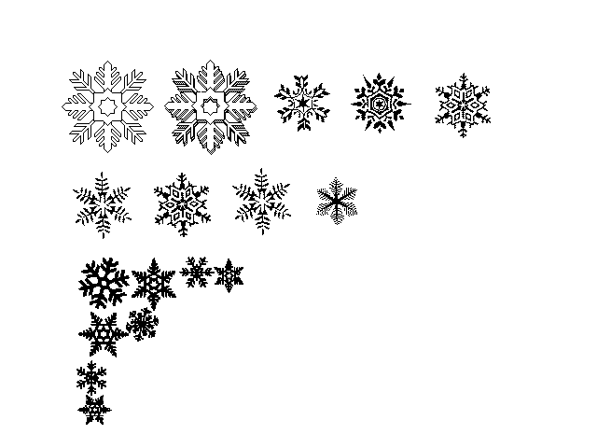

Notaro et al., 2006: Model and observational analysis of the NE regional winter climate and its relation to the PNA pattern. Mon. Wea. Rev.
Key wintertime Features in the Northeast
L
cP or cA
Alberta
storm track
Mean surface low
mP
Colorado
storm track
nor’easter
U p p e r - l e v e l J e t
L
Mean surface high
Gulf Stream
H
cT
mT
Notes:
Key Wintertime Features in the Northeast:
1. Upper-level Jet
-The core of the upper level jet is positioned to the south of New York. The flow at 250hPa within the jet is from the SW to NE. During +PNA pattern, the jet is centered to the southeast over the Atlantic, placing NY in the cyclonic entrance region. During -PNA pattern, the jet is centered to the northwest over Pennsylvania, with NY in the exit region. The jet stream strongly influences the surface climate.
2. Air masses
-cP and cA (continental polar and Arctic) from Canada, associated with cold frontal passages and cold surges. When the cold fronts pass over the lakes, lake-effect snow can occur.
-mP (maritime polar) air sometimes wraps around coastal nor’easter storms over the Atlanti
-cT (continental tropical) air masses sometimes enter the region behind warm fronts.
-mT (maritime tropical) air sometimes advects into the area from the warm Gulf Stream waters.
3. Mean surface pressure
-At the surface, there’s a surface anticyclone centered over Kentucky/West Virginia and a surface cyclone off to the northeast of Maine, leading to surface northwesterlies through NY (cold advection).
4. Gulf Stream
-Warm channel of waters off the coast, encouraging coastal cyclogenesis.
5. Mountains
-Appalachians, Adirondacks, Catskills…encourage lee cyclogenesis and cold air damming.
6. Cyclone tracks
-Alberta track = from Alberta, Canada = little moisture = move across lakes = NW to SE track
-Colorado track = from east of Rockies = pick up moisture from Gulf = SW to NE track
-Warmer waters of Atlantic encourage coastal lows and warmer lakes enhance cyclogenesis.

Slide 6
For the winter snow storms in the NEUS:
Zero temperature contour at 850hPa (Kocin and Uccellini 1990)
Strong low-level easterly anomalies (Stuart and Grumm 2006)
Near coast cyclone tracks (Milrad et al. 2009)
February 2, 2015 NEUS Snow Storm
(Rauber et al., 2017, BAMS)
Notes:
Rauber, R. M., S. M. Ellis, J. Vivekanandan, J. Stith, W.-C. Lee, G. M. McFarquhar, B. F. Jewett, and A. Janiszeski, 2017: Finescale structure of a snowstorm over the Northeastern United States: A first look oat high-resolution HIAPER cloud radar observations. BAMS, DOI:10.1175/BAMS-D-15-00180.1

Slide 7
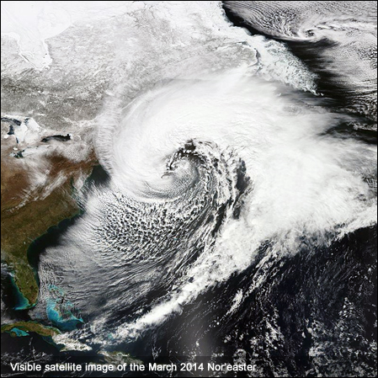
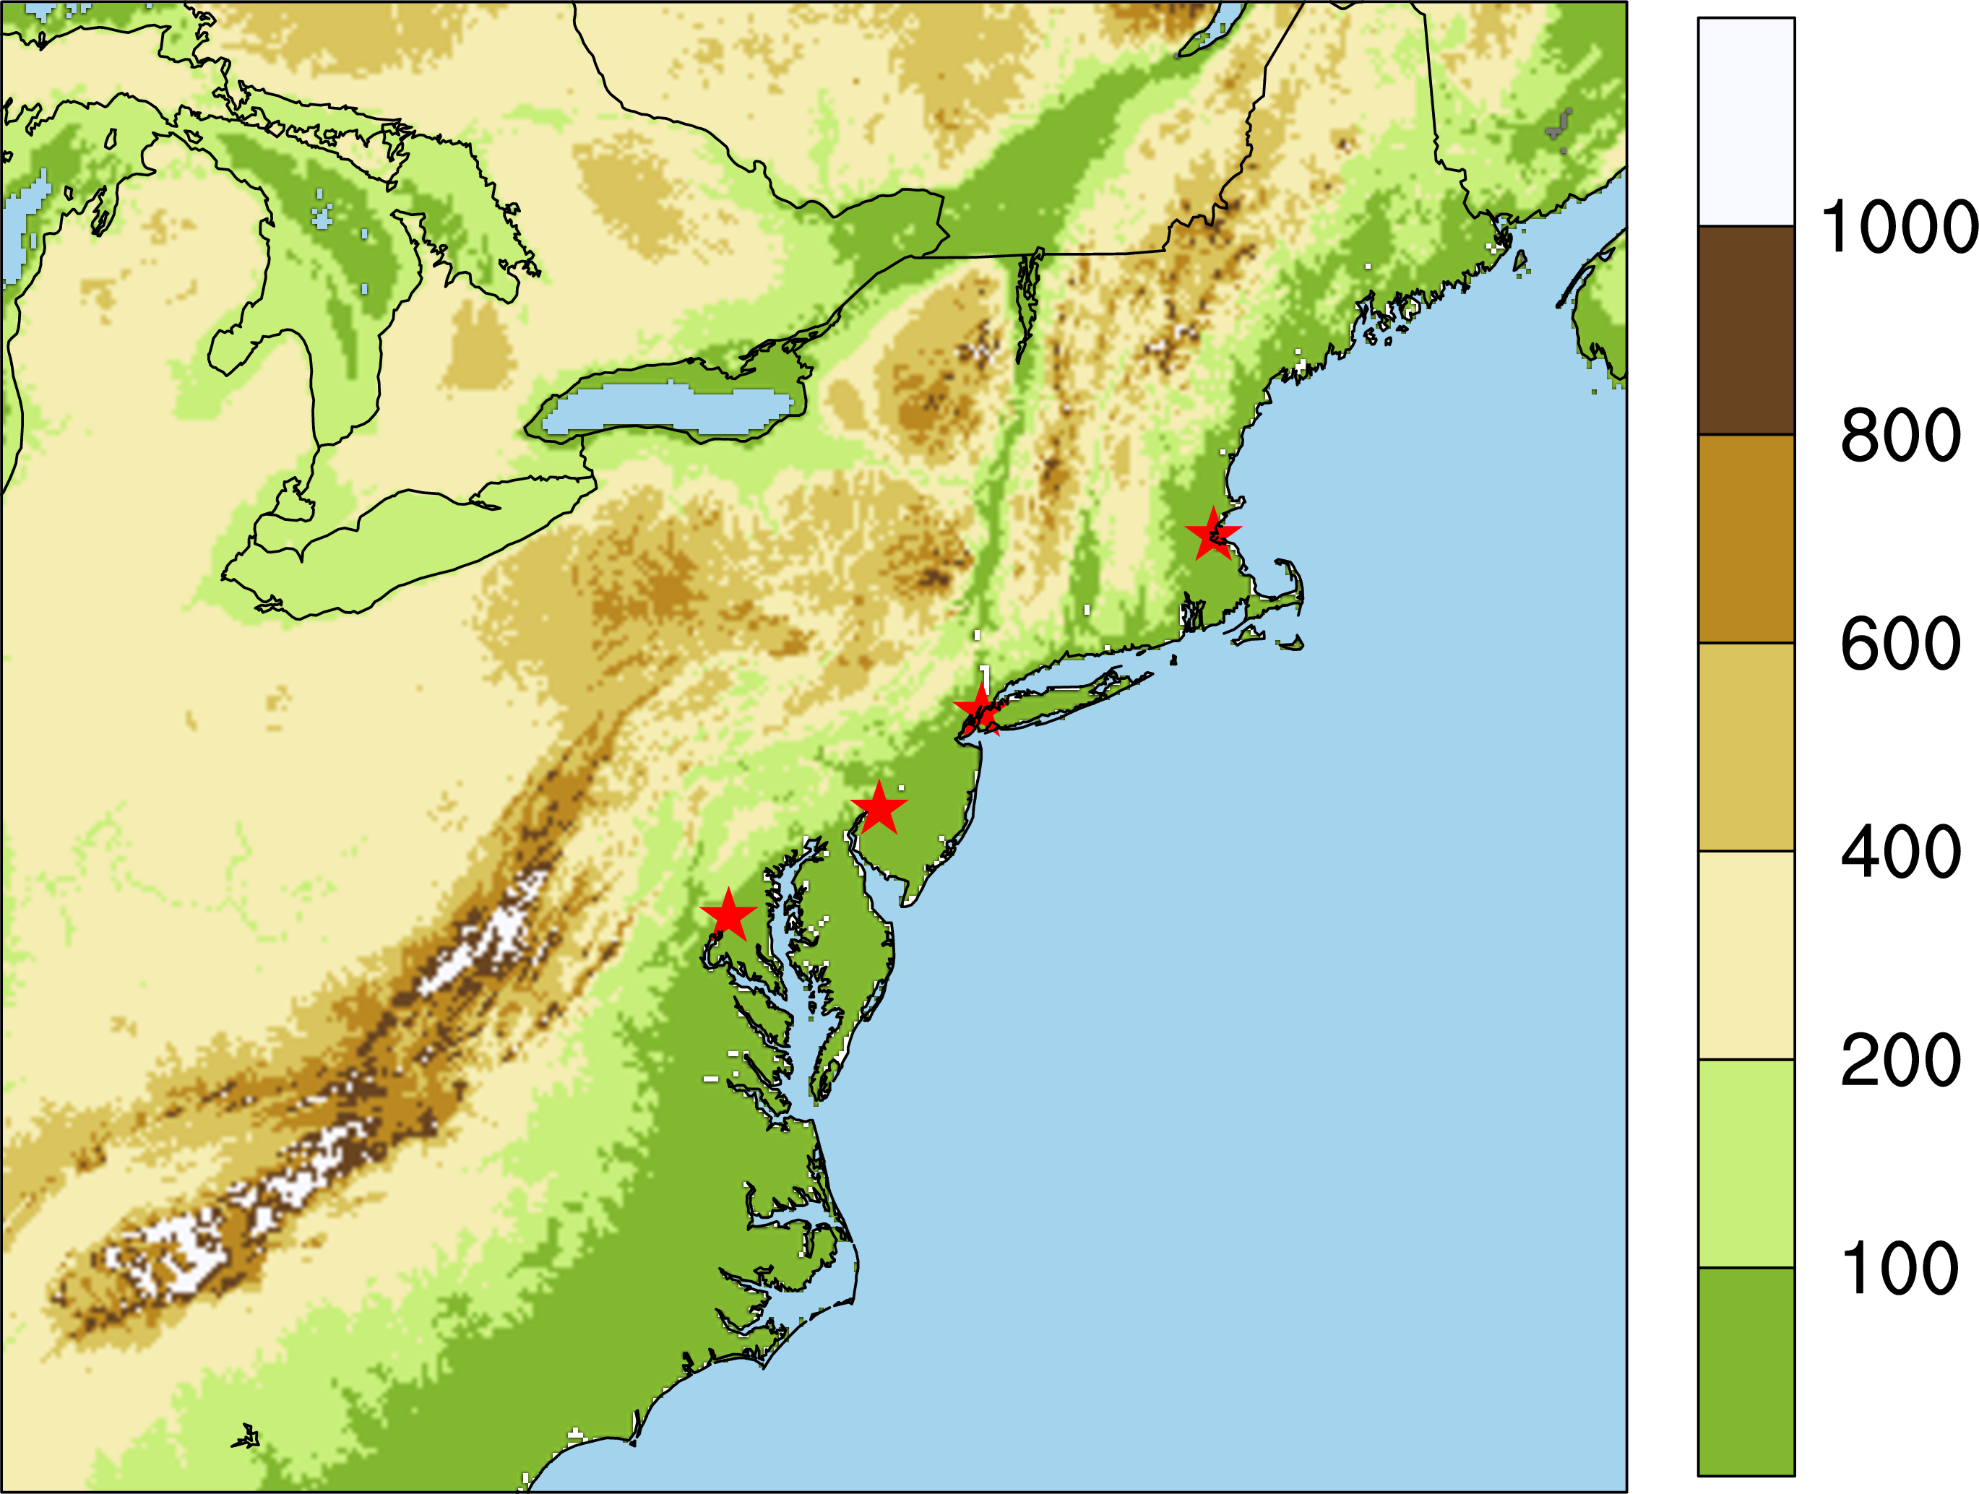
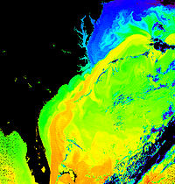
Extreme snow storm events along the coast:
“I-95 Corridor”: Washington DC/Philadelphia/NYC/Boston
significantly impacted by Nor’easters
Polar Cold front
Upper-level troughs
Upper-level jets
nor’easter
L
Cyclone tracks
Gulf Stream
Notes:
Kocin, P. J., and L. W. Uccellini. 1990. Snowstorms along the northeastern coast of the United States: 1955 to 1985. Meteorological Monograph no. 44. Boston: American Meteorological Society.

Slide 8
Approach
Global Historical Climatology Network-daily Dataset (GHCN; 1980-present): Station snowfall (daily) =>Extreme snowfall Events: Boston/New York City/Philadelphia/Washington DC; Snowfall exceed 97.5% the local daily climatology 109, 76, 53 and 43 mm
MERRA2 reanalysis (1980-present): SLP; wind & T at 850hPa (6h) =>Indicators (Near coast cyclone tracks; Strong low-level easterly anomalies; Zero temperature contour at 850hPa)
High-Resolution Atmospheric Model (HiRAM/C384) simulation (1979-2008; 2075-2100; Forced by monthly SST, 0.23°x0.23°: snow water (10.4, 7.2, 7.1, 6.6 mm); SLP, wind & T at 850hPa (6h) =>Events---Indicators
Notes:
The conversion between snow-water-equivalent to snow-depth
The snow density, the ratio between snow-water-equivalent to snow-depth, depends on temperature, snow depth, and location. The typical snow density can range from 10-20% in the winter to 20-40% in the spring.
For simplicity, we define the snow density as 10%, which means 10cm of new snow has 1cm of water when melt.
What is SST used in driving HiRAM?
For AMIP type simulations, we use sea surface temperatures and sea ice specified from the Hadley Centre Sea Ice and Sea Surface Temperature (HadISST; Rayner et al. 2003) 1-degree monthly dataset
Rayner, N. A., D. E. Parker, E. B. Horton, C. K. Folland, L. V. Alexander, D. P. Rowell, E. C. Kent, and A. Kaplan(2003), Global analyses of sea surface temperature, sea ice, and night marine air temperature since the late nineteenth century, J. Geophys. Res., 108, 4407
Website: http://www.metoffice.gov.uk/hadobs/hadisst/

Slide 9
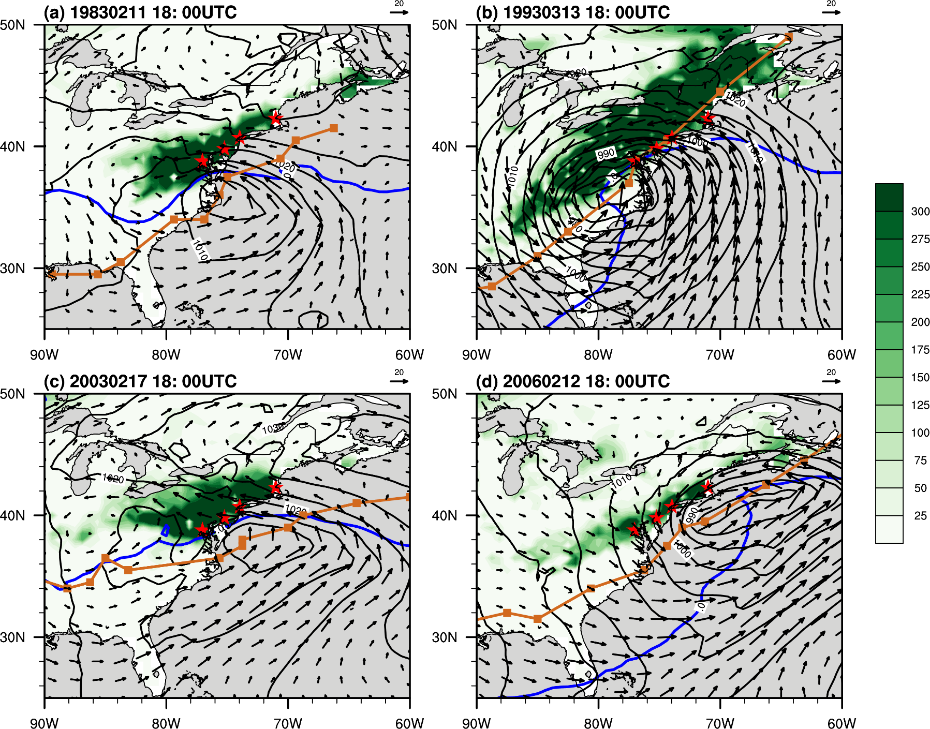
I-95 Extreme snowfall events (Observations)
(shading, mm) Accumulated snowfall amount; (line, d⁻¹ to d⁺¹) cyclone low track; (line)
850hPa 0°C isotherm;
(black contours) SLP;
(vectors)
850hPa Wind

Slide 10
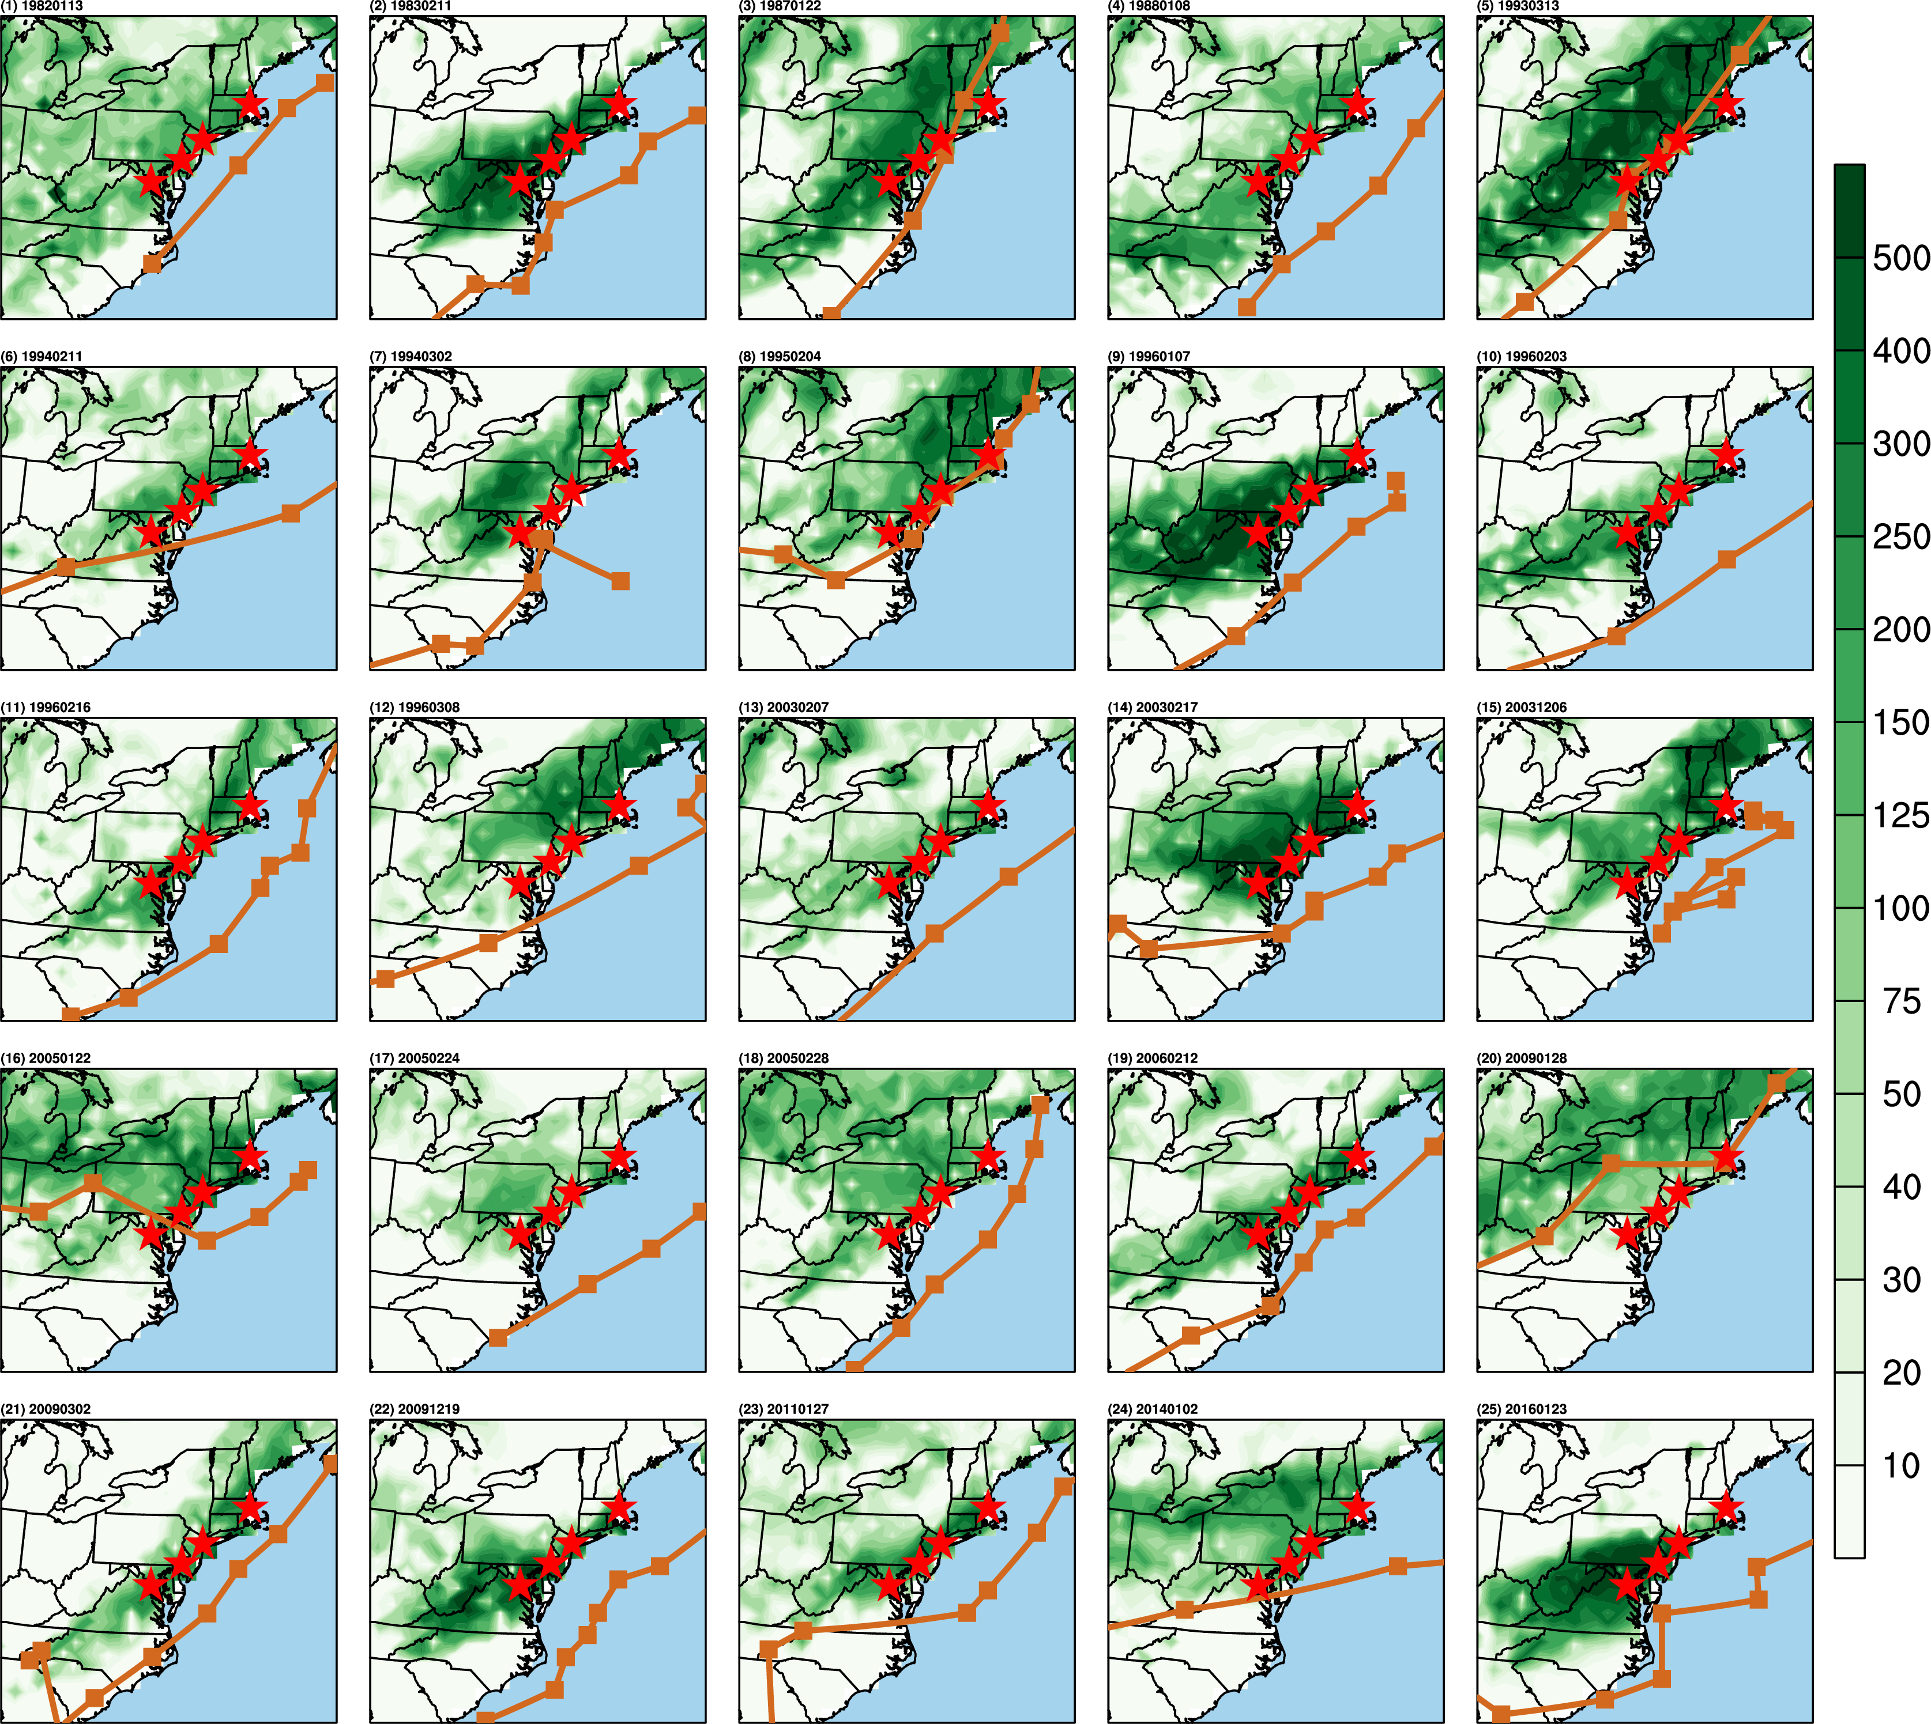
Observed snowfall & cyclone track: 25-events
Notes:
For the tracks on the left side of the 4 cities (No. 5 and 20), the main snowfall bands happened farther inland.

Slide 11
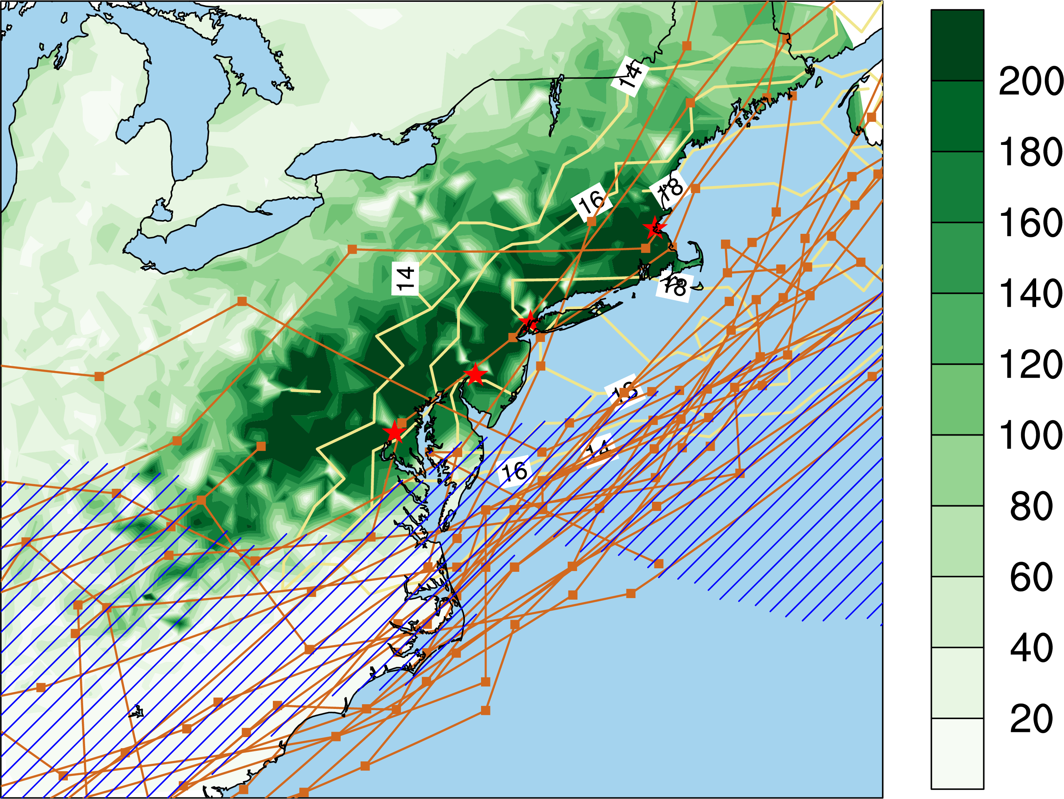
Observation: 25 events
Subjective criteria for analyzing HiRAM:
Strong low-level easterly winds near the coast.
Cyclone tracks lie off the northeast coast.
Below 0°C at the coastal four cities.
The snowfall averaged over all events (green shading), tracks (brown lines),
number count of events with strong low-level easterly wind at each grid point
(yellow contour) and the range of 0° isotherm at 850hPa (blue slash)
Notes:
Figure 2: The snowfall averaged over all events (green shading), tracks (brown lines), number count of events with strong low-level easterly wind at each grid point (yellow contour) and the range of 0° isotherm at 850hPa (blue slash) related to the 25 extreme winter snowfall events. The red stars locate the four weather stations on behalf of the coastal cities, Boston, New York City, Philadelphia, and Washingtong D. C, respectively.

Slide 12
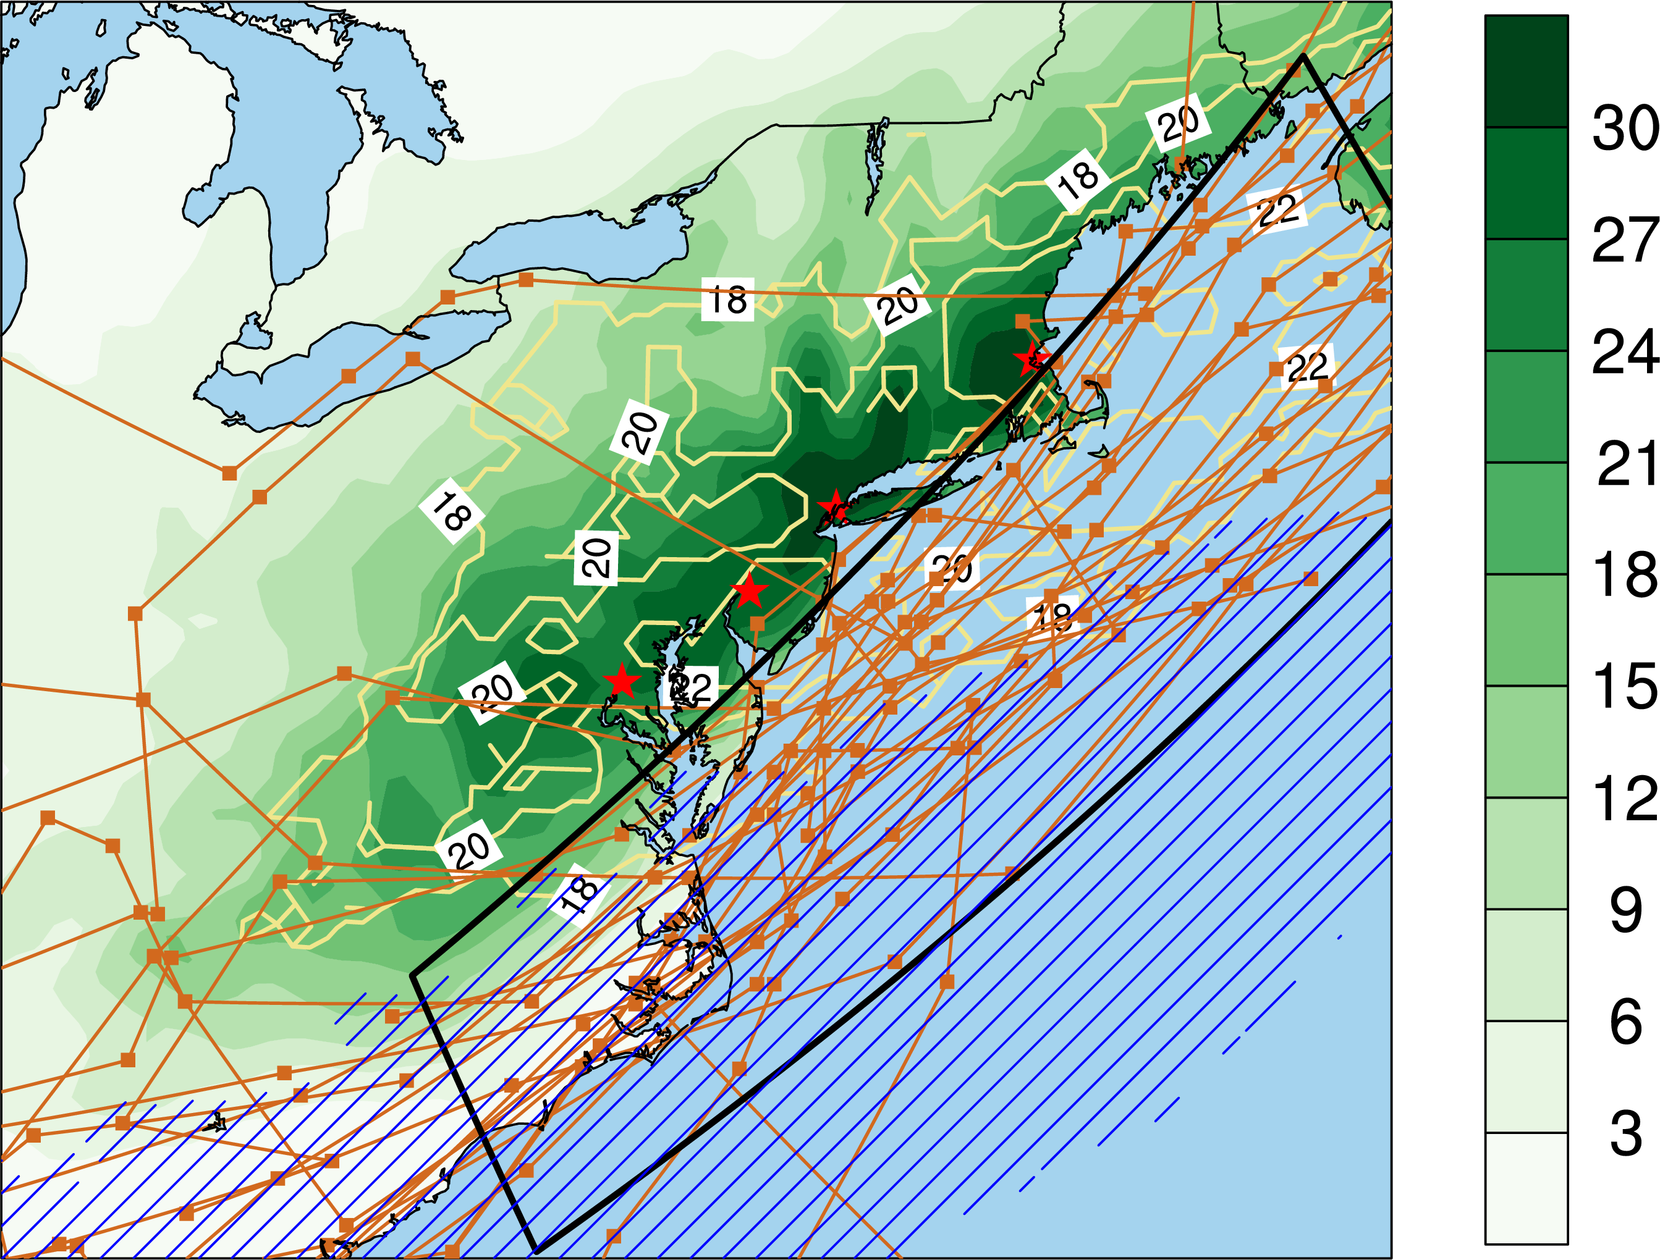
HiRAM historical simulation: 25 events
All four cities,
1. Near surface T < 0°C
2. At least a time step of strong low-level easterly winds (>2.5 SD)
Cyclone tracks
3. At least 3 time steps inside the black box
Notes:
Figure 3: The snowfall averaged over all events (green shading), tracks (brown lines), number count of events with strong low-level easterly wind at each grid point (yellow contour) and the range of 0° isotherm at 850hPa (blue slash) related to the 25 extreme winter snowfall events. The red stars locate the four weather stations on behalf of the coastal cities, Boston, New York City, Philadelphia, and Washingtong D. C, respectively. The black solid polygon indicates the area used for searching the near coastal cyclone tracks in HiRAM simulations.

Slide 13
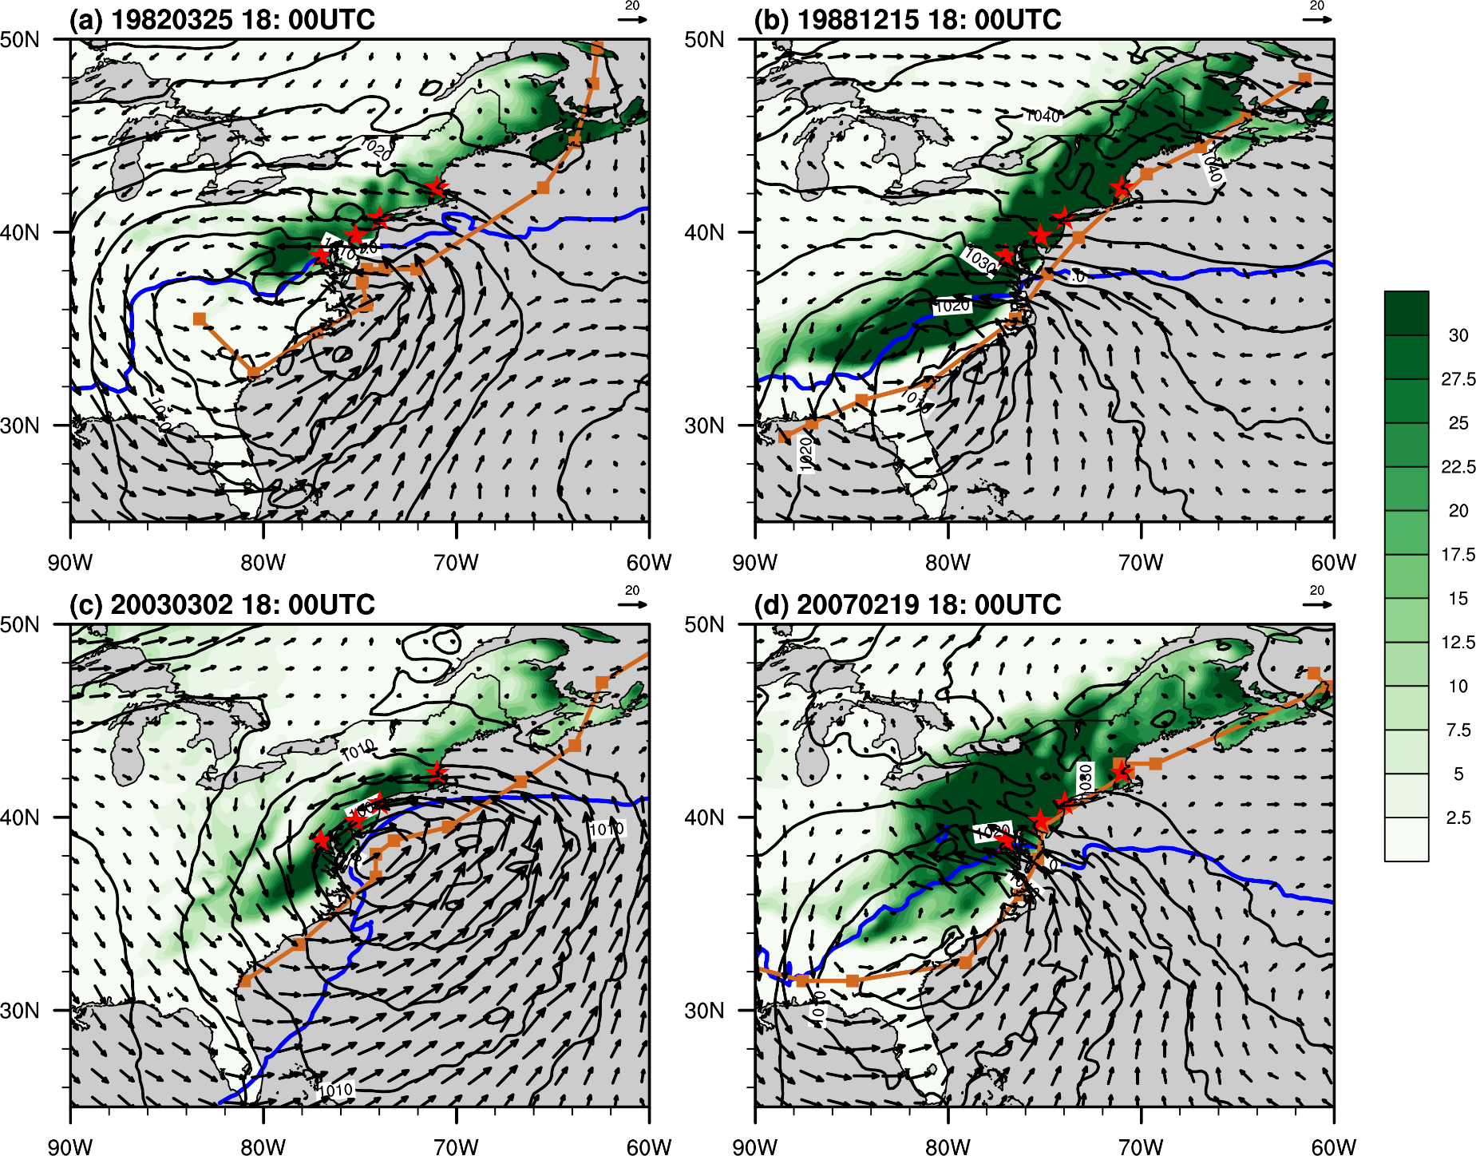
Extreme snowfall events (HiRAM)

Slide 14
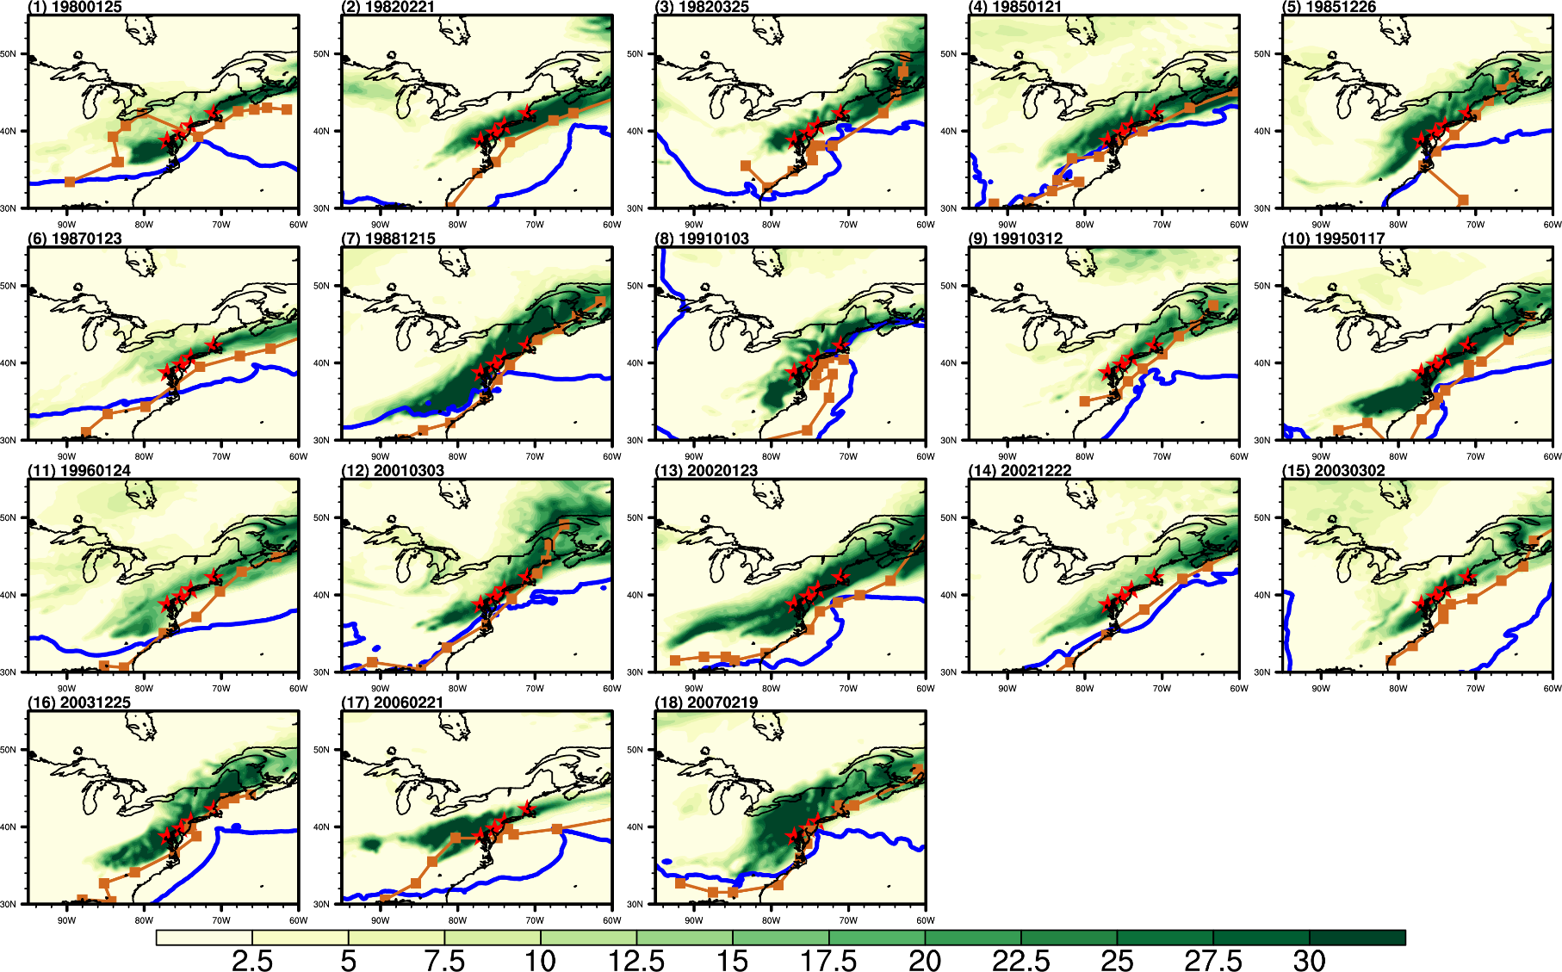
HiRAM historical simulation: 18 events satisfy the criteria
Notes:
Figure 5. The distribution of snowfall band (shading), the cyclone track (brown line) and 0° isotherm at 850hPa (blue contour) for each of the 16 events identified by the three indicators.

Slide 15
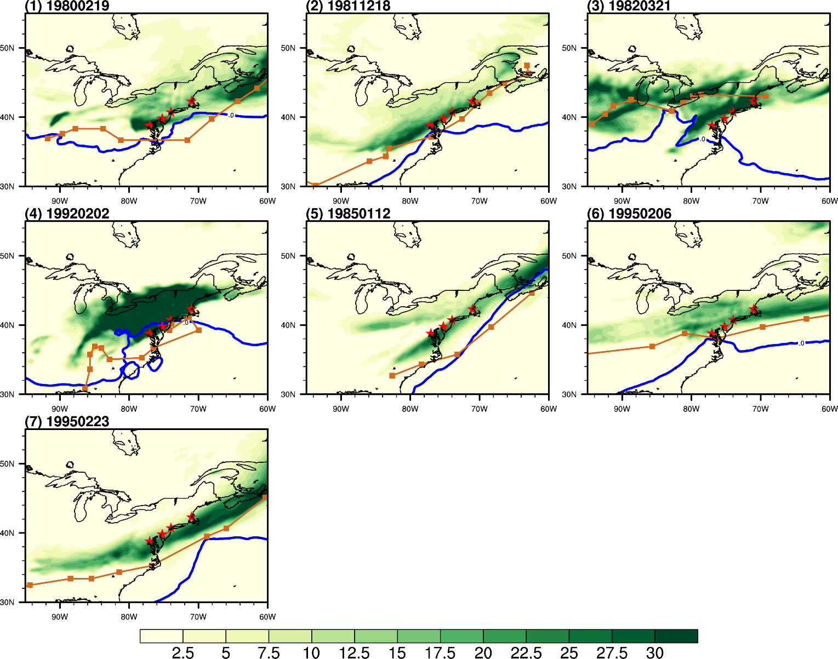
HiRAM historical simulation: 7 events
Tracks: 1,3,5,6
Easterly: 2, 7
Temperature: 4
Notes:
1082 19811218, No easterly
5897 19950223, No easterly
4780 19920202, No temp
(0) 414 19800219
(1) 1175 19820321
(2) 2203 19850112
(3) 5880 19950206

Slide 16
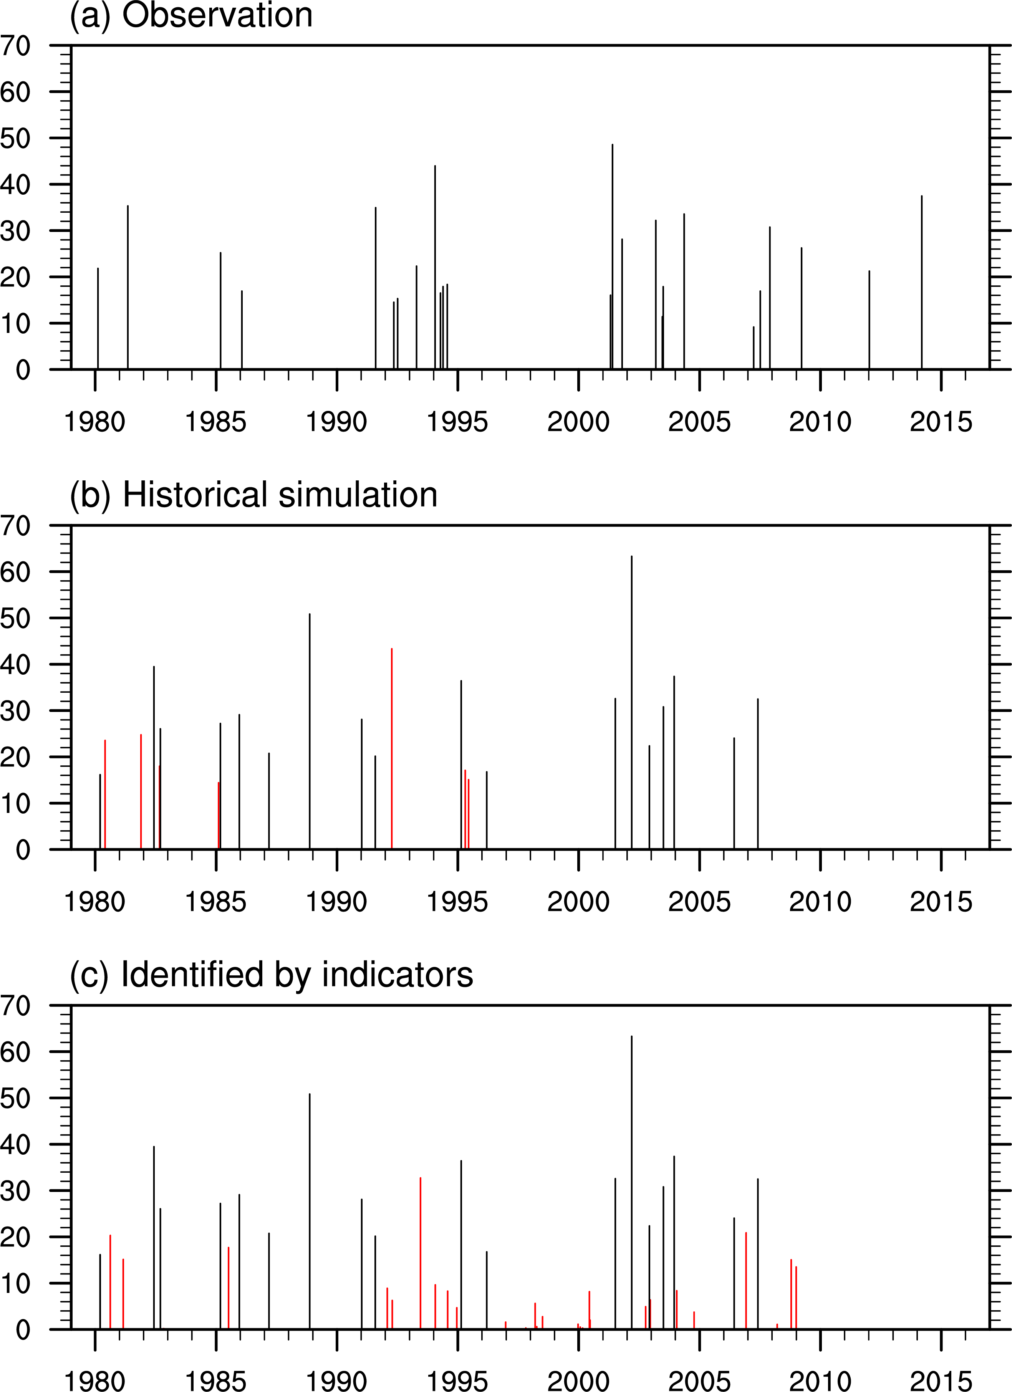
Extreme snow storm events over NEUS
(Mean snow-water-equivalent over 4-cities, mm)
Obs. (25)
Event (97.5%)
3-Indicators
HiRAM. (18/7)
Event (97.5%)
=>18 meet Indicators; 7 not
HiRAM. (18/32)
Indicators
=>18 meet Events;
32 not;
Notes:
Caption: Mean snow-water-equivalent over the four coastal cities derived from (a) extreme snowfall events in observation, identified events by (b) snowfall rates and (c) three indicators in HiRAM historical simulation. Units: mm
In (b), there are 18 events satisfied our criterion, while the other 7 don’t which are marked in red.
In (c), a total of 50 events are found. 18 events satisfied the criterion, while the other 32 events don’t which are marked in red.
Among the 32 events marked in red , 12 events have more snowfall water equivalent than 7.8mm, which is the mean of 97.5% threshold over the four coastal cities.

Slide 17
Model-observation contrast
Observations
Snow, mm
HiRAM
Snow-water equivalent, mm
Cyclone track ??

Slide 18
Remarks
Since 1980, using the snowfall statistics of four coastal cities as reference, 25 extreme snowfall events were identified from observation. The circulation exhibit: Near coast cyclone tracks; Strong low-level easterly wind; Below 0° near surface temperature.
The HiRAM historical simulation is used to test the relationship between the Event⬄circulation Indicators:
  25 events but 18 meet the “indicators”;
  50 indicators but 32 events not qualified.
  Indicators need to be refined for further test:
  Tracks;
  Extreme rainfall
  WRF simulations of selective events (cloud microphysics);
  HiRAM 2075-2100 simulation

Slide 19
Aerosol Effects on Clouds and Precipitation over East Asia
Wei-Chyung Wang1, Pay-Liam Lin2, Jen-Ping Chen3, Guoxing Chen1, Yangyang Song1,
Bo-Yi Lu2, and Tzu-Chin Tsai3
1 ASRC/SUNYA; 2 DAS/NCU; 3 DAS/NTU
Progress of a coordinated research task using WRF model to study aerosol effects on precipitation over monsoon Asia is reported. Two studies are conducted: the first on the responses of vertical cloud properties (microphysics and fraction), the circulation and precipitation over the eastern China; and the second on the sensitivity of heavy precipitation to cloud microphysical schemes used in simulating Mei-Yu front over the northern Taiwan. Both studies employ the NTU cloud microphysical scheme. For eastern China, the effects of more aerosols produce more but smaller cloud droplets (and also larger cloud water); and more low- and high-clouds but fewer mid-clouds. However, these characteristics exhibit strong regional variations. For example, the cloud liquid water content increases in South China and the Yangtze-Huai River Valley (YHRV), but decreases in North China; low- and high-cloud fractions decrease in South and North China, but increase in the YHRV. The precipitation changes are highly correlated with the intensification and westward extension of the western North-Pacific Subtropical High, which favor more (and longer duration) rainfall over the YHRV but less (and shorter) rainfall over other regions.
In addition to the NTU scheme, the Goddard 4ice microphysics scheme was also used to simulate the June 11, 2012 Mei-Yu front event, which brought heavy rainfall to the northern Taiwan. Although both schemes capture the observed landing time, but the spatial distribution of precipitation is different owing to the different time evolution of ice and rainwater mixing ratios associated with the front movement. Compared to observations, the NTU scheme captures the strength of reflectivity and rainfall when the front landed, but the location was further south. On the other hand, the 4ice scheme simulates a weaker reflectivity but better landing location yields more reasonable precipitation distribution.

