Slide 1
The Multi-Radar Multi-Sensor QPE System
Jian Zhang, Ken Howard, Carrie Langston, Brian Kaney, Youcun Qi, Lin Tang,
Heather Grams, Yadong Wang, Steve Cocks, Steve Martinaitis, Ami Arthur,
Karen Cooper, Jeff Brogden
National Severe Storms Lab
Norman, OK

Slide 2
Outline
What is MRMS?
MRMS Radar QPE Operational Products and Applications
Ongoing Research: Challenges and Opportunities
Taiwan MRMS System (“QPESUMS”)
Summary
Notes:
这是今天报告的主要内容。

Slide 3
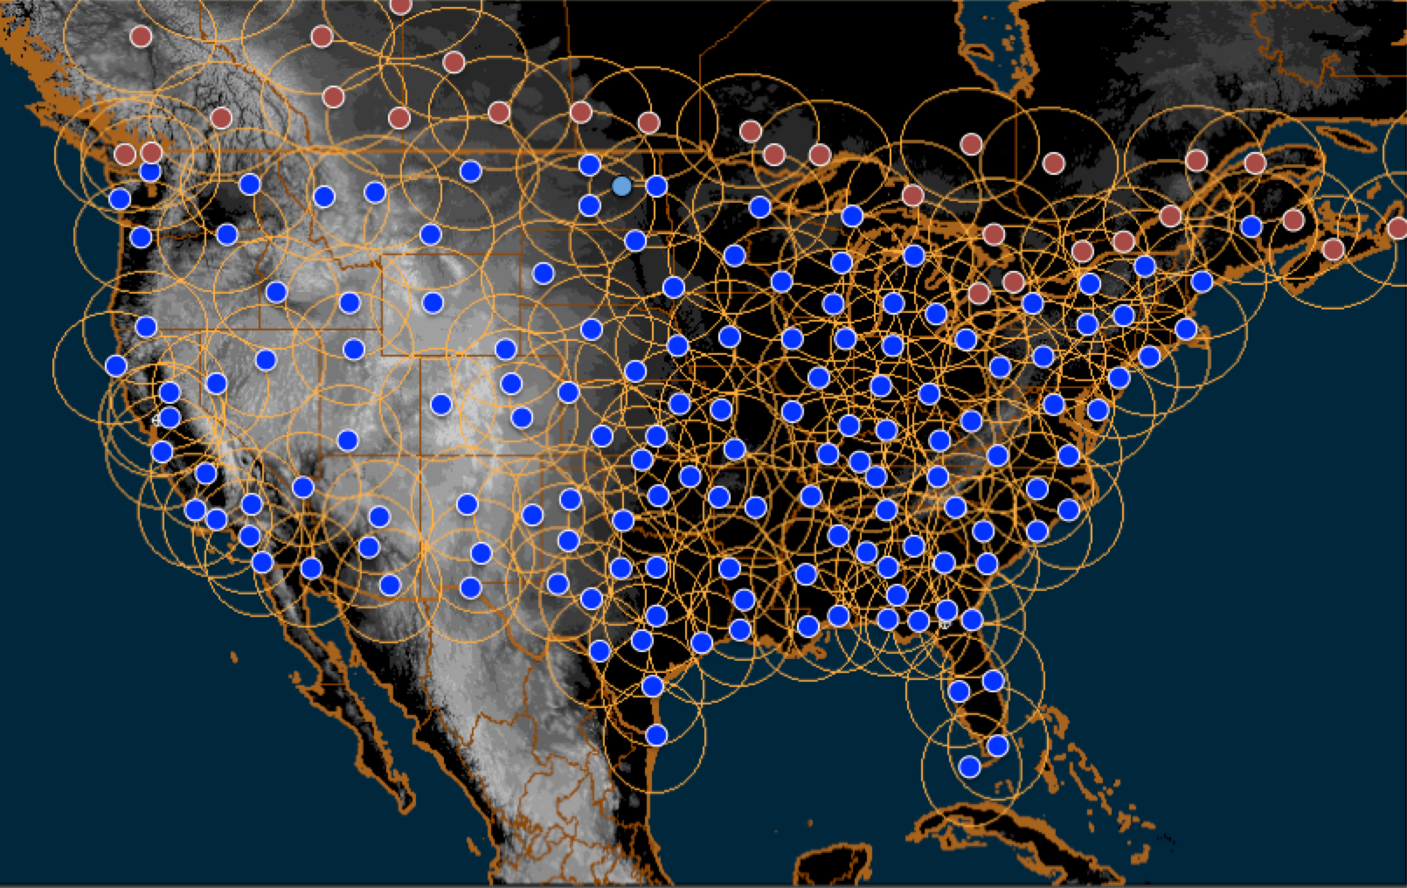
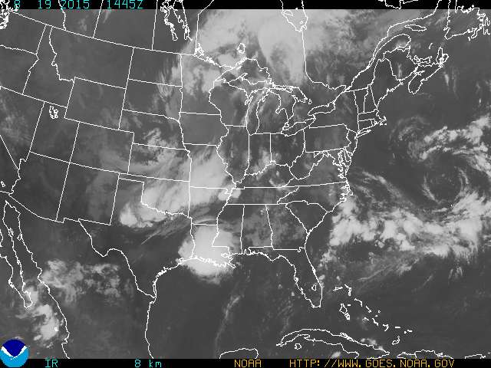
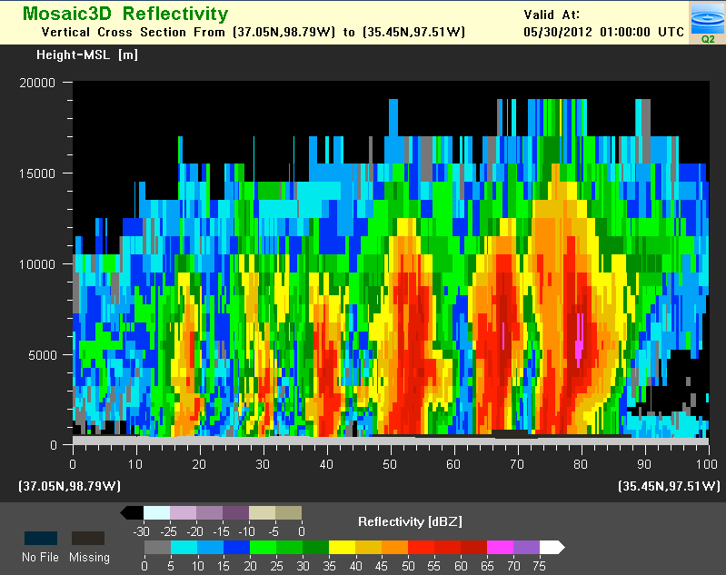
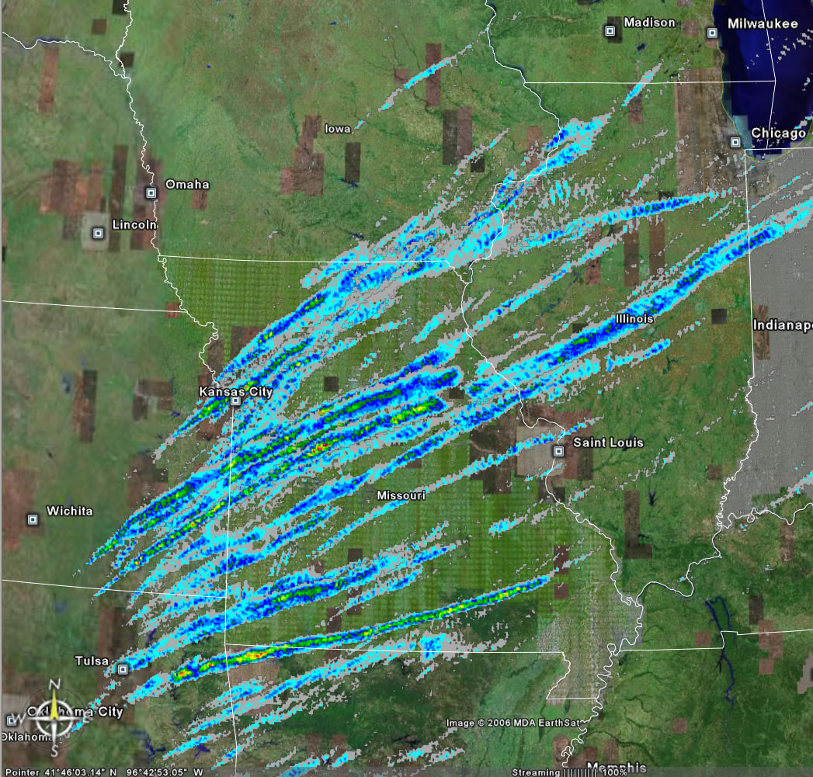
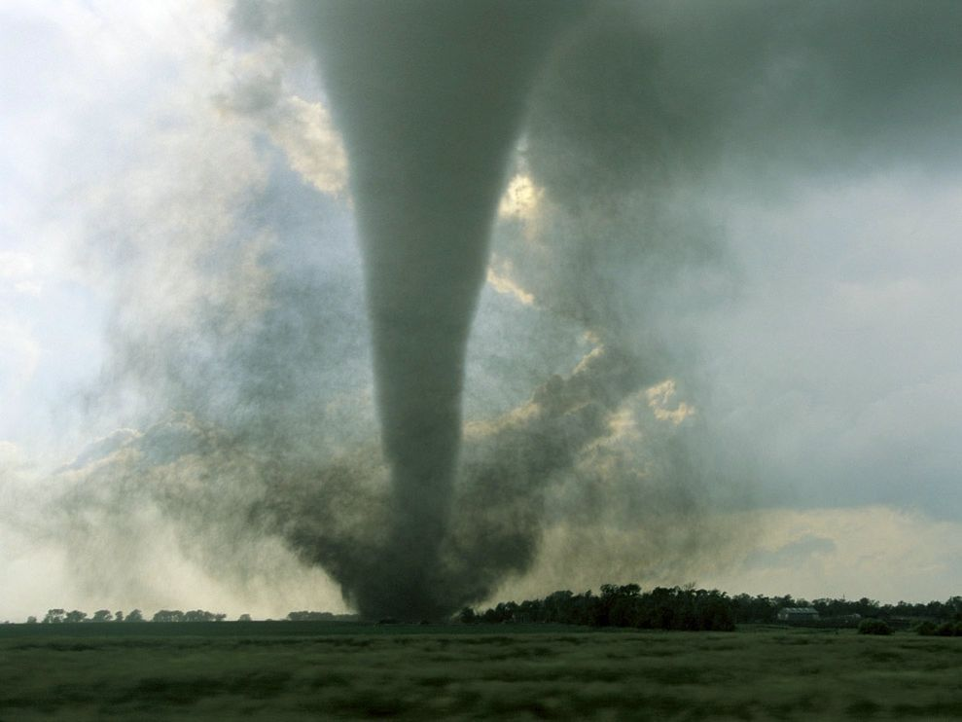
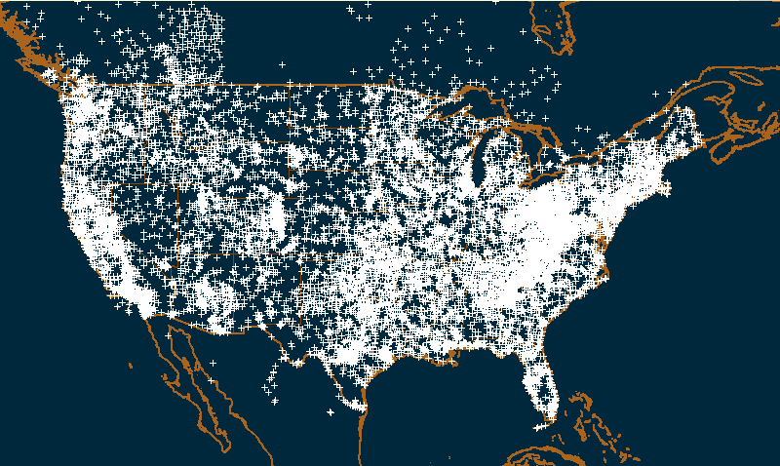
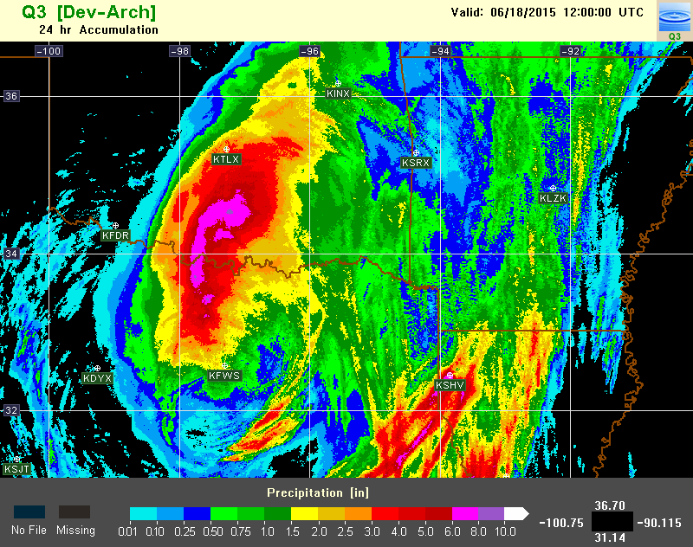
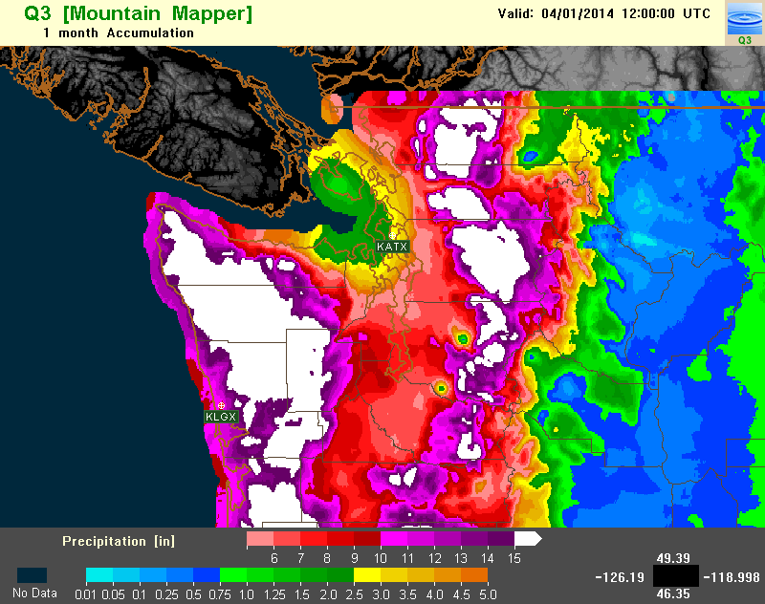
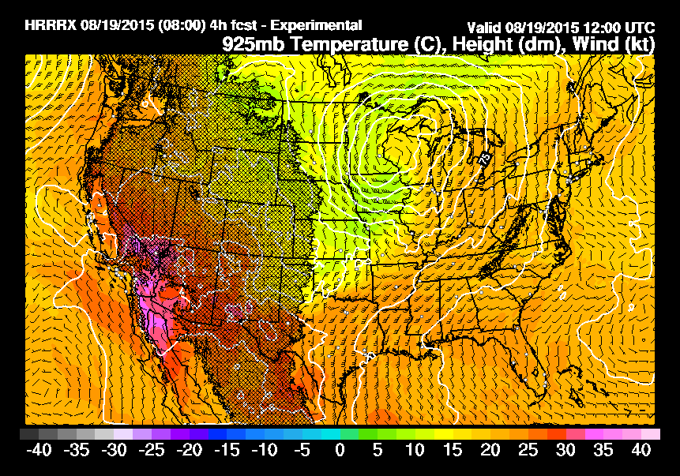
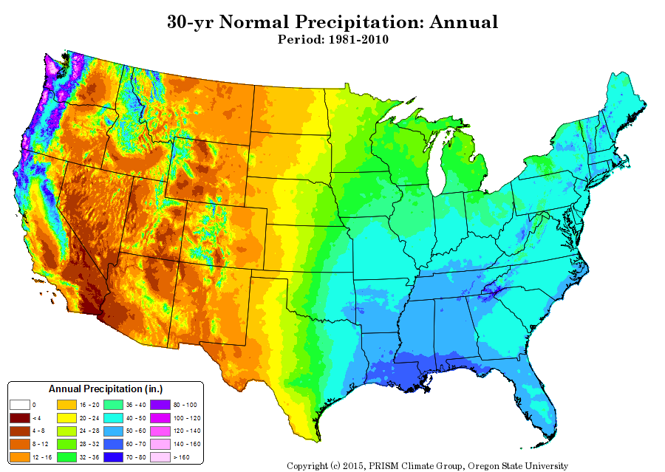
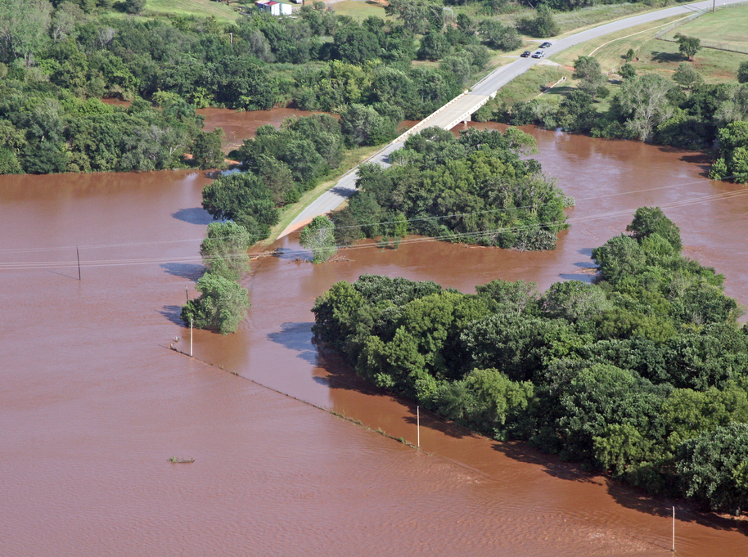
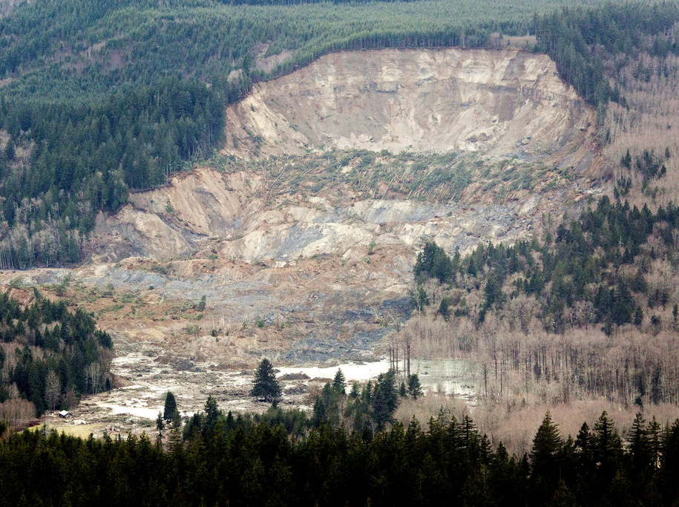
What is MRMS?
An operational system for the integration of multi-sensor data and creation of high-resolution (1km, 2min) severe weather and QPE products over CONUS and southern Canada.
INPUT DATA
PRODUCTS
Radar (~180 sites)
Severe Weather
Satellite
Gauge (~7000)
Lightning
QPE
Model
Climatology
Notes:
So what is MRMS?
It’s an operational system for the integration of multi-sensor data and creation of high-resolution severe weather and QPE products over CONUS and southern Canada. The system currently ingests ~180 radars, including 30 from Canada, 7000 hourly gauges, and model, satellite, lightning and climatology data. The satellite and lightning data is currently not used in QPE.

Slide 4
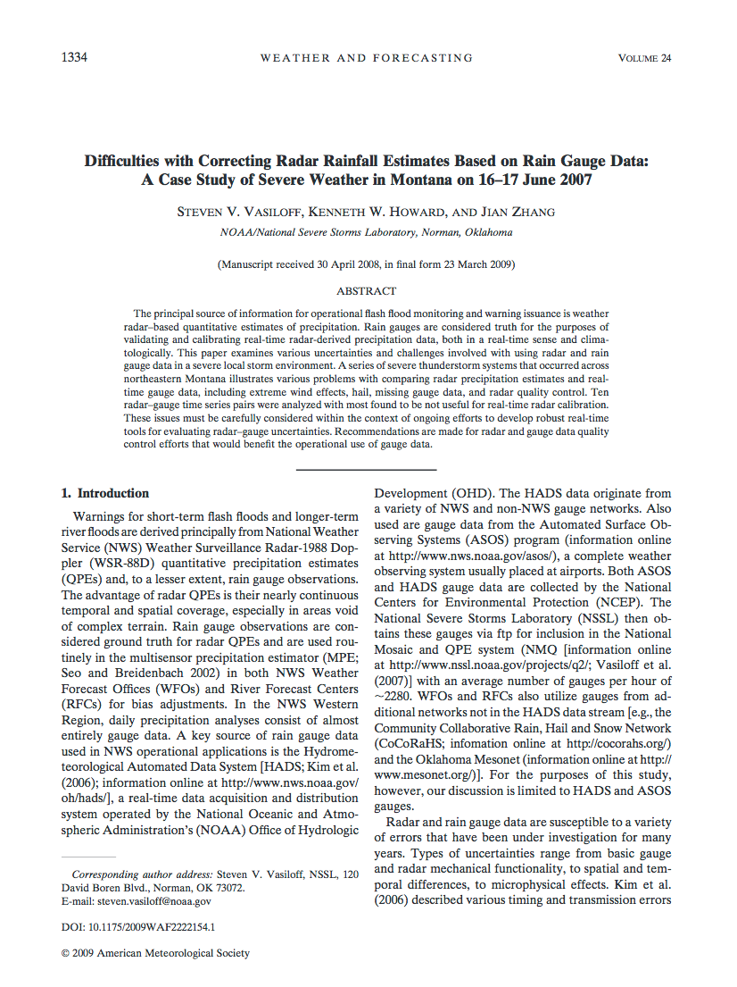
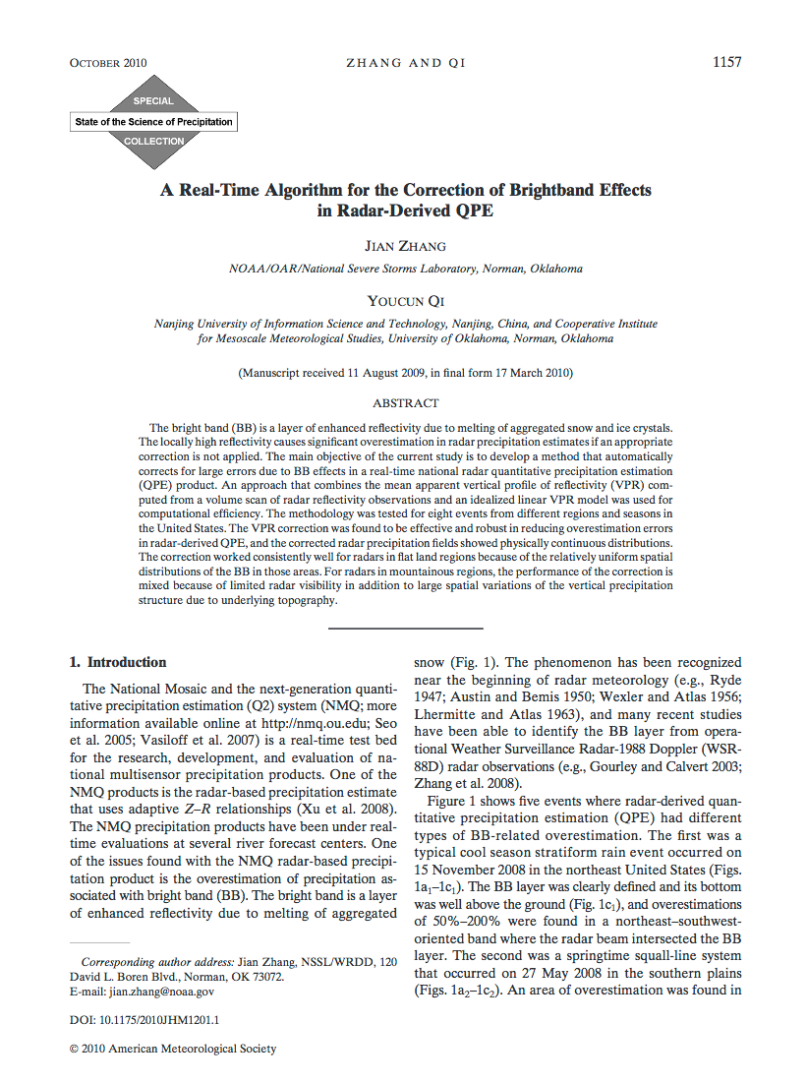
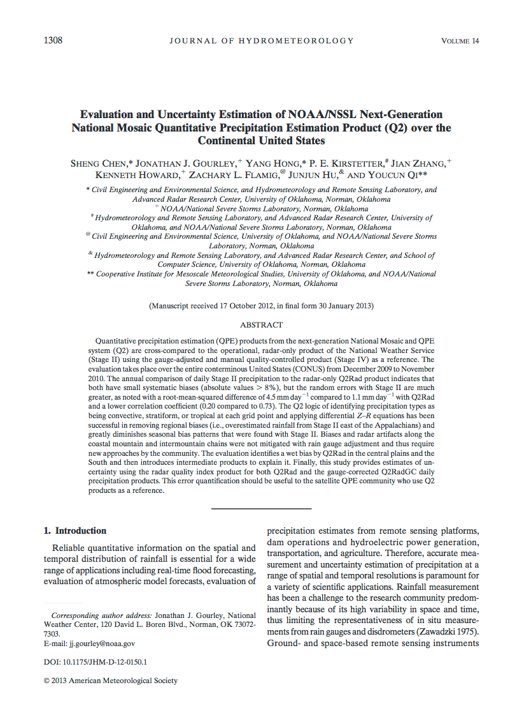
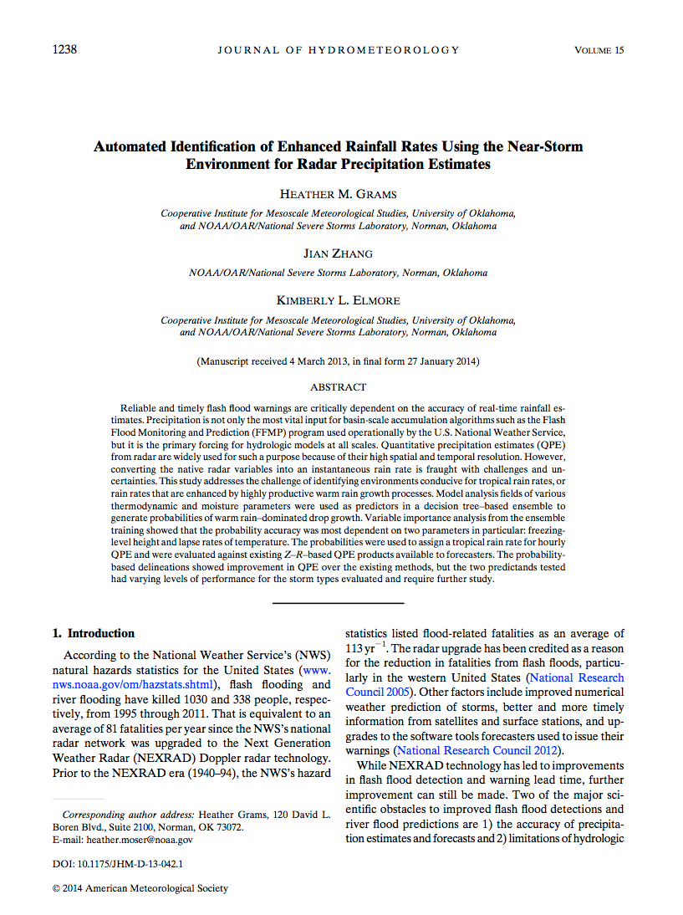
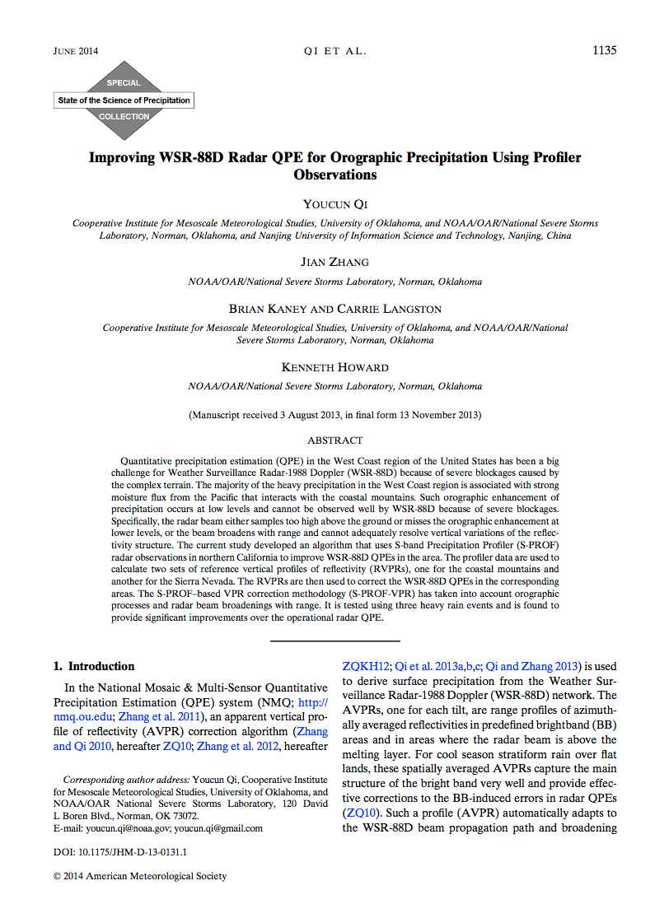
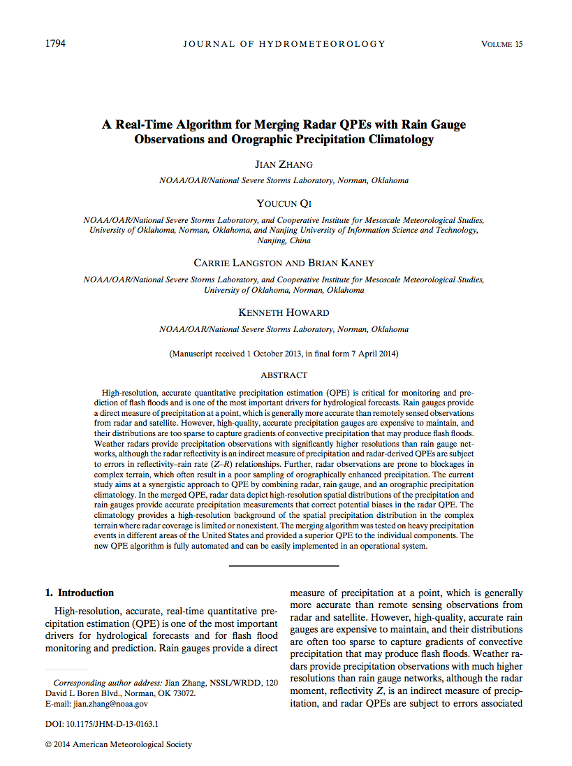
What is MRMS?
A research platform for evaluations of new radar techniques for severe weather, aviation, and hydrological applications and to facilitate their transition into operations.
“Basic” Research
MRMS CONUS testbed
(archived data)
New techniques are evaluated and refined using 2-yr archived data across CONUS
“Basic” Research
New and advanced radar techniques are developed based on specific data.
MRMS-Research (real-time, NSSL)
MRMS-Operational (NCEP)
Matured techniques are implemented on CONUS in real-time, and evaluated 24/7 .
New techniques are transitioned into operations
Notes:
MRMS is also a research platform for the evaluation of new radar techniques and can facilitate the transition of the new techniques into operations.
Each year many new research results are published, but transferring these science into operations effectively remains a challenge.
MRMS developed an archive and a real-time testbed trying to bridge this gap.
The new techniques are ported onto the MRMS archive testbed first and evaluated using a large archive data set across CONUS.
In the research environment, the technique may use data that is limited in time and space, and the research often involves non-operational data such as disdrometers, profiler radars. Complex models and manual sensor of data may be applied. For the benefit of operations, the new technique must be refined such that it provides improvements over the existing operational products, and it is robust in an operational data environment. It has to be fully automated and computationally efficient.
Matured techniques are further tested on the real-time system and evaluated 24/7 before they are transferred into operations.
Since the research and operational systems have similar hardware infrastructure, the transition is nearly seamless.

Slide 5
What is MRMS?
A web-based evaluation tool: CONUS, 24/7
mrms.ou.edu:
2-D product images
Cross sections of 3D refl grid
QPE/gauge scatterplots and stats
Time series of any MRMS variables at any point in CONUS, etc.
NWS partners have provided invaluable feedback that guided MRMS development to what it is today (Operations-2-Research).
Notes:
MRMS has a unique web-based evaluation tool. It is a publically accessible, and can view 2-D product images, cross sections, QPE/gauge scatterplots and stats, and time series of any MRMS product and co-located gauge data anywhere in CONUS.
Our weather service partners have provided invaluable feedback based on real-time, real world evaluations that guided MRMS development to what it is today.

Slide 6
MRMS History
1998: MRMS started with an U.S. Weather Research Program project to improve the operational radar QPE in the western U.S.
2000: The 1st real-time MRMS system (6 radars) at the Salt River Project
2003: Taiwan MRMS (“QPESUMS”) system (4 radars)
2004: CONUS real-time MRMS research system (~140 radars)
2006: Dissemination of research products to National Weather Service forecast offices and national centers.
2014: MRMS became operational (~180 radars).
MRMS philosophy: Research-2-Operations (to solve “real-world” problems) and Operations-2-Research (NWS users feedback guided MRMS development).

Slide 7
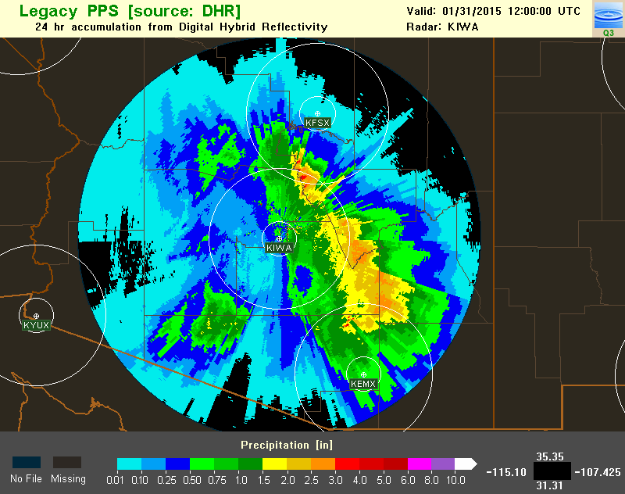
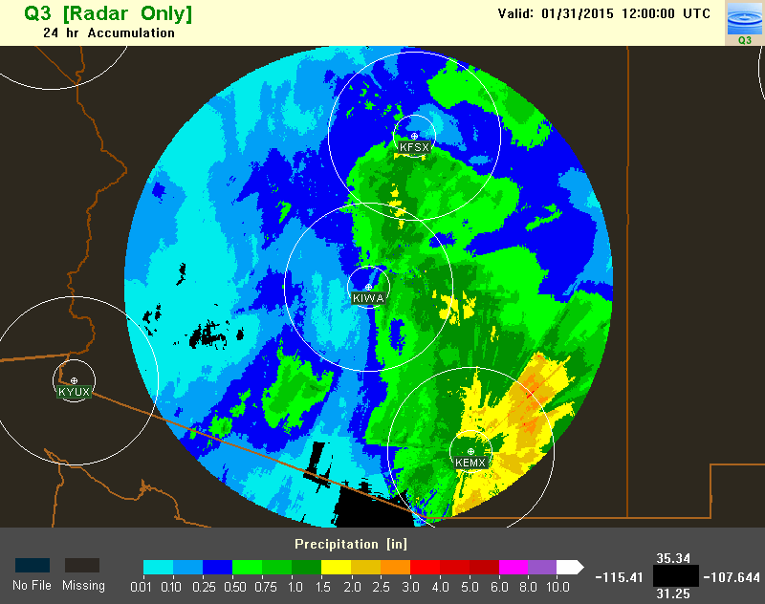
MRMS History
1998: MRMS started with an U.S. Weather Research Program project to improve the operational radar QPE in the western U.S.
2000: The 1st real-time MRMS system (6 radars) at the Salt River Project
2003: Taiwan MRMS (“QPESUMS”) system (4 radars)
2004: CONUS real-time MRMS research system (~140 radars)
2006: Dissemination of research products to National Weather Service forecast offices and national centers.
2014: MRMS became operational (~180 radars).
MRMS philosophy: Research-2-Operations (to solve “real-world” problems) and Operations-2-Research (NWS users feedback guided MRMS development).
Legacy QPE:
Single radar
Single R(Z)
Bright Band
Blockages
MRMS QPE:
Multi-Radar Multi-Sensor
Multiple R(Z)
Vertical profile of reflectivity correction
Blockages mitigations

Slide 8
Outline
What is MRMS?
MRMS QPE Operational Products and Applications
Ongoing Research: Challenges and Opportunities
Taiwan MRMS System (“QPESUMS”)
Summary
Notes:
Next I’d like to introduce MRMS QPE products and their applications.

Slide 9
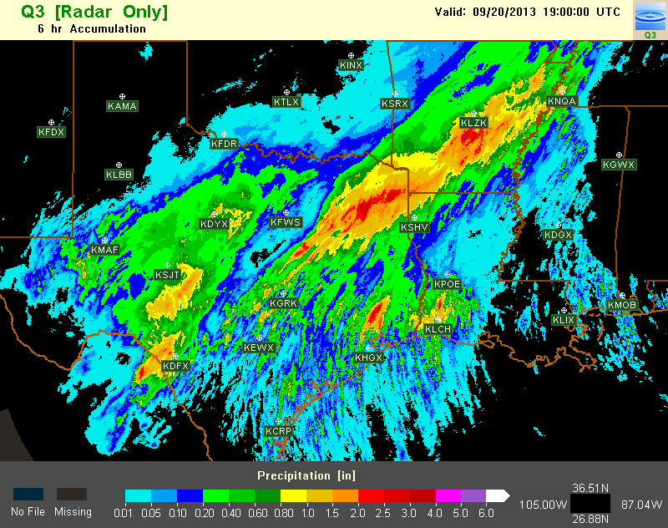
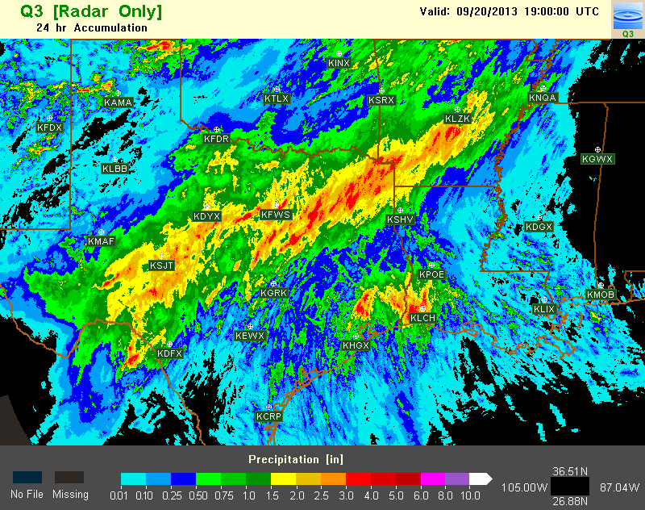
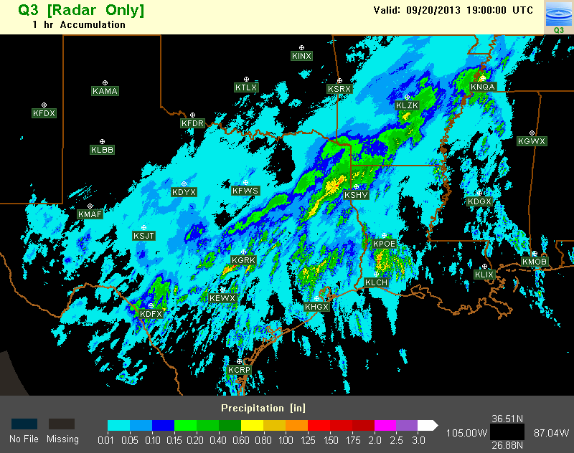
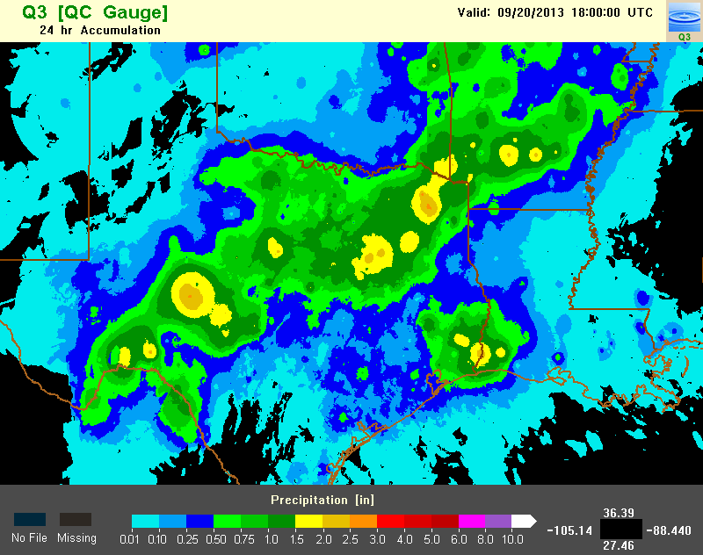
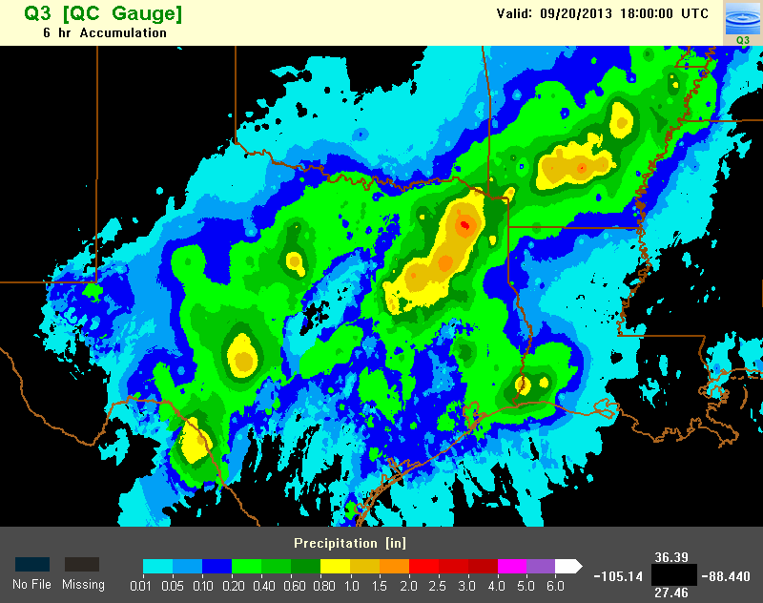
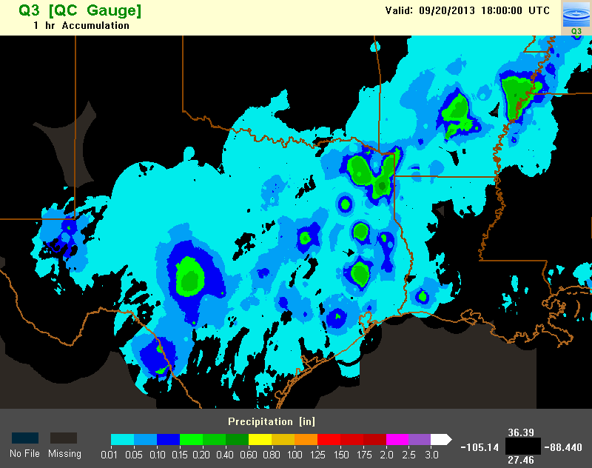
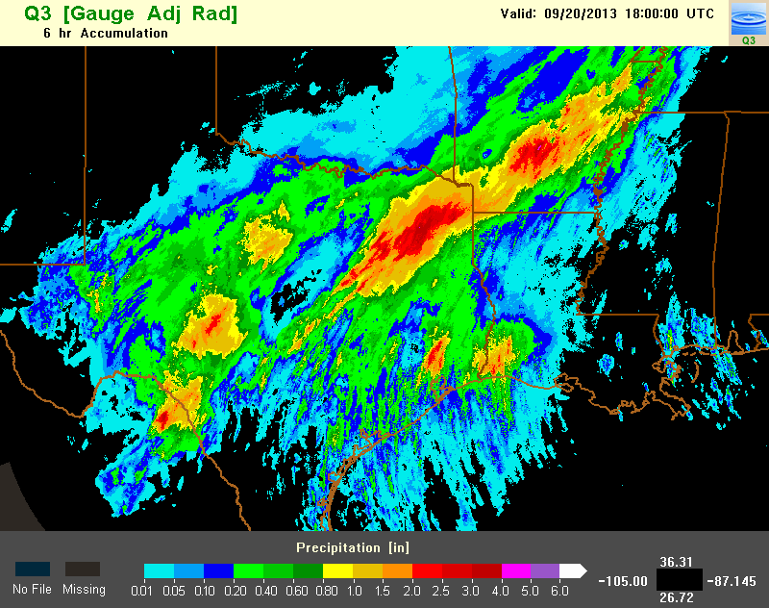
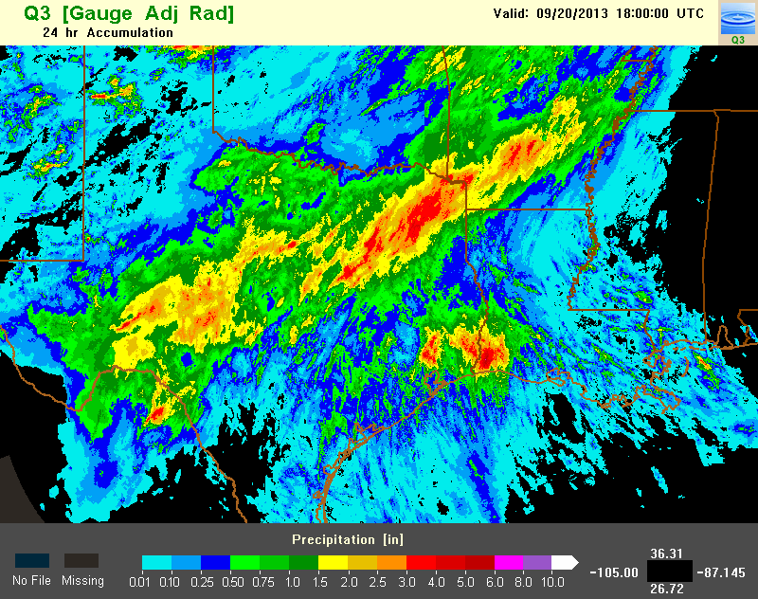
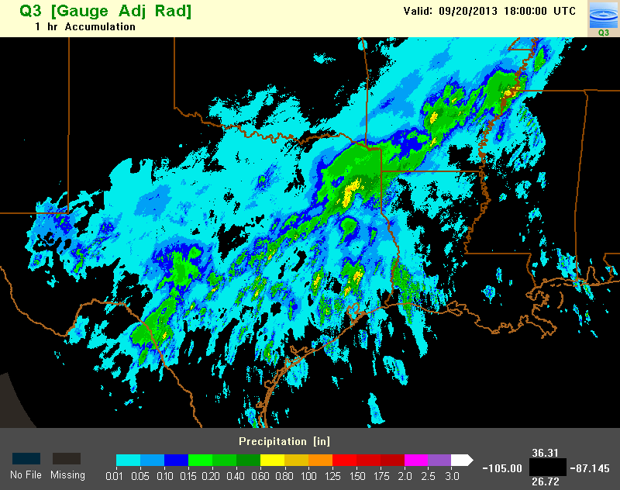
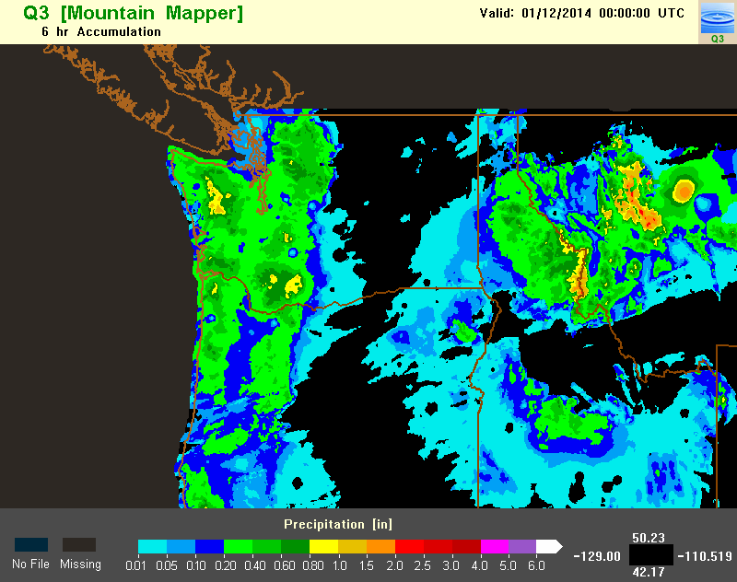
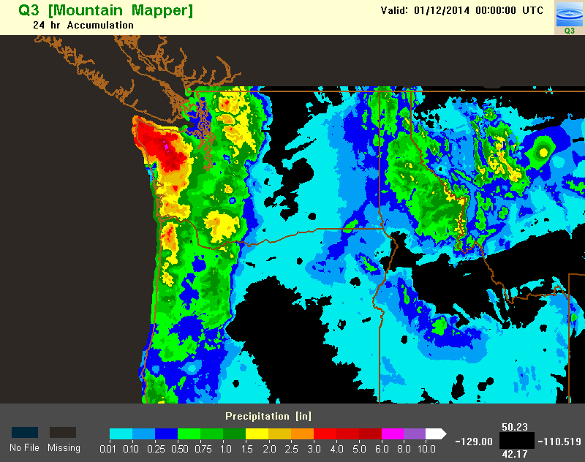
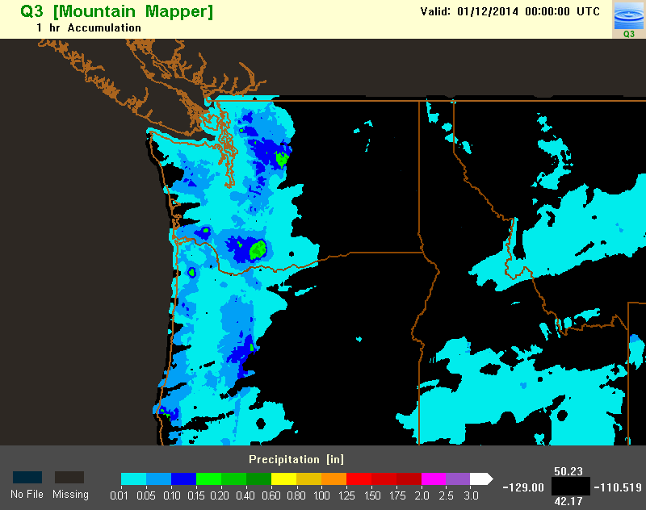
MRMS QPE Operational Products
4 groups:
Radar-based QPE
Gauge only QPE
Local gauge corrected radar QPE
Gauge and precipitation climatology merged QPE (“Mountain Mapper”)
Each group has 1 to 72hr accumulations
1 km resolution
hourly update cycle (2 min for radar 1hr QPE, daily for 48 and 72h QPE).
Notes:
There are four groups of QPE products in the current operational MRMS system.
They are radar-based, gauge-based, local gauge corrected radar QPE, and a gauge and climatology merged QPE called Mountain Mapper. For the sake of time, I’ll focus on the radar QPE and gauge corrected radar QPE.
Each group has 1 to 72h accumulations. And majority of the QPE products are 1km resolution and updated hourly.
The exceptions are the hourly radar QPE which is updated every 2 min and the 48 and 72h accumulations, which are updated daily at 12Z.

Slide 10
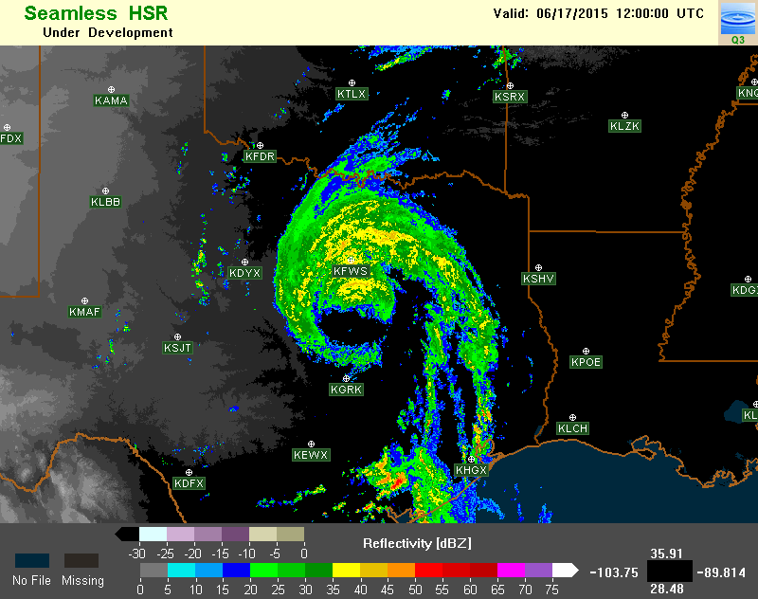
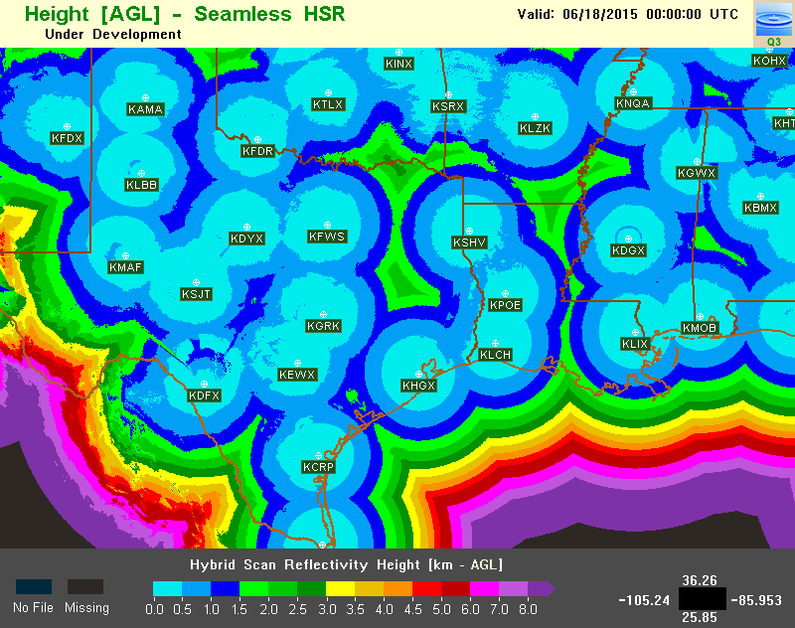
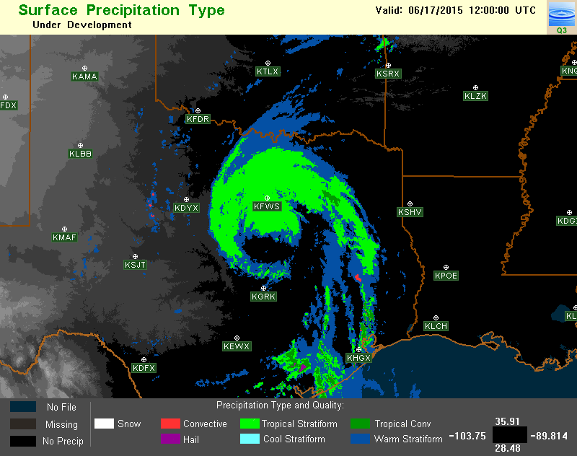
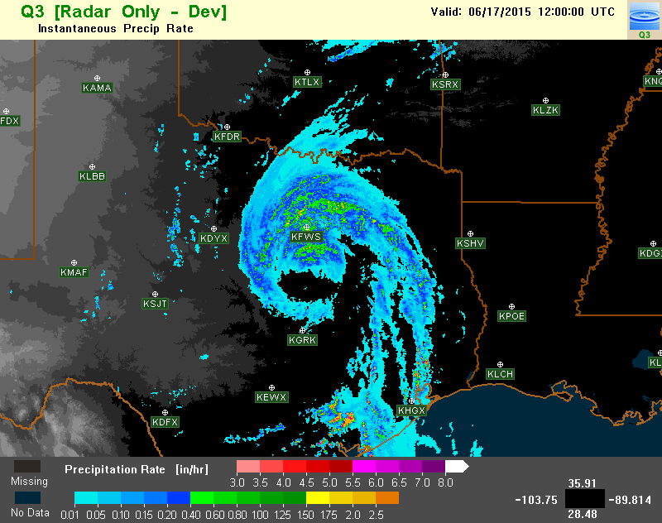
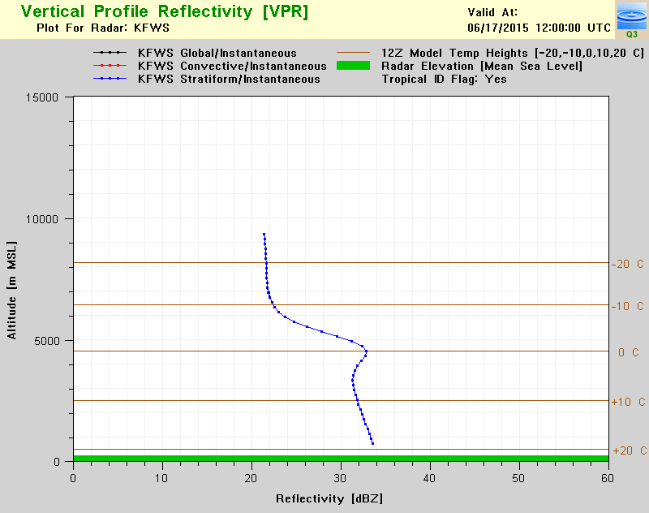
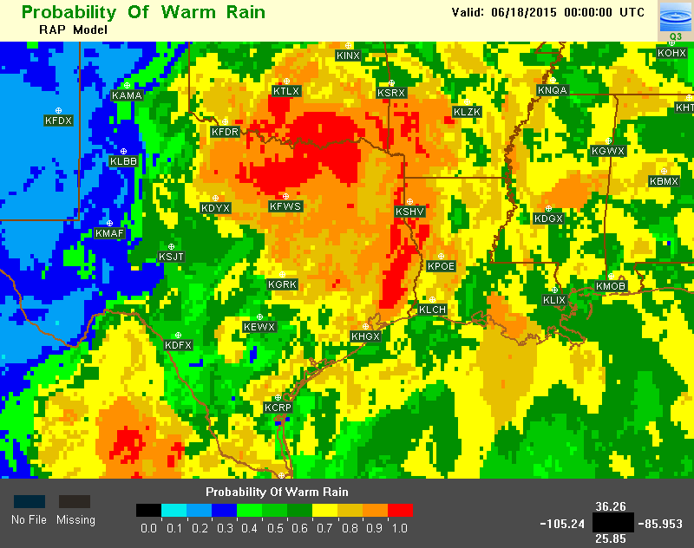
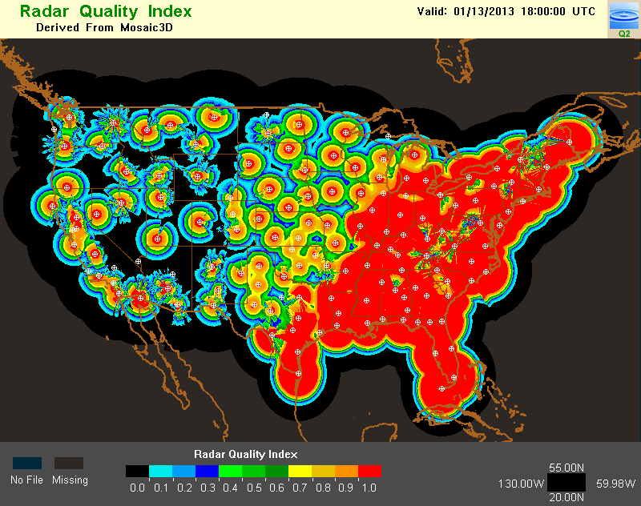
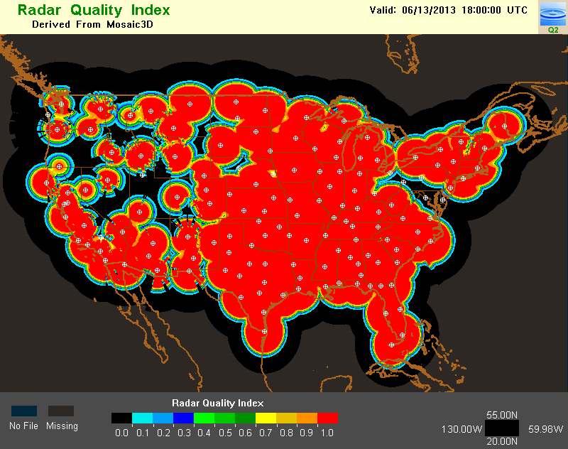
MRMS QPE Operational Products
Additional Products:
Seamless Hybrid Scan Reflectivity (SHSR) mosaic
SHSR height mosaic
Surface Precipitation Type
Surface Precipitation Rate
Vertical profile of reflectivity
Probability of warm rain (POWR)
Radar QPE Quality Index (RQI)
SHSR
SHSR height
Sfc Pcp Type
Sfc Pcp Rate
POWR
VPR
1 km resolution
2-min update cycle (POWR – hourly, VPR – 5min)
RQI 18Z 1/13/2013
RQI 18Z 6/13/2013
Notes:
MRMS also generate a suite of high resolution diagnostic products that did not exist before. They are very useful for analyzing the performance of MRMS QPE products, and are also used for various studies of precipitation properties across CONUS. Among them , the most used are the surface precipitation rate and type.

Slide 11
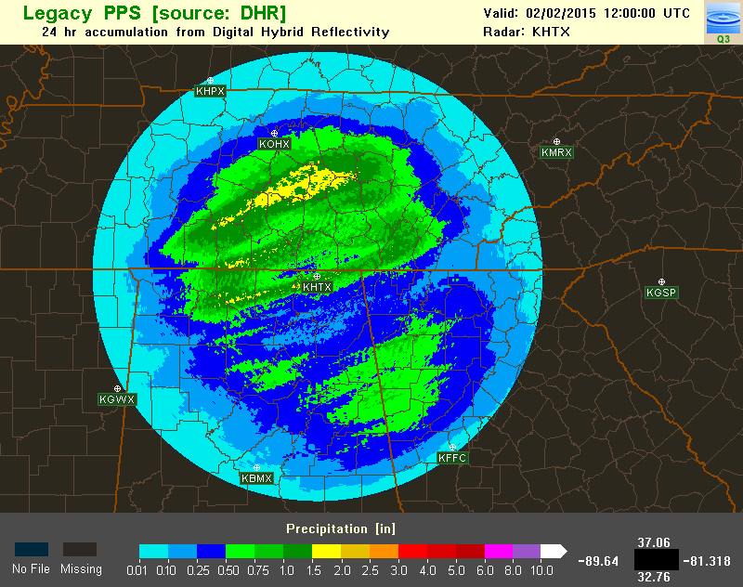
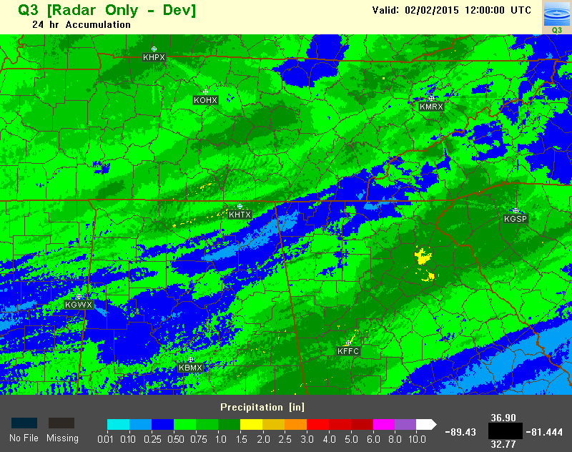
MRMS Radar QPE Processes
Before QC
After QC
Radar Data QC
Before
After
Single radar, multi-sensor
Blockage Mitigation
Before
After
Vertical Profile of Reflectivity (VPR) Correction
Single
Radar
Multiple
Radars
Seamless Hybrid Scan Reflectivity (SHSR) Mosaic
Sfc. P-Type
Multi-radar, multi-sensor
Surface Precipitation Classification
Dynamic Z-R Relationships
Notes:
This slides shows the key steps in the MRMS radar QPE process. They are the radar data quality control, blockage mitigation, VPR correction, seamless hybrid scan reflectivity mosaic, surface precipitation classification, and dynamic Z-R relationships.
The top three are single radar processes and bottom three multi-radar processes. I’ll quickly go through each step next.

Slide 12
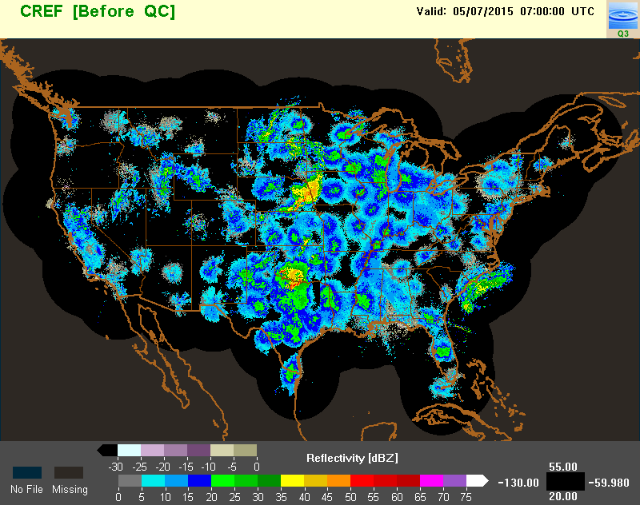
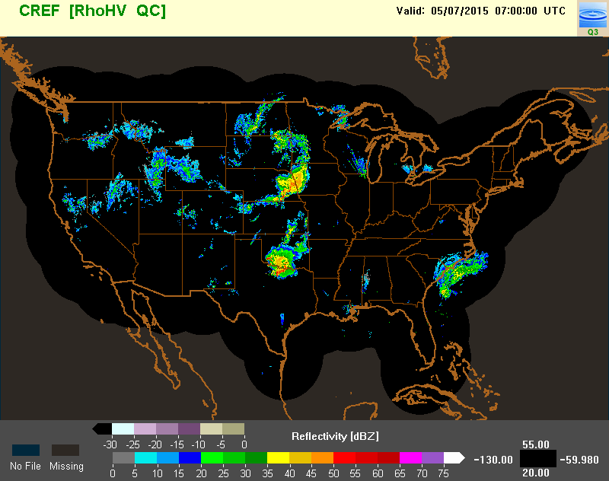
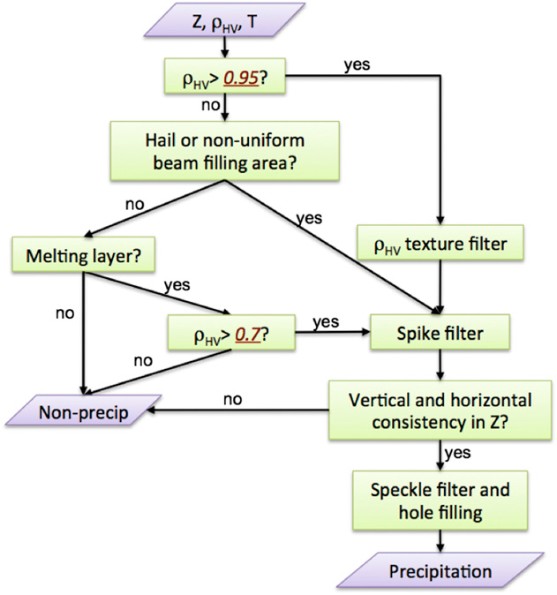
US Radar Data QC: Dual-Pol
Objective: to remove non-hydrometeor echoes.
CREF (before QC) 07Z 5/7/15
Methodology: a decision tree based on correlation coefficient, refl., 0°C height and surface temperature. (Tang et al. 2014, WAF)
CREF (after QC) 07Z 5/7/15
Notes:
The objective of radar data QC is to remove non-hydrometeor echoes. For the US radars, the methodology is based on correlation coefficient, 3-D reflectivity structure, the freezing level height and surface temperature. These two images show the composite reflectivity mosaic before and after QC.

Slide 13
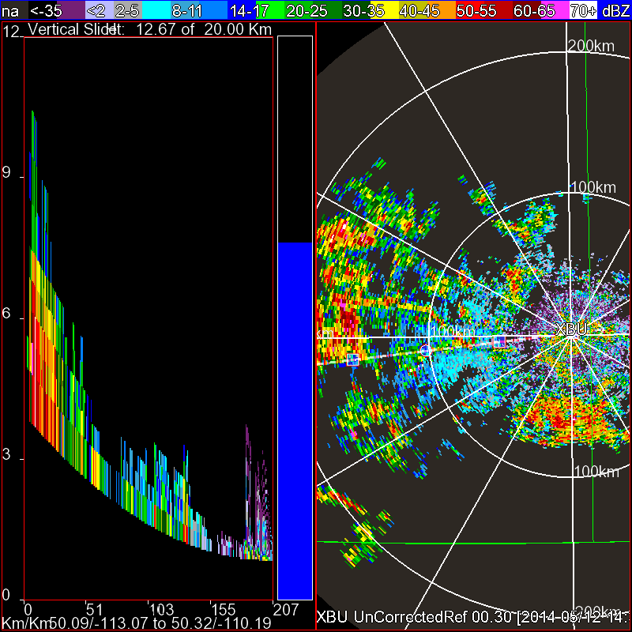
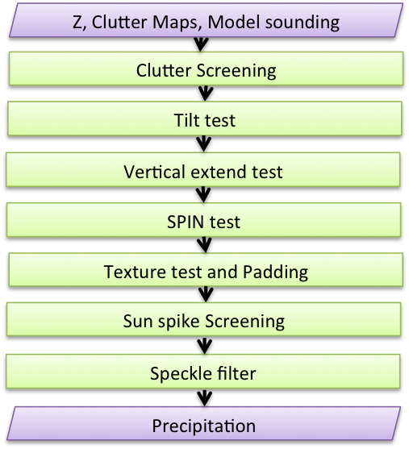
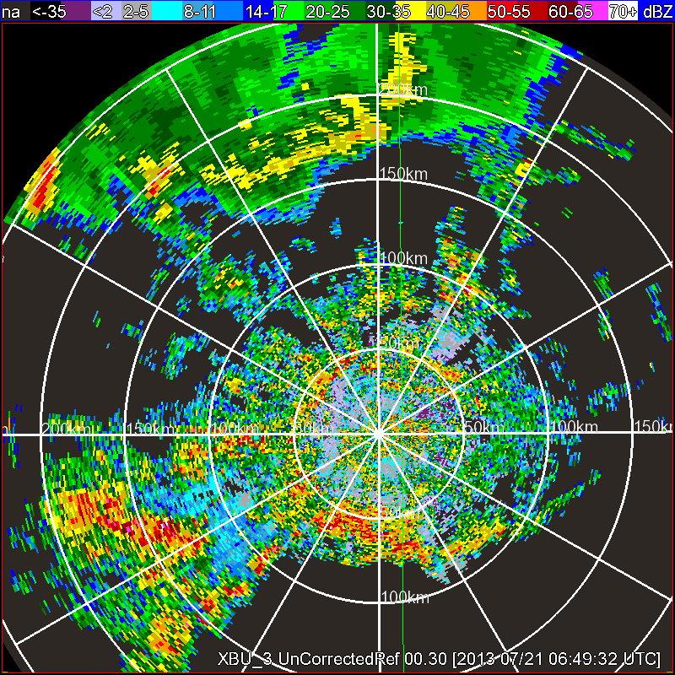
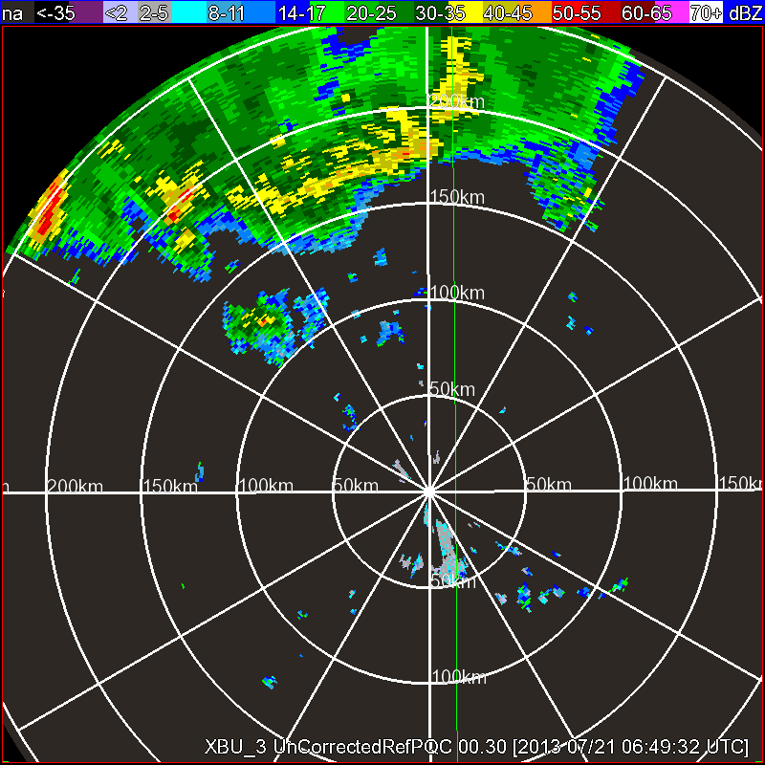
Canadian Radar QC: Single-Pol
Objective: to remove non-hydrometeor echoes.
Mitigation of Severe AP
Methodology: persistent clutter filter; AP mitigation via 3D refl. structure, texture and environmental data.
Notes:
The Canadian radars are single pol, and the QC methodology is based on a persistent clutter filter, and an AP mitigation scheme using 3D reflectivity structure, texture, and environmental data. And these images shows a PPI, RHI and a before and after QC reflectivity field.

Slide 14
Blockage mitigation
Objective: to mitigate discontinuities in the radar QPE due to blockages caused by 1) terrain; 2) above ground objects (trees, towers, etc).
Methodology:
Power compensation in terrain blockage areas assuming a standard beam propagation
Cross-azimuth interpolation
Replacing data with the higher tilt.
Before
After
Notes:
The objective of blockage mitigation is to minimize discontinuities in the radar QPE due to blockages caused by terrain and above ground objects, such as trees and man made towers.
The methodology include three procedures: 1st is to apply a power compensation in terrain blockage areas assuming a standard beam propagation. The 2nd is to apply a cross azimuth interpolation for narrow sectors blocked by manmade towers. The 3rd is to replace the data in a large sector of blockage with the data from the higher tilt.

Slide 15
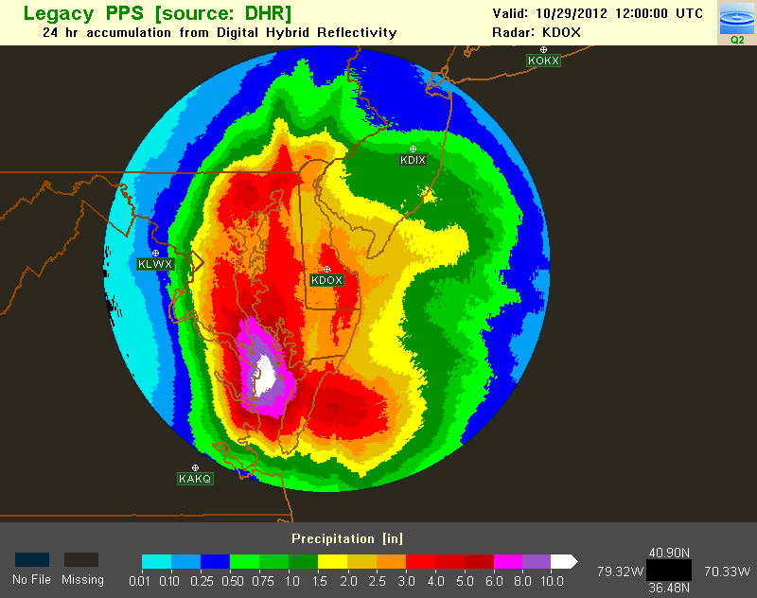
VPR Correction
Objective: to reduce radar QPE errors due to bright band and beam overshooting the melting layer
Methodology: Correction is applied to reflectivity based on the volume scan mean apparent VPR in stratiform region.
KDOX 24h QPE ending 12Z 10/29/12
Before VPR corr.
After VPR corr.
R/G ratio
Notes:
The objective of VPR correction is to reduce radar QPE errors due to bright band and beam overshooting the melting layer.
The methodology is to apply a correction to the hybrid scan reflectivity field based on the volume scan mean apparent VPR in the stratiform region.
This image shows an example 24h QPE before and after the VPR correction. The bubble charts show three pieces of information: each bubble is a gauge station; the size of the bubble represents the gauge observed 24h accumulation, and color of the bubble shows the ratio of radar 24h QPE over the gauge obs. Blue represents overestimation and red underestimation. White means radar and gauge matches each other.
The bubble chart in the lower left shows the radar/gauge comparison before the VPR correction. There was a band of blue bubbles indicating radar overestimation in the bright band, and a band of pink/red gauges further west, indicating underestimation when the radar beam overshoots the melting layer.
The bubble chart in the lower right shows the radar/gauge comparison after the VPR correction. The color of the bubbles shifted towards white indicating the over/underestimation are corrected. The scatter plots also show the improvements by the VPR correction.

Slide 16
Seamless Hybrid Scan Reflectivity Mosaic
Objective: create a seamless and accurate reflectivity mosaic for surface precipitation estimation
Methodology: “Conditionally Weighted Mean”
If the lowest (altitude) radar observation shows no precip, then set the mosaic value as “no precip”
Otherwise, take weighted mean of selected radar observations based on their heights with respect to the melting layer.
6
5
Multiple radar observations at one location
Melting Layer
4
3
2
1
Notes:
The objective of seamless hybrid scan reflectivity mosaic is to create a seamless and accurate reflectivity mosaic for surface precipitation estimation.
The methodology is a conditionally weighted mean.
At any grid point with multiple radar coverage, if the lowest radar observation shows no precipitation, then the mosaic value is set to no precip.
Other wise, the mosaiced value will be a weighted mean of selected radar observations based on their heights with respect to the melting layer.
In this example, there are six radars covering this same point. The mosaic will take a weighted mean of 1 and 2 because they are below the melting layer.

Slide 17
Single vs. Multi-Radar
24hr Single radar PPS QPE 12Z 2/2/15
24hr MRMS Radar QPE 12Z 2/2/15
Notes:
This slide shows the benefit of a multi-radar mosaiced QPE over a single radar QPE. The bubble chart in the upper middle shows distinct range dependent errors with overestimation in the bright band (i.e., a small band of blue bubbles) and underestimation when the radar beam overshoots the melting layer (i.e the circle of orange and red bubbles). In the multi-radar mosaic, only the data below the bright band are used because the radars are relatively dense.

Slide 18
Surface Precipitation Classification
Objective: To identify different precipitation regimes for the application of different R(Z) relationships
Methodology: A decision tree based on 3D reflectivity, Vertical Profile of Reflectivity, and environmental data.
Notes:
The objective of seamless hybrid scan reflectivity mosaic is to create a seamless and accurate reflectivity mosaic for surface precipitation estimation.
The methodology is a conditionally weighted mean.
At any grid point with multiple radar coverage, if the lowest radar observation shows no precipitation, then the mosaic value is set to no precip.
Other wise, the mosaiced value will be a weighted mean of selected radar observations based on their heights with respect to the melting layer.
In this example, there are six radars covering this same point. The mosaic will take a weighted mean of 1 and 2 because they are below the melting layer.

Slide 19
Surface Precipitation Classification
Surface wet bulb temperature < 0°C
and surface temperature < 2°C?
yes
no
snow
Z=75R^{2.0}
Max Expected Hail Size > 0 mm?
yes
no
hail
0°C hgt > 1.5km AGL and [VIL > 6.5kg/km² or CREF > 55dBZ or Z at or above -10°C hgt > 35dBZ?
yes
Z=300R^{1.4} (cap:49dBZ)
no
convective core
yes
Tsfc > 5°C?
Region-growing from the core to areas with Z ≥ 37.5dBZ
no
warm strat. rain
cool strat. rain
conv. rain
VPR slope < 0 below BB & Z ≥ 25dBZ & Tsfc ≥ 10°C & POWR ≥ 0.5?
yes
trop/conv. or
trop/strat. rain
no
Weighted mean of
Z=250R^{1.2} (cap:50dBZ) and
Z=300R^{1.4} (cap:53dBZ) or
Z=200R^{1.6} (cap:50dBZ) or Z=75R^{2.0} (cap:50dBZ)
Z=75R^{2.0} (cap:50dBZ) or Z=200R^{1.6} (cap:50dBZ) or
Z=300R^{1.4} (cap:53dBZ)
Cool or warm strat or conv rain
Notes:
This slides shows the MRMS surface precipitation classification flowchart. The pink parallel grams indicate the final seven categories, which are snow, hail, convective rain, cool and warm stratiform rain, and tropical rain. You will notice many environmental data and parameters such as the surface web bulb temp. and freezing level height. The vertical profile of reflectivity and probability of warm rain are also used.

Slide 20
Surface Precipitation Type
mPING obs
Notes:
This slide shows an example MRMS surface precipitation type field (color map) overlaid with the mPING observations (symbols). The rain/snow line matched the surface observations quite well in this case.

Slide 21
MRMS Operational QPE Performance
Stage-II radar only (4 km, hrly)
MRMS radar only (1km, 2min)
MRMS local gauge bias corrected (1km, hrly)
Stage-IV (manual merging of multiple QPEs; 4-km, hrly)
Steve Cocks: “MRMS QPE Performance during the 2014 Warm Season”, 11A.5A 2:30pm 9/17
Notes:
This slide shows the fractional mean absolute error of four daily QPEs with respect to the CoCoRaHS gauges over the entire year of 2014.
CoCoRaHS stands for community collaborative rain, hail and snow network, and the data are manually observed by volunteers.
The cyan line is the NWS operational radar only QPE called Stage-II, the blue line is the MRMS radar QPE, and pink line MRMS local-gauge bias corrected radar QPE. All three are real-time automated QPE products. Among them, MRMS QPE has the highest spatial and temporal resolution and shortest latency since it does not need to wait for gauge data.
The orange line is another NWS operational QPE product called Stage-IV. It is manually created by forecasters using radar, gauge (including cocorahs), and sometime satellite data. Stage-IV is considered the most accurate national QPE, although it is a little coarser resolution and has a long latency due to the manual quality assurance processes.
The figure shows that the MRMS radar QPE provided consistent improvements over the Stage-II radar only QPE.
The MRMS local gauge bias corrected QPE provided further improvements over the radar QPE. Both MRMS products have been used by river forecast centers as an input for their Stage-IV product.

Slide 22
MRMS QPE Applications
Serving as a base product for the River Forecast Centers’ operations
Providing a forcing for distributed flash flood model
Evaluations of satellite QPEs.
Probabilistic QPE study.
Land Information System
High-resolution precipitation reanalysis
Other (MRMS research system sends live data to ~70 users from government agencies, private companies, universities)
Notes:
The MRMS QPE product is currently served as a base product for the river forecast centers’ operations. It also provides a forcing for the distributed flash flood model.
The data are widely used in the evaluation of satellite QPEs

Slide 23
Outline
What is MRMS?
MRMS QPE Operational Products and Applications
Ongoing Research: Challenges and Opportunities
Taiwan MRMS System (“QPESUMS”)
Summary
Notes:
Now we have covered the operational products. Next I’d like to discuss some of our ongoing research, and challenges and opportunities for radar QPE.

Slide 24
Challenges in Radar QPE
Radar – LWC/IWC relationship variability
LWC = “liquid water content”
IWC = “ice water content”
western US
Radar coverage deficiency in lower atmosphere
Evaporation -> overestimation
Warm rain growth, orographically enhanced precipitation -> underestimation
Poor coverage in complex terrain
Nebraska, 24h QPE ending 12Z 6/4/14
R/G = 1.4
OK/TX
Calibration and attenuation correction, clutter mitigation (single-pol).
Overestimation due to misclassification of tropical rain and unrepresentative R(Z) and possibly gauge undercatch
Wilson & Brandes 1979 (BAMS)
Radar QPE errors from:
1) variation in the relationship between backscattered energy and rainfall rate, 2) changes in the precipitation before reaching the ground, and 3) anomalous propagation of the beam.
Notes:
One major challenge of the radar QPE is the uncertainty of the empirical relationships between radar variables and liquid or ice water content. This is a hail storm case where MRMS radar QPE had ~40% overestimation.
Another major challenge is the lack of coverage ….

Slide 25
Challenges in Radar QPE
Validation
AZ, 24h QPE 12Z 7/6/14
Gauge quality
Radar and gauge sampling differences
Courtesy: Roger's SkyPix; http://www.stormeyes.org/tornado/SkyPix/ftsumner.htm
Radar
R/G=2.3
Gauge
Notes:
There are new technologies that can improve the radar QPE by reducing the uncertainties in the radar-LWC relationships.

Slide 26
Ongoing Research
Radar – LWC relationship variability
Specific attenuation, A, was found to have a better correlation with LWC than Z and can provide more accurate rain rate estimation.
Ryzhkov et al. 2014
Notes:
There are new technologies that can improve the radar QPE by reducing the uncertainties in the radar-LWC relationships.

Slide 27
New Polarimetric Radar QPE: R(A)
U Bonn X-band
KVNX S-band
R(A) is immune to attenuation biases and partial beam blockages
R(A) has higher spatial resolution than R(K_{DP}).
Courtesy of Ryzhkov.

Slide 28
New Polarimetric Radar QPE: R(A)
Networking S- and C-band radars
C-band attenuation
R(A) is immune to attenuation and calibration biases, partial beam blockages, and wet radome.
Courtesy of Ryzhkov.

Slide 29
Pros and Cons of R(A) Method (S-Band)
Advantages
Immunity to radar miscalibration, partial beam blockage, attenuation, and impact of wet radome
Higher spatial resolution than R(K_{DP})
R(A) relationship parameters are less sensitive to the DSD variability than R(Z) and R(K_{DP})
At S-band:
Limitations
r₁ & r₂: beginning and ending gates of rain segments in a given radial
Does not work when segement ΔΦ_{DP} < 2-3° (R(Z))
Does not work in the presence of hail (R(K_{DP}))
The parameter α = A/K_{DP} generally depends on the type of rain (e.g., continental vs tropical) and should be optimized in real-time (Z_{DR} slope).
b: ≈ 0.62
α: a function of DSD (determined by Z_{DR} slope between Z=20 and 40dBZ.

Slide 30
Impact of Rain Drop Size Distribution on R(A): S-Band
At S-band, d and γ are not sensitive to rain drop size distributions (RDSD) variations, while α is.
α^{c}
α^{s}
α^{t}
K^{con}
K^{str}
K^{tro}

Slide 31
Impact of Rain Drop Size Distribution on R(A): C-Band
At C-band, d and γ are sensitive to the RDSD variations, while α is relatively stable (≈0.1dB/°).
stratiform
stratiform
convective
tropical
convective
tropical

Slide 32
Adaptive R(A) for Typhoon Dujuan
Bias R/G: 1.03
CC: 0.80
RMSE: 70mm
R(A) with adaptive α
Bias R/G: 0.35
CC: 0.42
RMSE: 155mm
R(Z) + R(KDP)
Notes:
R(A) applied when blk <90%, using Taiwan DSD derived alpha; Q2 precipitation type.
R(Kdp) applied when blk < 50%, and R(kdp) > 13mm/hr. Beyond 100km attenuation issue.

Slide 33
New Dual-Pol Radar Synthetic QPE
Variable: Z, Z_{DR}, ρ_{HV}, Φ_{DP}, environmental data
Preprocessing of Z, Z_{DR}, Φ_{DP}
A estimation
K_{DP} estimation
Z VPR correction
R(A) estimation
R(K_{DP}) estimation
R(Z) estimation
pure rain, Δφ_{DP}>3°
hail
other
Synthetic R(A) + R(K_{DP}) + R(Z)
“Q3DP”
Stratiform: Z=131R^{1.72}
Convective: Z=87.5R^{1.64}
Tropical: Z=30.7R^{1.66}

Slide 34
Q3DP Example: 28 Apr. 2014
34
R(Z)
R(A)
KPAH
KPAH
KPAH
R(Kdp)
KHPX
W(A)
KHPX
KHPX
KOHX
KOHX
KOHX
KNQA
KHTX
KNQA
KHTX
KNQA
KHTX
KGWX
KGWX
KGWX
KBMX
KBMX
KBMX
KDGX
KDGX
KDGX
KPOE
KPOE
KPOE
SyntheticQPE
SyntheticQPE_ID
KPAH
KHPX
KPAH
KOHX
KHPX
KOHX
KNQA
KHTX
KNQA
KHTX
KGWX
KGWX
KBMX
KBMX
KDGX
KDGX
KPOE
KPOE
R(Z)
R(Kdp)
R(A)
Notes:
Add Radar Name

Slide 35
Taiwan Radar QPE – 2015
RCCG, RCKT, RCHL
RCWF
RCMK, RCCK
RCCU
Single-pol QC
Dual-pol QC_A
Dual-pol QC_A
Dual-pol QC_B
Sea clutter removal
Attenuation Correction
Attenuation Correction
Ground clutter filter
3-D Mosaic
Precipitation classification
R(Z)
R(Z) + R(A) (fixed α)
R(Z) + R(K_{DP})
Model
QPE Mosaic
Notes:
Using R(Z) if R(KDP)<13mm/hr
R(Z), R(KDP) derived from TW DSD

Slide 36
Taiwan Radar QPE – 2016
RCCG, RCKT, RCHL
RCWF
RCMK, RCCK, …
RCCU
Single-pol QC
Dual-pol QC_A
Dual-pol QC_A
Dual-pol QC_B
Sea clutter removal
Attenuation Correction
Attenuation Correction
Ground clutter filter
3-D Mosaic
Precipitation classification
R(Z)
R(Z) + adaptive R(A) + R(K_{DP})
“Q3DP”
Model
QPE Mosaic
Notes:
Using R(Z) if R(KDP)<13mm/hr
R(Z), R(KDP) derived from TW DSD

Slide 37
Ongoing Research
Radar – IWC relationship variability
Bulk Z-S relationship study using dual-pol radar, all weather precipitation accumulation gauges, and environmental data (T, RH).
AWPAG (~300)
Notes:
For radar-IWC relationship, there have been many microphysical studies as we have seen through out this conference. Meanwhile, we are also

Slide 38
Opportunities
Radar coverage deficiency at lower atmosphere and in complex terrain
More gauges
Current: ~7,000
Next year: ~16,000 (from MADIS)
Gap-filler radars
CASA
Radars from local government agencies and universities
Notes:
MADIS: Meteorological Assimilation Data Ingest System
CASA: Collaborative Adaptive Sensing of Atmosphere

Slide 39
Opportunities
Radar coverage deficiency at lower atmosphere and in complex terrain
GPM
New satellite with more channels and higher resolution:
GPM
GOES-R
GOES-R

Slide 40
Summary
The Multi-Radar Multi-Sensor system provides high-resolution (1km, 2min) operational QPE products for the CONUS and southern Canada.
MRMS is a research platform for evaluations of new radar techniques and facilitates research-to-operations transfer of the new techniques.
Challenges remain with variabilities in the radar – LWC/IWC relationship and due to a lack of radar coverage in the lower atmosphere/complex terrain.
Many new observational technologies and physical model studies provide opportunities for further improving QPE and its applications.

Slide 41
Thank You!
mrms.ou.edu
jian.zhang@noaa.gov

Slide 42
Taiwan Radar Mosaic – Now
ISHI
RCCG, RCKT, RCHL
RCWF
RCMK, RCCK
RCCU
Single-pol QC
Single-pol QC
Dual-pol QC_A
Dual-pol QC_A
Dual-pol QC_B
Sea clutter removal
Sea clutter removal
Attenuation Correction
Attenuation Correction
Ground clutter filter
Philippines Radars?
2-D Mosaic
(large surveillance domain)
3-D Mosaic (full product suite domain)

Slide 43
COOL SEASON
East of Rockies
Q3RAD ≤ 230 km
R/G Pairs = 4,026
B = 1.17
R = 14.7 mm
MAE = 9.6 mm
C = 0.83
Dual Pol ≤ 230 km
R/G Pairs = 4,026
B = 1.24
R = 19.9 mm
MAE = 14.1 mm
C = 0.71
COOL SEASON
For 2013-2014 Cool Season east of Rockies Q3RAD had the best statistical results for R/G pairs ≤ 230km
Dual Pol nearly equal to PPS in RMSE/MAE…both impacted by bright band contamination
Again, this is an example of how a mosaic and bright band contamination removal can reduce errors
PPS ≤ 230 km
R/G Pairs = 4,026
B = 1.69
R = 20.5 mm
MAE = 14.5 mm
C = 0.74

Slide 44
Northeast
Q3RAD ≤ 230 km
R/G Pairs = 4,332
B = 1.02
R = 12.5 mm
MAE = 7.8 mm
C = 0.85
Dual Pol ≤ 230 km
R/G Pairs = 4,332
B = 1.24
R = 16.3 mm
MAE = 10.1 mm
C = 0.75
For 2014 Warm Season in the Northeast, Q3RAD estimate had the best statistics for R/G pairs ≤ 230km
There were a number of events where substantial areas of stratiform rain and radar bright banding were present…hence the increased scatter in the Dual Pol/PPS estimates
PPS ≤ 230 km
R/G Pairs = 4,332
B = 1.54
R = 19.2 mm
MAE = 11.8 mm
C = 0.69

Slide 45
Southern
Plains
Q3RAD ≤ 230 km
R/G Pairs = 4,781
B = 1.04
R = 14.8 mm
MAE = 9.8 mm
C = 0.87
Dual Pol ≤ 230 km
R/G Pairs = 4,781
B = 0.97
R = 17.7 mm
MAE = 11.7 mm
C = 0.83
For 2014 Warm Season in the Southern Plains, Q3RAD estimate had the best statistics for R/G pairs ≤ 230km
A number of MCSs with trailing stratiform rain occurred within this region
Dual Pol likely exhibited more scatter due to some melting layer & calibration challenges
PPS ≤ 230 km
R/G Pairs = 4,781
B = 1.16
R = 18.0 mm
MAE = 11.4 mm
C = 0.82

Slide 46
Southeast &
Mid-Atlantic
Q3RAD ≤ 230 km
R/G Pairs = 5,369
B = 1.05
R = 15.6 mm
MAE = 9.7 mm
C = 0.85
Dual Pol ≤ 230 km
R/G Pairs = 5,369
B = 1.08
R = 16.3 mm
MAE = 10.5 mm
C = 0.84
For 2014 Warm Season in the Southeast & Mid-Atlantic, Q3RAD/Dual Pol estimates very similar for R/G pairs ≤ 230km
All the radar only products exhibited an underestimate bias for events during March – May
Q3RAD developed an overestimate bias during the summer
PPS ≤ 230 km
R/G Pairs = 5,369
B = 1.26
R = 18.4 mm
MAE = 11.6 mm
C = 0.80

Slide 47
Northern
& Central Plains
Q3RAD ≤ 230 km
R/G Pairs = 4,245
B = 0.74
R = 15.6 mm
MAE = 9.4 mm
C = 0.91
Dual Pol ≤ 230 km
R/G Pairs = 4,245
B = 0.81
R = 14.7 mm
MAE = 9.1 mm
C = 0.87
For 2014 Warm Season in the Northern & Central Plains, PPS and Dual Pol were quite similar in performance for R/G pairs ≤ 230km
Once again, Dual Pol/Q3RAD exhibited an overestimate trend
To better understand, results, compared/ contrasted two Central Plains cases
PPS ≤ 230 km
R/G Pairs = 4,245
B = 0.92
R = 13.8 mm
MAE = 8.4 mm
C = 0.84

Slide 48
Probability of Warm Rain
Objective: to identify areas with enhanced rain rates
Methodology: derive a “probability of warm rain” by correlating environmental characteristics with radar QPE underestimation.
Hurricane Irene
Enhanced rain rates are associated with:
Moist adiabatic profile – Weak lapse rates support weaker updrafts
High freezing level – Deep warm
layer for warm rain drop growth
Abundant low to mid-Level moisture – Reduced evaporation of drops and/or low cloud bases

Slide 49
RCCU Data Processing
Reflectivity
Correlation Coefficient
Differential Phase
interferences?
Low ρ_{HV}
Differential Reflectivity
Radial Velocity
Spectrum Width
Null field?

Slide 50
RCCU Data Processing
ρ_{HV} > 0.98
ρ_{HV} > 0.85
RCWF ρ_{HV}
(11:09 UTC on Nov. 9th, 2014)
RCCU ρ_{HV}
(06:51 UTC on Aug. 14th, 2015)
RCCU Z
(06:51 UTC on Aug. 14th, 2015)
RCWF ρ_{HV} in rain: > 0.98
RCCU ρ_{HV} in rain: ~ 0.9 – 0.96?
The current dpQC algorithm has to be modified for RCCU.

Slide 51
Quality Control for RCCU
Before
After

Slide 52
Integration of RCCU in the 3D Mosaic
before (2040 UTC 12/02/2015 )
after (2050 UTC 12/02/2015 )
RCCU
RCCU

