Slide 1
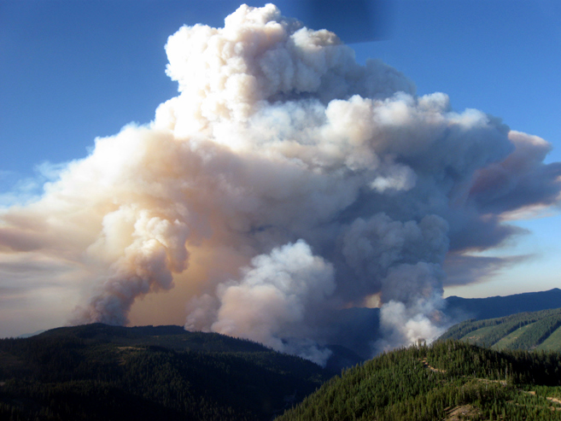
Ozone and secondary aerosol production in wildfire plumes
Professor Dan Jaffe
University of Washington

Slide 2
Other topics
Ozone and secondary aerosol production in wildfire plumes;
An Overview of Air Quality Issues in the Western US (Saturday at ICAST)
Importance of boundary conditions on Ozone in the Western US;
Aircraft observations of Mercury over the US: The NOMADSS experiment.
Quantification of O₃ impacts in urban areas;

Slide 3
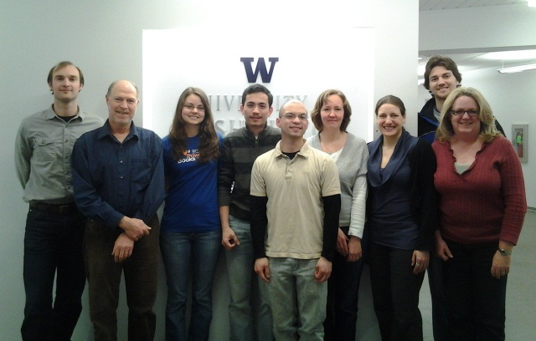
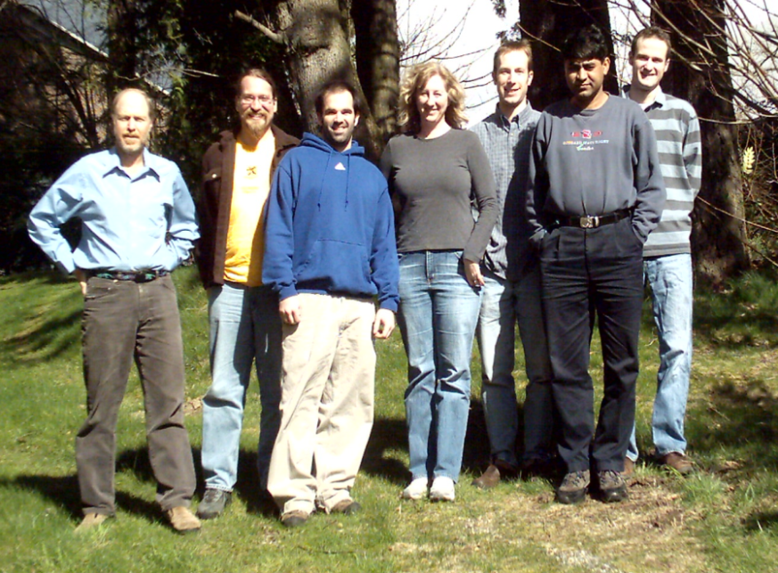
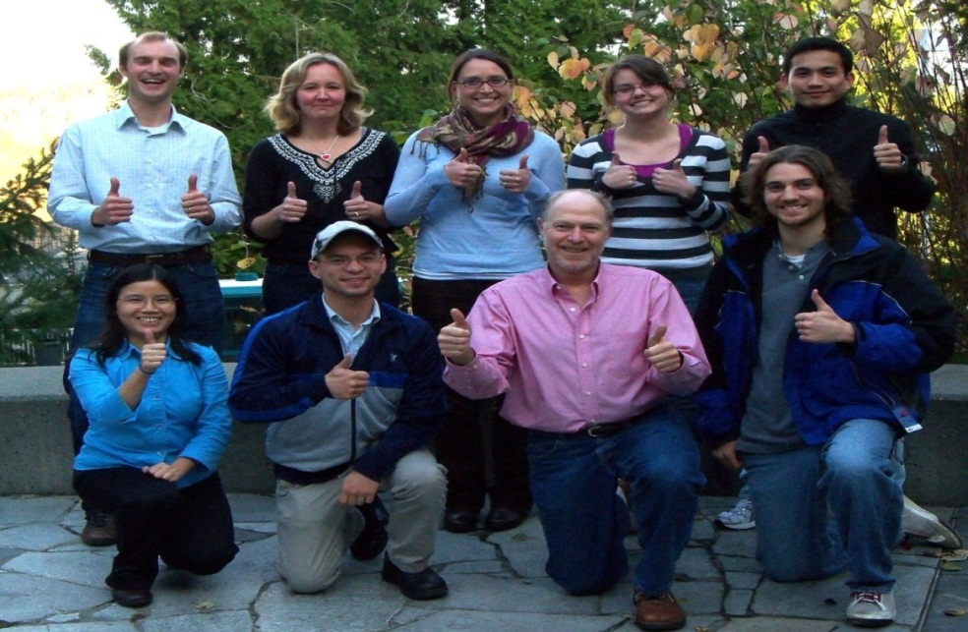
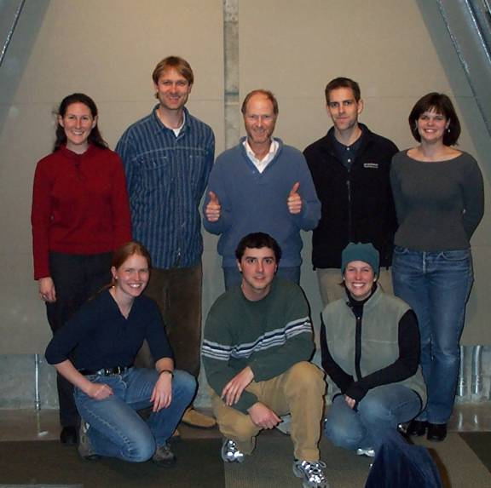
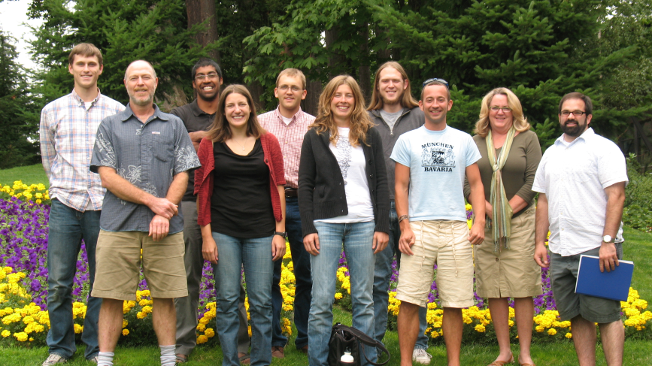
Jaffe-group Students, Post-docs and Staff

Slide 4
Wildfire contribution to global budgets
Wildfires make a large contribution to the global primary emissions for CO, VOCs, aerosols and other compounds;
Wildfires make a smaller, but still significant, contribution to the global emissions of NOx.
Wildfires are a large source of secondary species incuding Secondary Organic Aerosols (SOA), O₃, Peroxyacetyl nitrate (PAN) and other compounds, although there are large uncertainties over amounts.

Slide 5
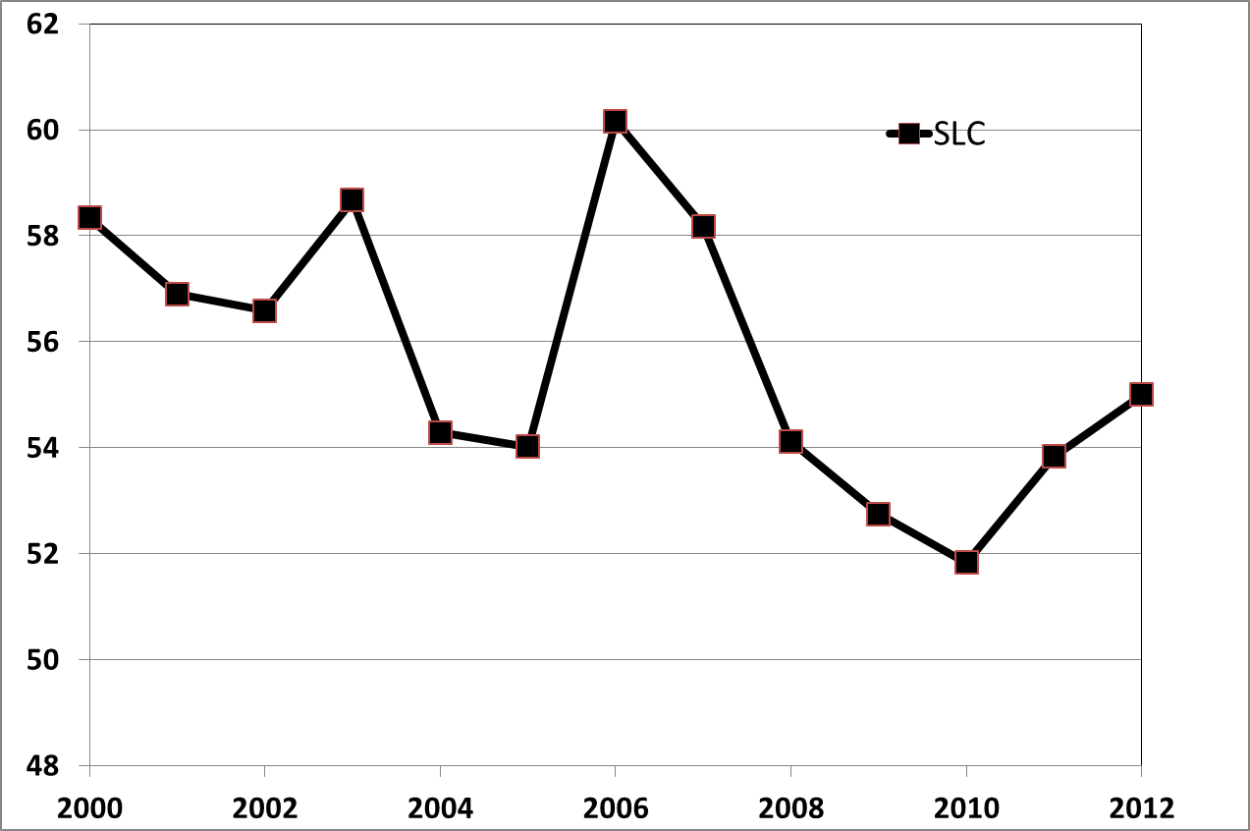
Median O₃ summer MDA8 in Salt Lake City, Utah
Large fire years
Low fire years
What drives year to year variation in MDA8?

Slide 6
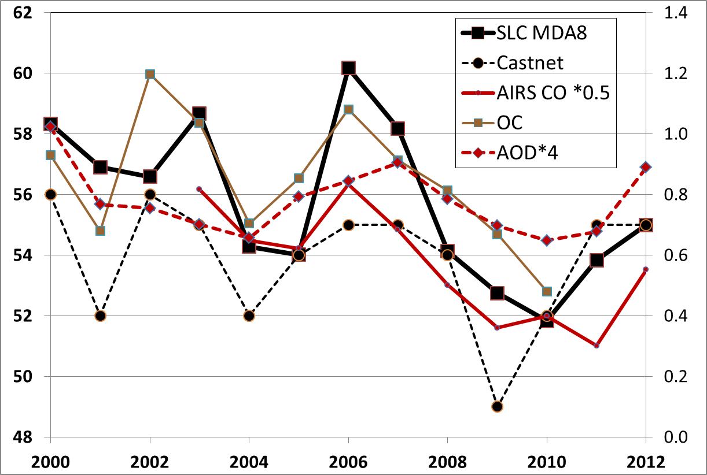
Median MDA8 in SLC, CASTNET, OC, AIRS CO and AOD
R values between 0.58 and 0.86 for these. Year to year variation in MDA8 is
driven by wildfires (Jaffe et al 2013).

Slide 7
Causes of “Wildfires”
Lightning
Industrial activity
Vehicles
Hikers/Campers
Sometimes we do not know the cause, but we will refer to all fires except agricultural fires as “wildfires”.

Slide 8
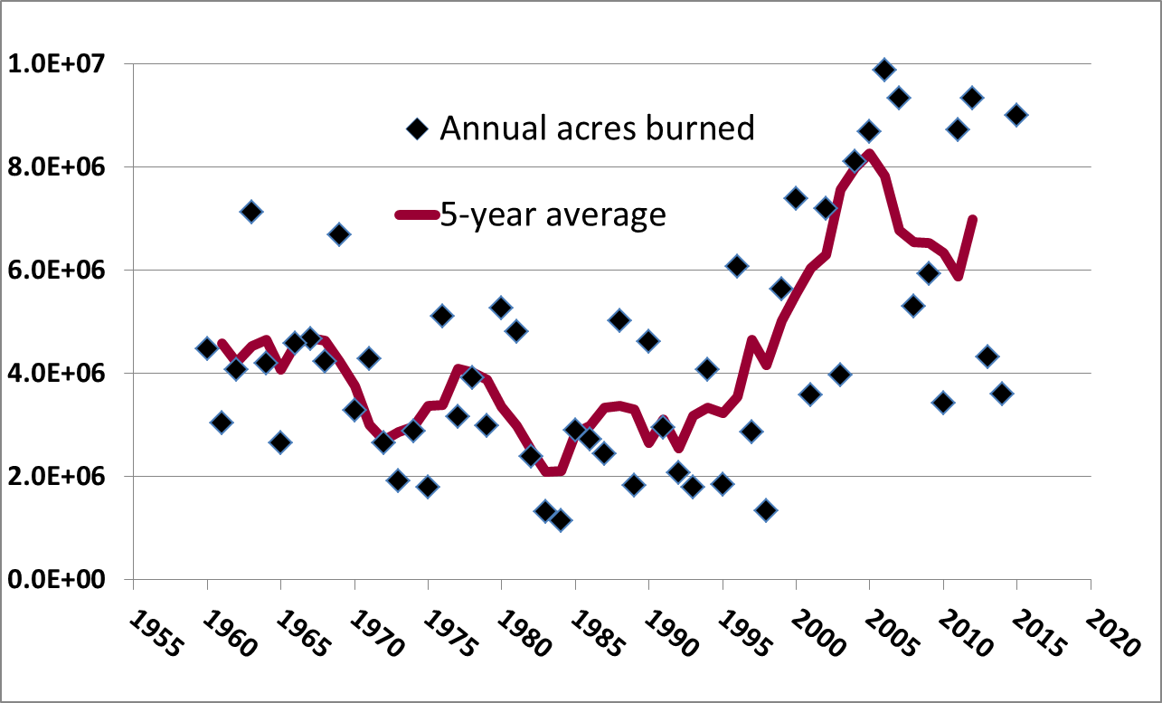
Area Burned for US Wildfires
The last decade has seen a significant increase in the area burned. Approx 70% of
these fires are in the Western US

Slide 9
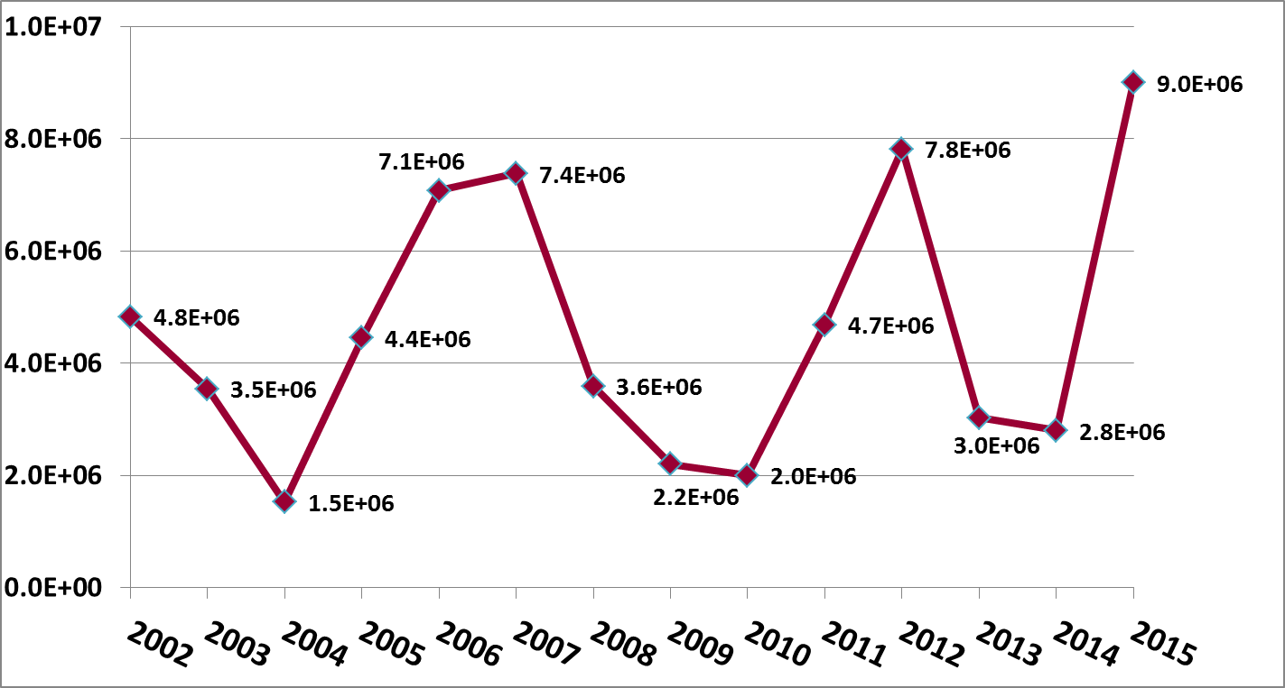
Area Burned in the Western US (acres)
Wildfires in the Western US are about 60-75% of the US total each year.

Slide 10
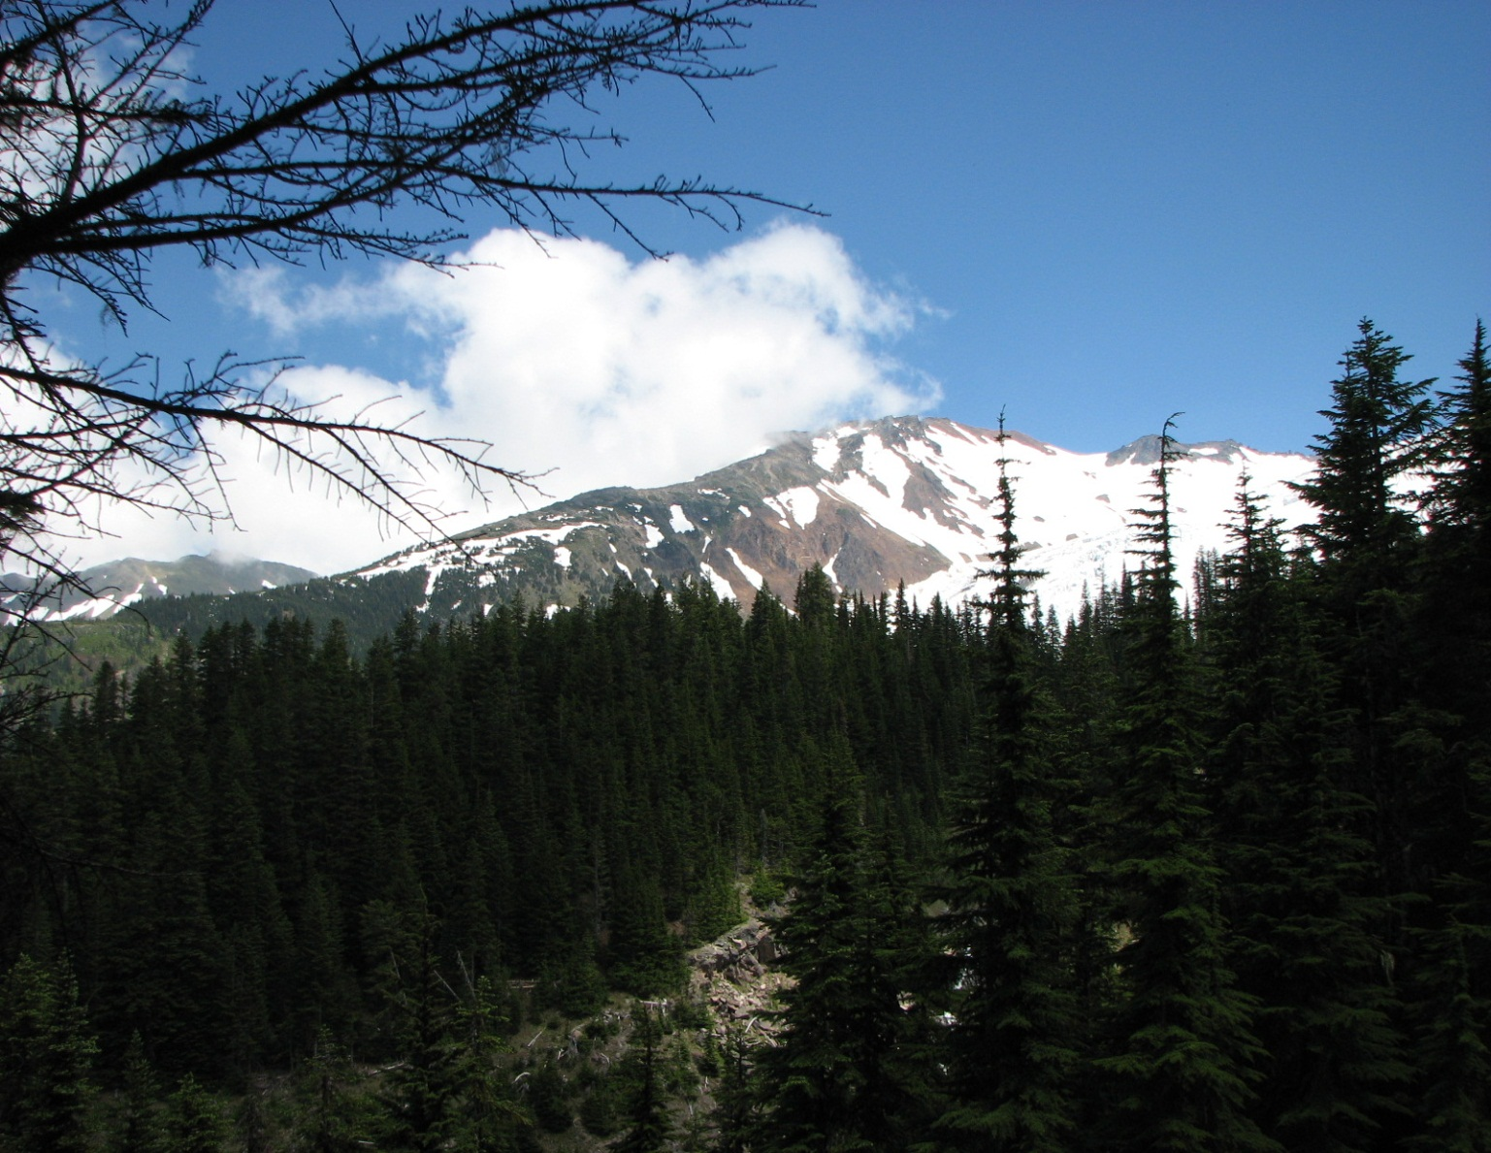
Mountains of Washington State

Slide 11
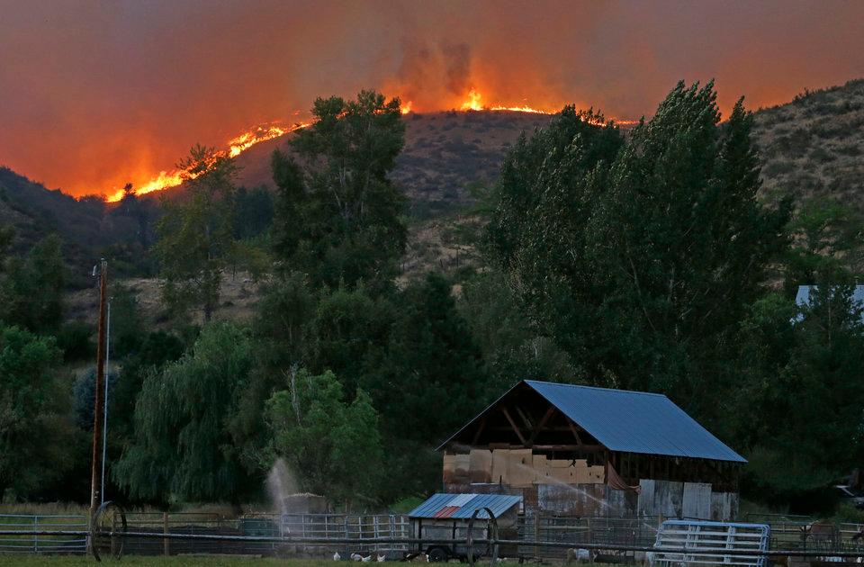
2015 Fires in Washington State

Slide 12
2015 Wildfire stats
At least 3 firefighters killed;
1000s of homes destroyed;
As of Sept 26, 2015, more than 9 million acres (14,000 sq miles or 36,000 km² ) have already burned. This is about the same area as Taiwan!
Winter 2015 was unusually warm, which resulted in a very low snowpack across the Northwestern US;
Low snowpack resulted in unusually dry conditions, which led to massive wildfires in the summer of 2015;
All evidence points to a linkage between climate change and wildfires;
Most scientists forecast continued growth in the size and severity of wildfires in the Western US due to climate change.

Slide 13
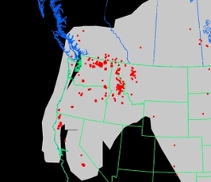
2015 Fires in Washington State
MODIS Fire detects from Terra and Aqua satelleites.
Pacific Ocean
Wash.
Oregon
Calif
Montana
Idaho

Slide 14
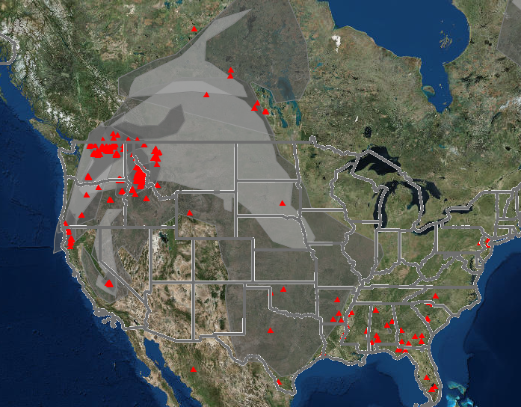
Aug 25, 2015

Slide 15
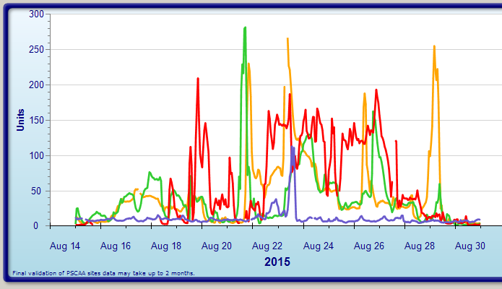
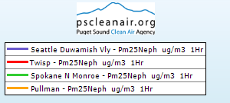
Air Quality (PM_{2.5}) in Washington State
PM2.5 µg/m³

Slide 16
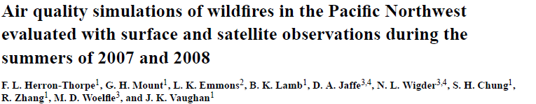
Collaboration with Washington State University (B.Lamb, J. Vaughan, F Heron-Thorpe);
CMAQ modeling with USFS “SMART-FIRE” emissions system for biomass burning;
AIRPACT 3 ran at 12 km resolution. AIRPACT 4 runs at 4 km resolution;
Model is run daily with current forecast meteorological data to inform public and air quality managers on likely impacts.
http://www.lar.wsu.edu/airpact/

Slide 17
Modeled and Observed Wildfire Impact: August 12, 2007
Herron-Thorpe 2014

Slide 18
Modeled CO is close, but PM_{2.5} and AOD are low
Surface Obs Satellite AOD Satellite col CO
µg/m³ 10¹⁸ mol/cc
Herron-Thorpe 2014

Slide 19
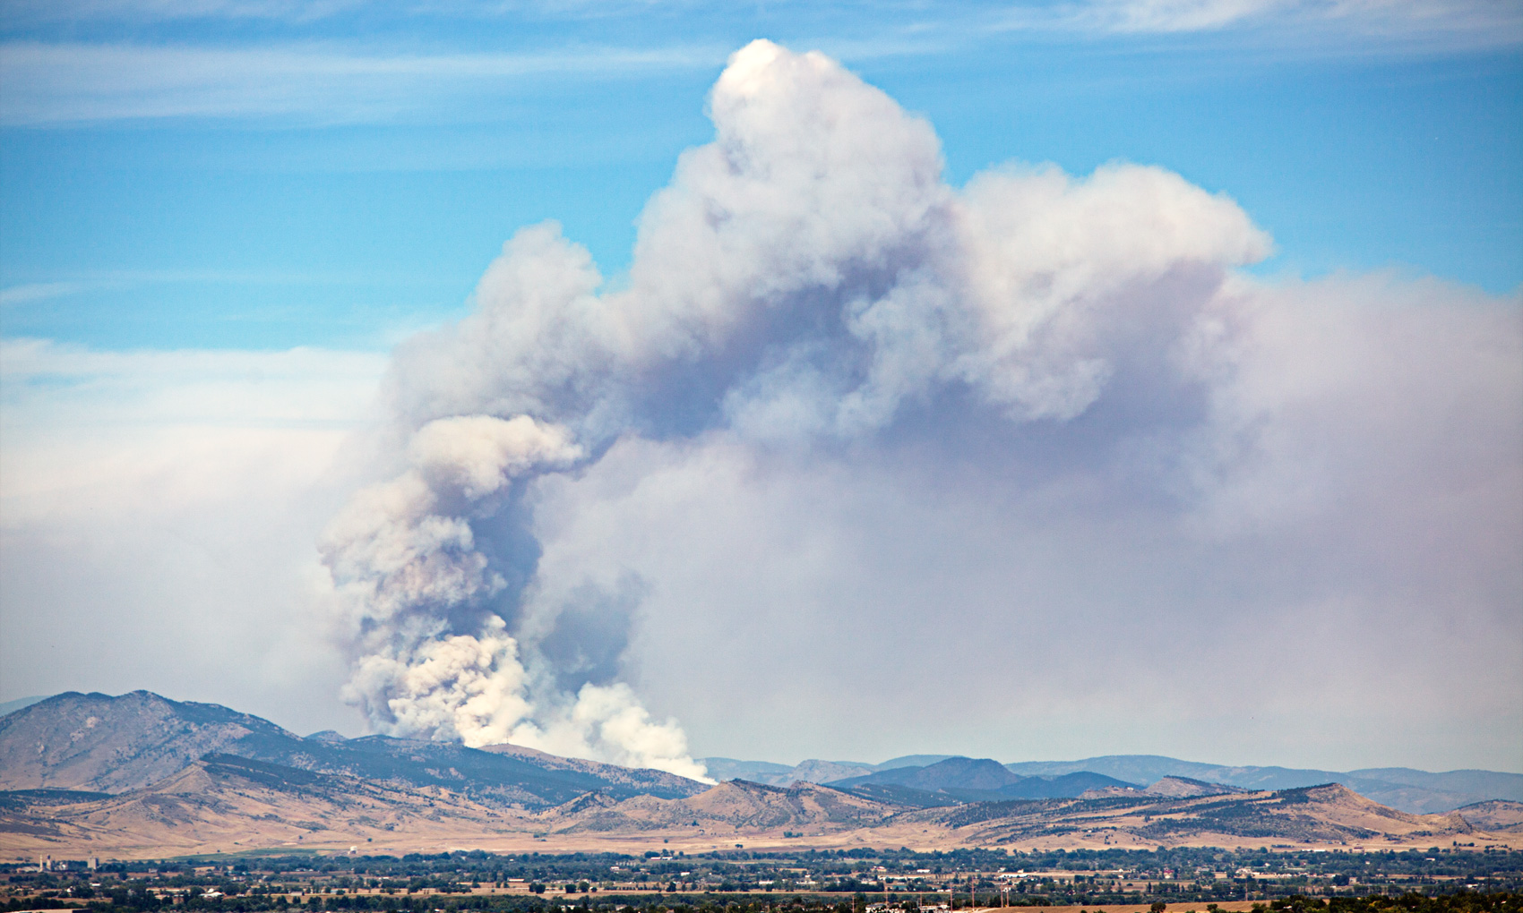
Primary emissions in a wildfire plume
CO₂
Primary aerosols (largely Organic compounds)
Volatile Organic Compounds (VOCs = gas phase)
Oxygenated-VOCs (eg CH₂OH; CH3COCH₃, CH₃CHO, etc
CO, NO_{x} (NO+NO₂), NH₃, HONO, etc

Slide 20
100s of Different VOCs are Emitted by Wildfires
Acetylene (C2H2)
Benzene (C6H6)
cis-2-Butene (C4H8)
cis-2-Pentene (C5H10)
Cyclopentane (C5H10)
Ethane (C2H6)
Ethylbenzene (C8H10)
Ethylene (C2H4)
Heptane (C7H16)
i-Butane (C4H10)
i-Butene (C4H8)
i-Pentane (C5H12)
Isoprene (C5H8)
Methane (CH4)
n-Butane (C4H10)
n-Hexane (C6H14)
n-Pentane (C5H12)
n-Propylbenzene (C9H12)
Propadiene (C3H4)
Propane (C3H8)
Propylene (C3H6)
Propyne (C3H4)
Toluene (C6H5CH3)
trans-2-Butene
trans-2-Pentene
Xylenes (C8H10)
Ethanol
Methanol
Phenol
Formaldehyde
Acetaldehyde
Methy vinyl ethere
n-Propyl Nitrate
i-Propyl Nitrate
2-Butyl Nitrate
And many more!
These have a range in volatility and reactivity.
Akagi et al 2011

Slide 21
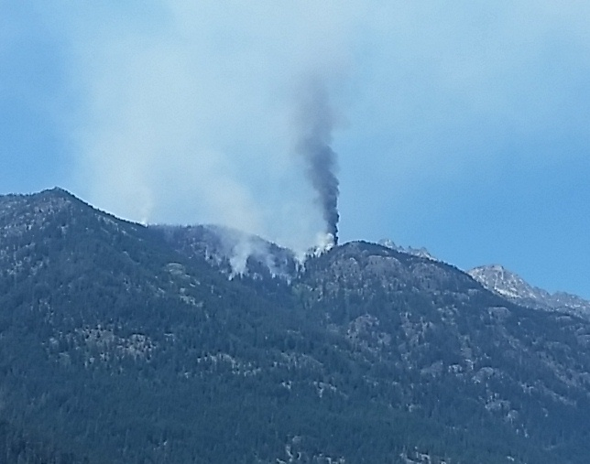
Emissions depend on combustion efficiency
Smoldering Flaming
(white smoke) (black smoke)
CO₂
Primary aerosols (largely Organic compounds)
Volatile Organic Compounds (VOCs = gas phase)
Oxygenated-VOCs (eg CH₂OH; CH3COCH₃, CH₃CHO, etc
CO, NO_{x} (NO+NO₂), NH₃, HONO, etc

Slide 22
Emissions depend on combustion conditions
Smoldering Flaming
More VOCs ↔ Lower VOCs
Less Black carbon ↔ More Black Carbon
Less NOx ↔ More NOx
More NH₃ ↔ Less NH₃
More primary PM ↔ Less primary PM
Per kg fuel consumed
CO₂
Primary aerosols (largely Organic compounds)
Volatile Organic Compounds (VOCs = gas phase)
Oxygenated-VOCs (eg CH₂OH; CH3COCH₃, CH₃CHO, etc
CO, NO_{x} (NO+NO₂), NH₃, HONO, etc

Slide 23
Modified Combustion Efficiency (MCE)
MCE = CO₂ / [CO₂ + CO]
Smoldering Flaming
MCE < 0.9 ↔ MCE > 0.9
CO₂
Primary aerosols (largely Organic compounds)
Volatile Organic Compounds (VOCs = gas phase)
Oxygenated-VOCs (eg CH₂OH; CH3COCH₃, CH₃CHO, etc
CO, NO_{x} (NO+NO₂), NH₃, HONO, etc

Slide 24
Photochemical processing in a wildfire plume
Cloud scavenging for soluble speces (eg aerosols, HNO₃, NH₃, HNO₃, etc.
Aerosol Evaporation and/or growth due to phase transitions.
Oxidation and/or reaction
More volatile VOC + ox = Less volatile OVOC

Slide 25
Primary and secondary Organic Aerosols in a wildfire plume
Dilution
Primary aerosol Loss of VOC + ox = (90% Organic) Aerosol mass Secondary Organic Aerosol production
Black carbon BC + SOA coating

Slide 26
NOx/O₃ chemistry in a wildfire plume
Primary emissions of NOx and HONO;
HONO may be important for rapid production of OH;
NOx can produce O₃ via known route, but NOx is usually scavenged quickly to PAN due to large amounts of acetaldehyde (CH₃COH) in fire emissions: NO₂ + CH₃CO. + O₂ = CH₃COOONO₂ (PAN);
Impact of aerosols on photolysis rates not well known;

Slide 27
Wildfire plume cross-section
Enhanced albedo
O₃ + H₂O + UV = OH
Multiple scattering
Entrainment
Absorption (BC, OC f(λ))
Need AOD and single scattering albedo ($\frac{σs}{σs+σa}$) as a function of λ

Slide 28
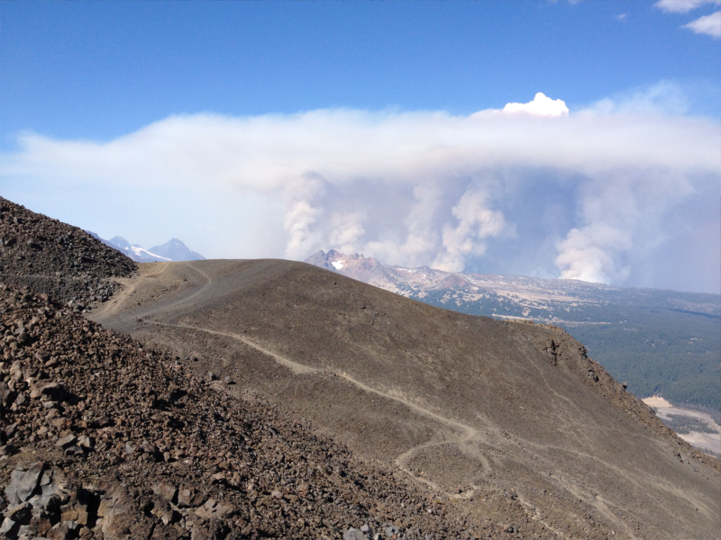
Fire plumes are very different from urban plumes
Huge PM levels, which impacts chemistry and photolysis.
Emissions vary dramatically with time, combustion efficiency, etc.
Very different chemistry: Oxy-VOCs, PAN, HONO, etc.
This makes modeling O₃ in wildfire plumes very tough!
At MBO we found PAN to be 48% of NOy in 6 plumes (Wigder et al 2014) compared to 10-15% for urban plumes (Roberts 2008). This likely contributes to significant O₃ production far downwind (Jaffe and Wigder 2013).
Pole Creek fire on 9/19/ 2012
CO > 9000 ppbv CO
PM₁ > 1000 µg/m³

Slide 29
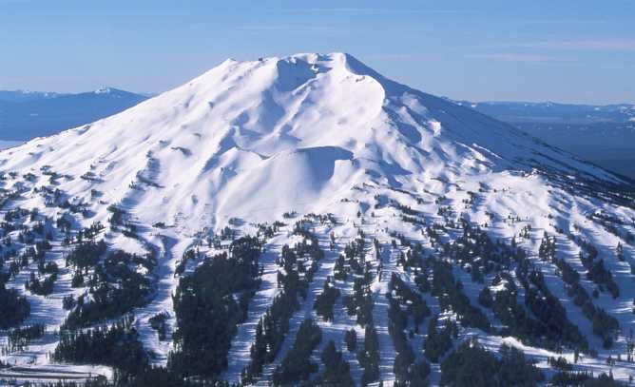

Mt. Bachelor, Oregon, 2.7 km above sea level
The only high elevation/free trop research site in western U.S.
Continuous observations of CO, O₃, aerosols and Hg since 2004;
Frequent detection of Asian pollution and biomass burning plumes;
In summer 2013 added AMS from Qi Zhang’s group (UC-Davis)

Slide 30
Chemical measurements at MBO
  Continuous since 2004:
CO and CO₂ Cavity Ring Down Spectroscopy
O₃: UV spectroscopy
Aerosol scattering (continuous PM1, PM2.5)
Aerosol absorption (climate relevance)
Campaigns:
NOx: Chemiluminescence spectroscopy w/UV photolysis
NOy: Chemiluminescence spectroscopy
Peroxyacetyl nitrate (PAN): Gas chromatography-ecd
Mercury (Hg): Cold vapor atomic fluorescence (CVAFS)
Hydrocarbons: Gas chromatography/mass spec.
Acids (H₂SO₄, HNO₃): Ion chromatography
Aerosol chemistry: X-ray fluorescence, AMS (Zhang UCD)
Multiple measurements are essential to understand the sources and chemical processing!

Slide 31
Use of CO as a conserved tracer
CO is relatively inert (τ = weeks-months) so any changes are due to dilution only;
We assume that once emitted enhancement ratio (ΔX/ΔCO) will provide information on changes in species X due to plume chemistry, deposition, etc.
Examine ΔPM/ΔCO to provide this information ΔO₃/ΔCO.
We can also look at ERs relative to CO₂ (ΔX/ΔCO₂), which allows to link to fuel combustion amounts.

Slide 32
Ozone and PM in wildfires seen at MBO
32 fire plumes observed in 2004-2011;
ΔPM₁/ΔCO ratio varied from 0.06-0.42 µg/m³ per ppbv
13 plumes had enhanced ozone with ∆O₃/∆CO range of 0.01-0.51 (Wigder et al 2013; Atm. Env.)
Due to controversy over whether wildfires make O₃ we completed a review of >125 papers on wildfires obs. We found that the majority reported significant O₃ production but with large variability (Jaffe and Wigder 2012; Atm. Env.)

Slide 33
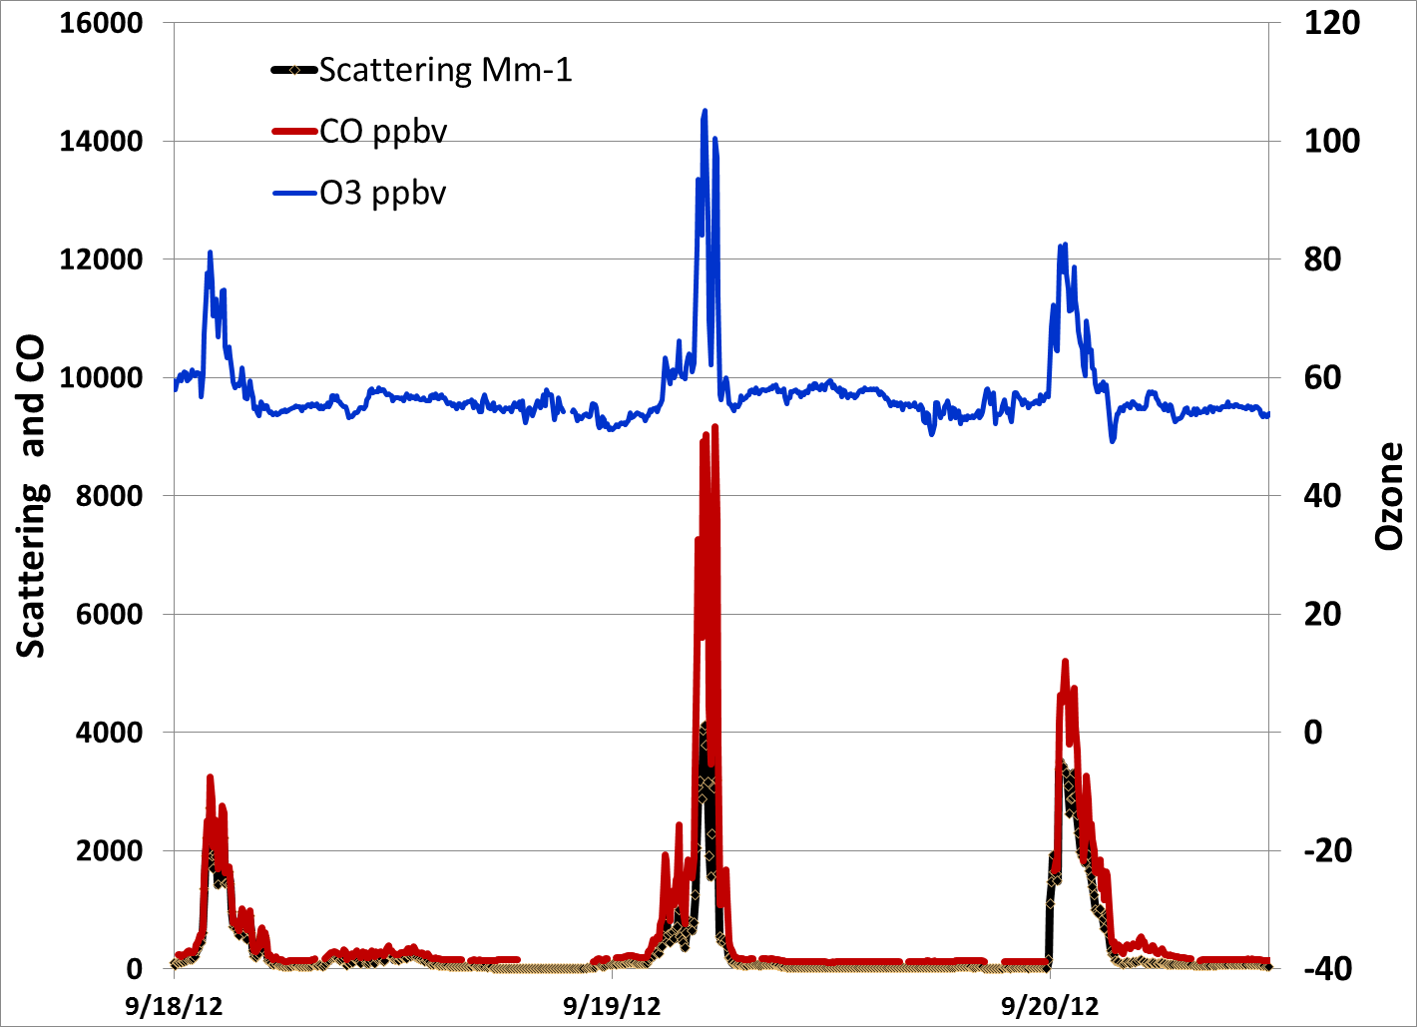
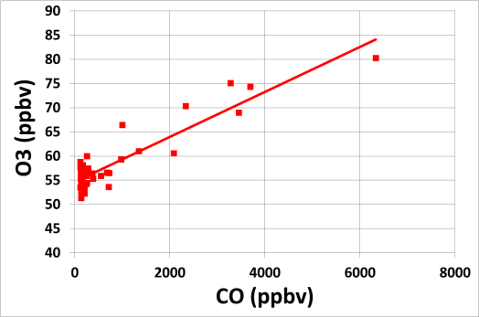
Wildfires can make O₃ very quickly
O₃
CO
Aerosol scattering
Mt. Bachelor observations of the Pole Creek Fire on three successive days. O₃ production of 20-50 ppbv in 6 hours.
(Baylon et al 2014)

Slide 34
Smoke plumes at MBO in summer 2010
Event | σsp/CO (PM1/CO) | R² | O₃/CO | R² | Location
1 | 0.19 ± 0.01 | 0.95 | 0.03 ± 0.02 | 0.27 | Modoc, CA
2 | 0.29 ± 0.02 | 0.93 | 0.09 ± 0.02 | 0.83 | BC, Canada
3 | 0.82 ± 0.04 | 0.91 | 0.08 ± 0.03 | 0.25 | Rooster Rock, OR
4 | 0.64 ± 0.02 | 0.80 | -0.02 ± 0.04 | 0.02 | Rooster Rock, OR
5 | 0.37 ± 0.08 | 0.70 | -0.02 ± 0.02 | 0.01 | Rooster Rock, OR
6 | 0.84 ± 0.04 | 0.85 | 0.09 ± 0.03 | 0.24 | Oak Flat, OR
Wid`
Plume characteristics can vary substantially even from a single fire.
Notes:
* Regression is significant at p<=0.05
Dates:
7/28/10 15:00-23:00
8/1/10 8:00-16:00
8/5/10 0:00 - 8/6/10 0:00
8/6/10 2:00-10:00
8/6/10 11:00 – 8/7/10 4:00
8/25/10 15:00 – 8/26/10 21:00

Slide 35
Our past work has demonstrated large variability in emissions and chemistry from fire to fire
What controls large variability in ΔPM/ΔCO and ΔO₃/ΔCO?
Do some wildfire plumes generate SOA?
How do radiative properties vary with plume age?
How does combustion efficiency (MCE) change plume properties?
How do aerosols impact photolysis rates in fire plumes?

Slide 36
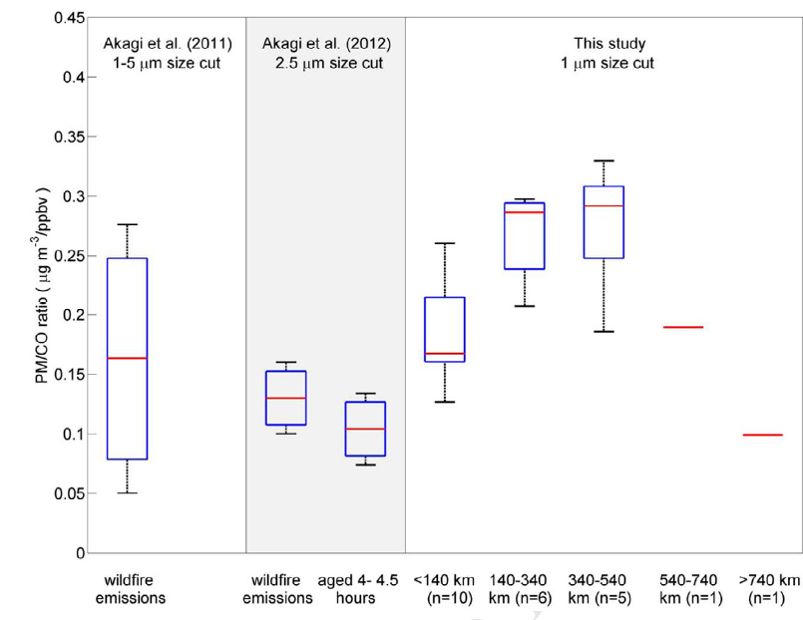
PM enhancement (ΔPM₁/ΔCO)
Initial emissions→ Near-field → More distant transport
Wigder et al 2013 ( Atm. Env)

Slide 37
Variations in OC/CO₂ ER
Individualplumes at MBO (1-2 days old)
Large variability in OC/CO₂ from plume to plume.
Average OC/CO₂ ER in plumes 1-2 days old is ~50% greater than value reported for fresh emissions.
Wigder et al (2015)

Slide 38
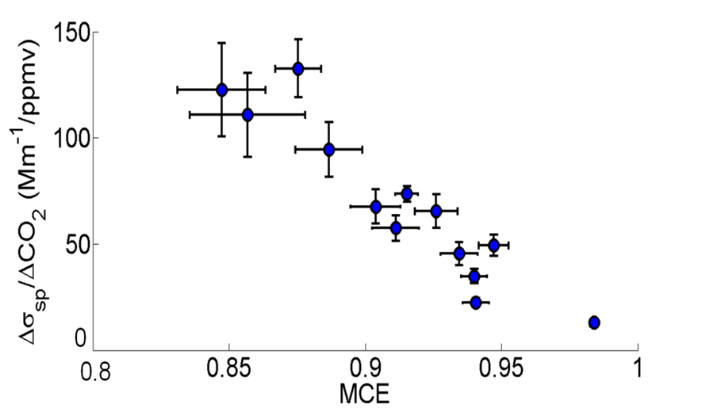
Influence of Modified Combustion Efficiency on Pollutant Enhancements in Fire Plumes
Aged fire plumes (1-2 days) at MBO from 2012-2013 shows negative correlation between aerosol scattering enhancement ratio (Δσ_{sp}/ΔCO₂) and Modified Combustion Efficiency (MCE) due to:
Greater primary emissions of aerosols at low MCE
Greater SOA formation at low MCE due to greater emissions of oxygenated VOCs
Wigder et al 2015
r = -0.93
Low MCE: more smoldering combustion
High MCE: more flaming combustion

Slide 39
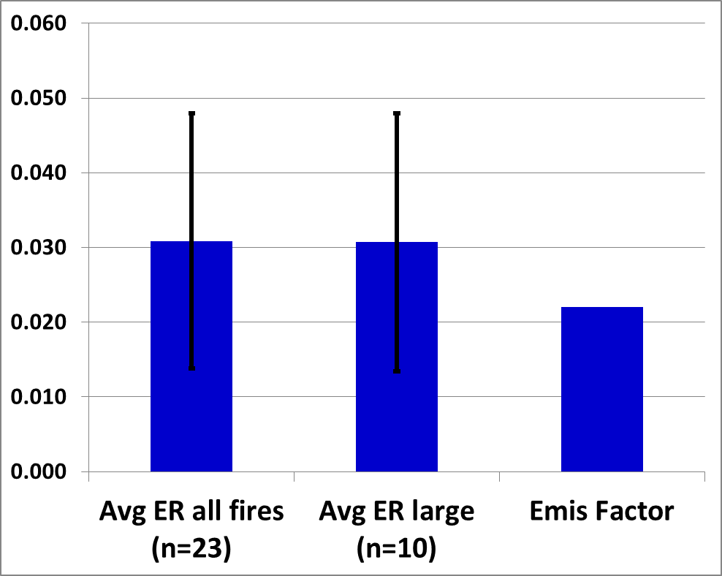
Emission Ratios vs Emission Factors for OC/CO₂ (gmC/gmC)
Error bars show variability (1 σ) in observed ERs at MBO
Average ER is about 50% greater than average EF suggesting SOA production during transport.
Uncertainty is dominated by uncertainty in CO₂ bg.
Focus on large plumes (n=10) reduces the uncertainty and strengthens evidence for SOA production.

Slide 40
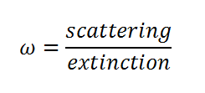
Single Scattering Albedo (ω) and Modified Combustion Efficiency (MCE)
Line: Liu et al. (2014) parameterization for biomass burning emissions
smoldering
MCE ~ 0.80
flaming
MCE ~ 1.00
Points with uncertainty bars show SSA vs MCE from indiv plumes at MBO. Obs do not show a sig drop in SSA w/with MCE.

Slide 41
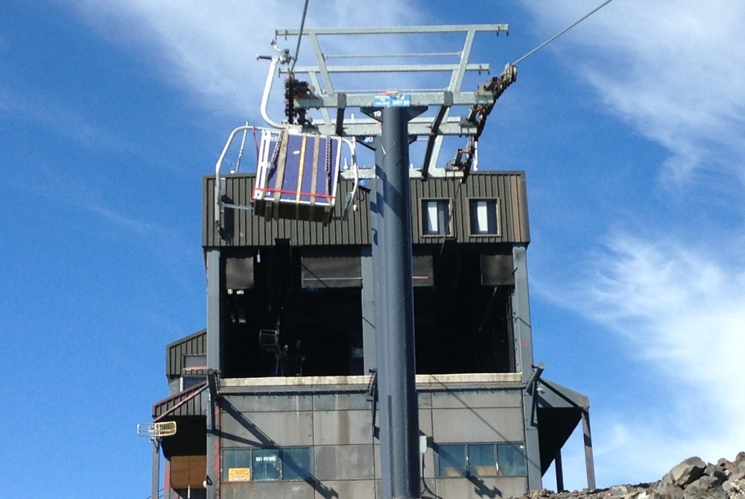
High Resolution TOF Aerosol Mass Spectrometer at MBO in summer 2013-Qi Zhang’s group at UCD
AMS
on a ski lift at MBO.

Slide 42
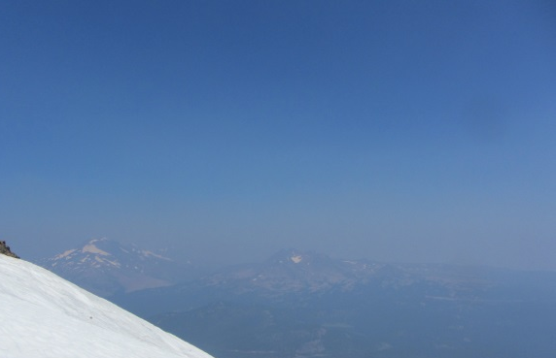
Chemical composition of PM during smoke events by AMS
Organics
Data from Sonya Collier, Shan Zhou and Qi Zhang University of California-Davis

Slide 43
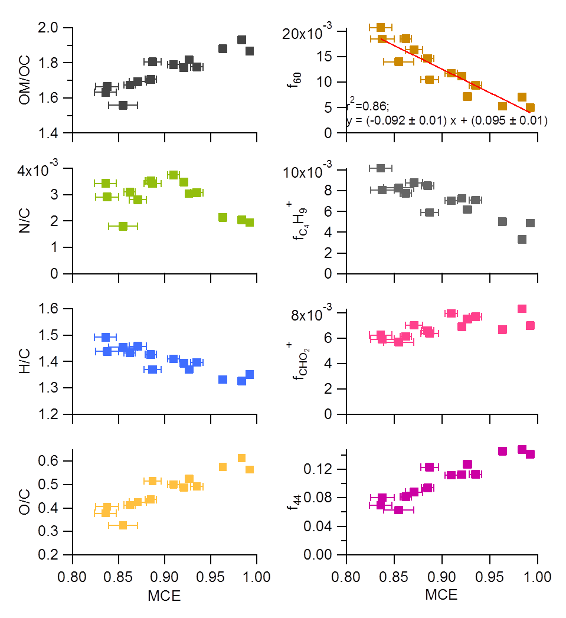
Changes in smoke chemistry as a function of Modified Combustion Efficiency
Aerosol is more highly oxygenated at higher MCE.

Slide 44
Wildfires can make O₃ very quickly
O₃
CO
Aerosol scattering
Mt. Bachelor observations of the Pole Creek Fire on three successive days. O₃ production of 20-50 ppbv in 6 hours.
(Baylon et al 2014)

Slide 45
Summary of ΔO₃/ ΔCO from >100 published studies
Boreal/ Temperate:
Plume Age | Mean ∆O₃/∆CO (ppbv/ppbv) (# plumes) | Range of ∆O₃/∆CO
≤ 1-2 days | 0.018 (n=55) | -0.032-0.34
2-5 days | 0.15 (n=39) | -0.07-0.66
≥ 5 days | 0.22 (n=29) | -0.42-0.93
Tropics/ Subtropics:
Plume Age | Mean ∆O₃/∆CO (ppbv/ppbv) (# plumes) | Range of ∆O₃/∆CO
≤ 1-2 days | 0.14 (n=59) | -0.06-0.37
2-5 days | 0.35 (n=13) | 0.26-0.42
≥ 5 days | 0.63 (n=18) | 0.19-0.87
Jaffe, D.A. and Wigder, N.L., Ozone production from wildfires: A critical review. Atmos. Envir., doi:10.1016/j.atmosenv.2011.11.063, 2012.
Jaffe & Wigder (2012)

Slide 46
Ozone enhancement in wildfire plumes: The Role of NOx
Analysis of more than 20 fire plumes at MBO in 2012-2013.
Negative correlation between ΔO₃/ΔCO and ΔNOx/ΔNOy enh. ratios. This shows that degree of oxidation is a primary determinant of O₃ production.
Size of markers proportional to absolute ozone enh. (ΔO₃). This shows that even if ΔO₃/ΔCO is low, ΔO₃ may still be significant if CO enhancement is large.
Baylon et al 2014
See also review of wildfire-O₃ by Jaffe and Wigder 2012.

Slide 47
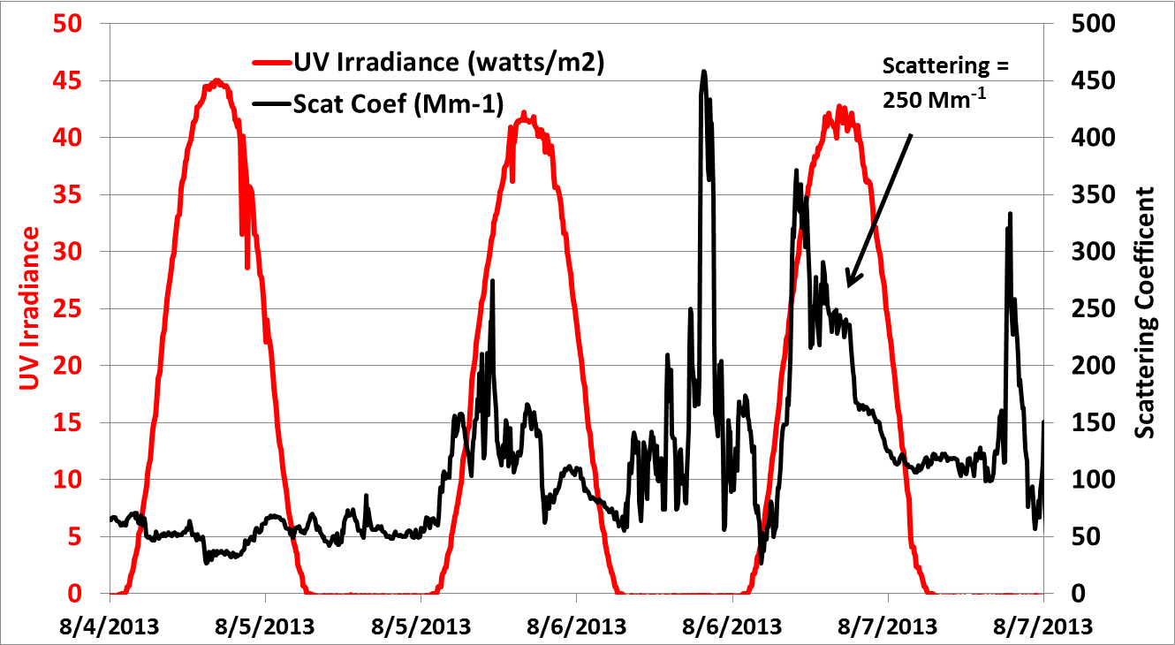
UV irradiance (295–385 nm) and scattering in a fire plume
In this case, only a 6% reduction in UV irradiance.

Slide 48
NO_{y}: NO_{x}, PAN and aerosol nitrate in fire plumes
PAN & aerosol NO₃- are most of measured NO_{y}
HNO₃ (g) probably not a large proportion of plume NO_{y}

Slide 49
Conclusions
Wildfires are a major part of the landscape in the Western US and have a dominant effect on regional air quality in summer.
Wildfires are clearly linked with warmer temperatures and seasonal precipitation. Climate change appears to be increasing wildfires in the Western US.
While “smoke” from wildfires is obvious, there is much we do not understand about the photochemical processing.
Key uncertainties:
Variations in emissions;
Variations in PM and O₃ production, radiative forcing and impacts in urbans areas;
Are data indicate that most fires result in SOA production; O₃ is highly variable, but for most fires there does appear to be downwind production.
Single scattering albedo is likely increased downwind of fires due to SOA production;

