Slide 1
From MODIS to VIIRS – New Satellite Aerosol Products
Ho-Chun Huang and
NOAA STAR Aerosol Cal/Val Team
March 18, 2014
National Central University, Chungli, Taiwan

Slide 2
Outline
NOAA/NASA Joint Polar Satellite System (JPSS)
Visible Infrared Imaging Radiometer Suite (VIIRS) instrument
History, aerosol algorithms and products
Difference between VIIRS and MODIS
VIIRS Performance Evaluation on Aerosol Optical Thickness
Summary
Description of obtaining VIIRS data

Slide 3
VIIRS Aerosol Cal/Val Team
Name | Organization | Major Task
Kurt F. Brueske | IIS/Raytheon | Code testing support within IDPS
Ashley N. Griffin | PRAXIS, INC/NASA | JAM
Brent Holben | NASA/GSFC | AERONET observations for validation work
Robert Holz | UW/CIMSS | Product validation and science team support
Nai-Yung C. Hsu | NASA/GSFC | Deep-blue algorithm development
Ho-Chun Huang | UMD/CICS | SM algorithm development and validation
Jingfeng Huang | UMD/CICS | AOT Algorithm development and product validation
Edward J. Hyer | NRL | Product validation, assimilation activities
John M. Jackson | NGAS | VIIRS cal/val activities, liaison to SDR team
Shobha Kondragunta | NOAA/NESDIS | Co-lead
Istvan Laszlo | NOAA/NESDIS | Co-lead
Hongqing Liu | IMSG/NOAA | Visualization, algorithm development, validation
Min M. Oo | UW/CIMSS | Cal/Val with collocated MODIS data
Lorraine A. Remer | UMBC | Algorithm development, ATBD, liason to VCM team
Andrew M. Sayer | NASA/GESTAR | Deep-blue algorithm development
Hai Zhang | IMSG/NOAA | Algorithm coding, validation within IDEA

Slide 4
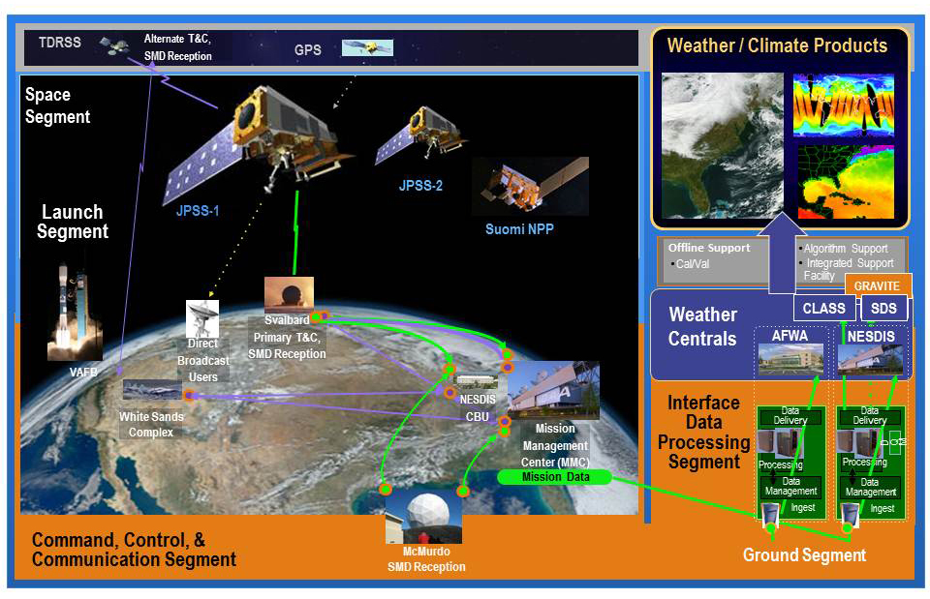
NOAA/NASA Joint Polar Satellite System (JPSS)
JPSS/NPP will provide a continuation of major long-term observations by
the NASA Earth Observing System (EOS)
NOAA/NASA JPSS Program

Slide 5
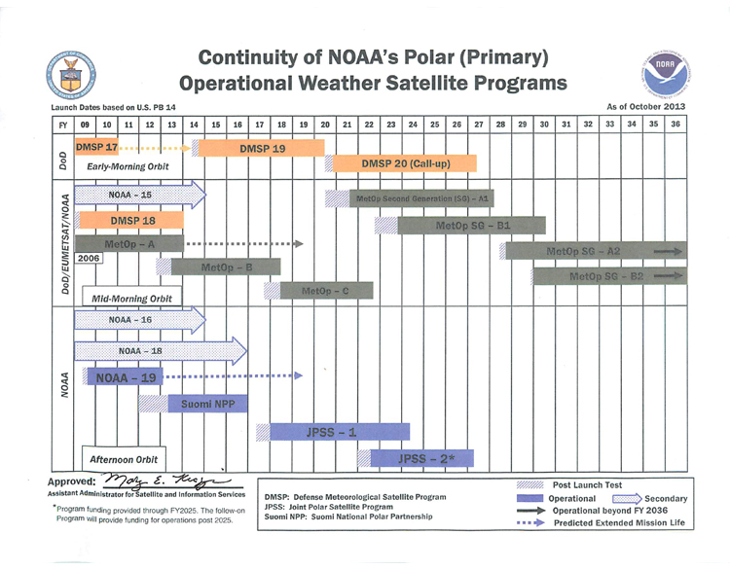
2017
Oct 2011
2021
NOAA/NASA JPSS Program

Slide 6
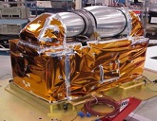
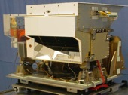
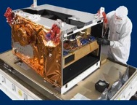
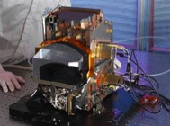
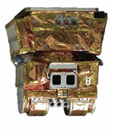
JPSS Instrument |  | Measurement
 | ATMS - Advanced Technology Microwave Sounder | ATMS and CrIS together provide high vertical resolution temperature and water vapor information needed to maintain and improve forecast skill out to 5 to 7 days in advance for extreme weather events, including hurricanes and severe weather outbreaks
 | CrIS - Cross-track Infrared Sounder
 | VIIRS – Visible Infrared Imaging Radiometer Suite | VIIRS provides many critical imagery products including snow/ice cover, clouds, fog, aerosols, fire, smoke plumes, vegetation health, phytoplankton abundance/chlorophyll
 | OMPS - Ozone Mapping and Profiler Suite | Ozone spectrometers for monitoring ozone hole and recovery of stratospheric ozone and for UV index forecasts
 | CERES - Clouds and the Earth’s Radiant Energy System | Scanning radiometer which supports studies of Earth Radiation Budget
Courtesy of Mitch Goldberg

Slide 7
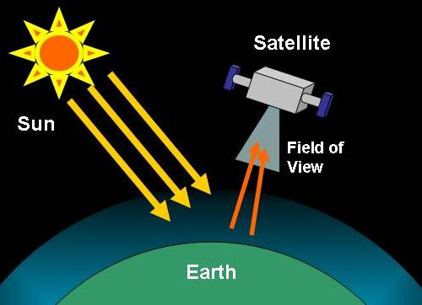
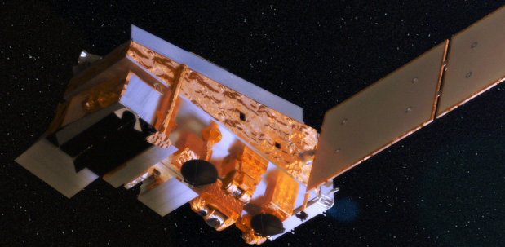
Satellite Aerosol Retrieval
TOA Reflectance
Aerosol Optical Thickness
Surface Reflectance

Slide 8
Visible Infrared Imaging Radiometer Suite (VIIRS)
cross-track scanning radiometer with ~3000 km swath – full daily sampling
7 years lifetime
22 channels (412-12,016 nm)
16 of these are M bands with 0.742 x 0.776 km nadir resolution
aerosol retrieval is from M bands
high signal-to-noise ratio (SNR):
M1-M7: ~200-400
M8-M11: ~10-300
2% absolute radiometric accuracy
single look
no polarization
Band name | Wavelength (nm) | Bandwidth (nm) | Use in algorithm
M1* | 412 | 20 | L
M2* | 445 | 14 | L
M3* | 488 | 19 | L, TL TO
M4* | 555 | 21 | TO
M5* | 672 | 20 | L, O, TO
M6 | 746 | 15 | O
M7* | 865 | 39 | O, TL
M8 | 1,240 | 27 | O, TL, TO
M9 | 1,378 | 15 | TL
M10 | 1,610 | 59 | O, TL, TO
M11 | 2,250 | 47 | L, O, TL, TO
M12 | 3,700 | 191 | TL
M13 | 4,050 | 163 | none
M14 | 8,550 | 323 | none
M15 | 10,763 | 989 | TL, TO
M16 | 12,016 | 864 | TT, TO
*dual gain, L: land, O: ocean; T: internal test
Istvan Laszlo

Slide 9
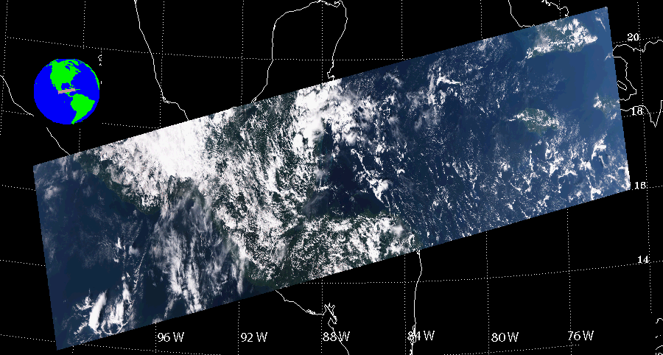
VIIRS Granule
Sensor Data Records (SDRs), converted from raw VIIRS data (RDR), are used in the VIIRS aerosol algorithm.
Processing is on a granule by granule basis. VIIRS granule typically consists of 768 x 3200 (along-track by cross-track) 0.75-km pixels
Example VIIRS granule, 11/02/2013, 19:05 UTC
RGB image
Istvan Laszlo

Slide 10
VIIRS Environmental Data
Land
Active Fire
Land Surface Albedo
Land Surface Temperature
Vegetation Index & Fraction
Surface Type
Ice Surface Temperature
Sea Ice Characterization
Snow Cover/Depth
Ocean
Sea Surface Temperature
Ocean Color/Chlorophyll
Clouds
Cloud Mask
Cloud Optical Thickness
Cloud Effective Particle Size Parameter
Cloud Top Height
Cloud Fraction
Polar winds
Aerosols
Aerosol Optical Thickness (AOT)
Aerosol Particle Size Parameter (APSP)
Suspended Matter (SM)

Slide 11
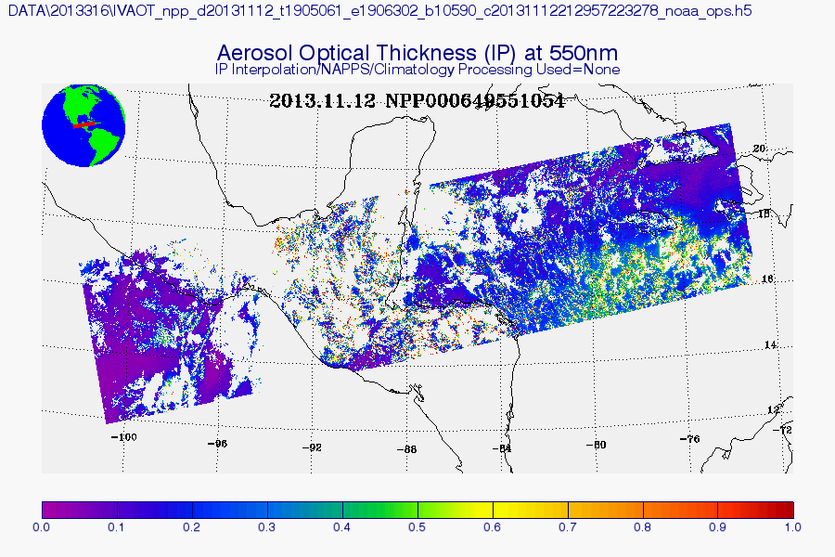
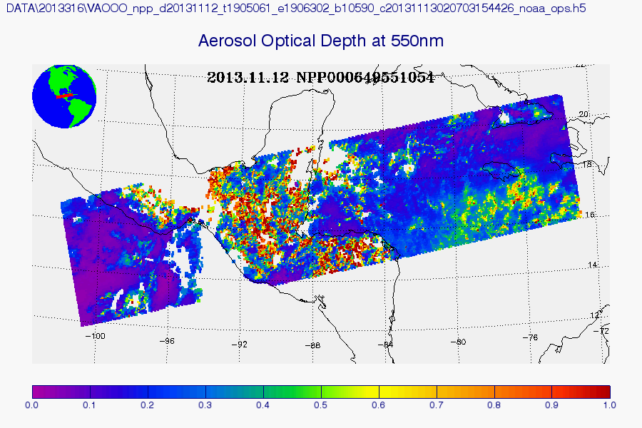
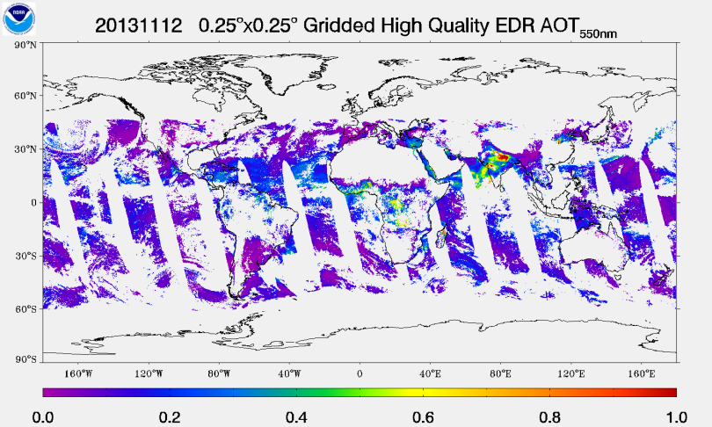
VIIRS Aerosol Products
At NOAA Comprehensive Large Array-data Stewardship System (CLASS):
Intermediate Product (IP)
0.75 km pixel (768x3200)
AOT, APSP, AMI (Aerosol Model Information), and quality flags
Environmental Data Record (EDR)
6 km aggregated from 8x8 IPs filtered by quality flags (96x400)
AOT, APSP, and quality flags
0.75 km pixel (768x3200)
SM
At NOAA/NESDIS/STAR
Gridded 550-nm AOT EDR
regular equal angle grid: 0.25°x0.25° (~28x28 km)
only high quality AOT EDR is used
Istvan Laszlo

Slide 12
VIIRS Aerosol Algorithm
Separate algorithms used over land and ocean
Algorithm heritages
over land: MODIS atmospheric correction
over ocean: MODIS aerosol retrieval
The VIIRS aerosol algorithm is similar but NOT identical to the above MODIS algorithms
Many years of development work:
Initial science version is by Raytheon
Updates and modifications by NGAS
Current Cal/Val Team is to maintain, evaluate and improve the algorithm
See Jackson et. al. (2013) for detail
Istvan Laszlo

Slide 13
Istvan Laszlo
 | VIIRS | MODIS
Algorithm (general)
Main source of data screening | External VCM | Internal tests
Aggregation on | Outputs | Inputs
Residual calculated as | Absolute difference | Relative difference
Over-ocean algorithm
Channel used | 0.67, 0.74, 0.86, 1.24, 1.61, 2.25 µm | 0.55, 0.66, 0.86, 1.24, 1.61, 2.12 µm
Surface reflection | Non-lambertian, function of wind speed and direction | Lambertian, independent on wind (will change in C6)
Aerosol model | Combination of fine and coarse modes | Combination of fine and coarse modes
Match to | TOA reflectances | TOA reflectances
Retrieval over inland water | No | Yes
Over-land algorithm
Channel used | 0.41, 0.44, 0.48, 0.67, 2.25 µm | 0.47, 0.66, 2.12 µm
Aerosol model | Select one from five pre-defined models | Mix two assigned fine and coarse mode dominated models
Spectral surface reflectance | Constant ratios of 0.41, 0.44, 0.48, 2.25 µm over 0.67 µm (will depend on NDVI) | Linear relationship between 0.66 and 2.12 µm as a function of NDVI and scattering angle; constant linear relationship between 0.47 and 0.66 µm
Match to | Surface reflectances | TOA reflectances
VIIRS versus MODIS

Slide 14
VIIRS versus MODIS
 | VIIRS | MODIS
Products
Nominal spatial resolution | 0.75 km (IP) 6 km (EDR) | 10 km (C5) 3 km (C6)
Granule size | 86 seconds | 5 minutes
AOT range | [0, 2] (will change) | [-0.05, 5]
Main product land | Spectral AOT | Spectral AOT
Main product ocean | Spectral AOT Ångström exponent | Spectral AOT Fine mode fraction
Orbit
Orbit altitude | 824 km | 690 km
Equator crossing time | 13:30 UTC | 13:30 UTC (Aqua)
Swath width | 3000 km | 2300 km
Pixel resolution (Nadir) | 0.75 km | 0.5 km
Pixel resolution (swath edge) | 1.5 km | 2 km
EDR AOT product (nadir) | 6 km | 10 km
EDR AOT product (swath edge) | 12 km | 40 km
Istvan Laszlo

Slide 15
Don Hillger, Tom Kopp, and the EDR Imagery Team

Slide 16
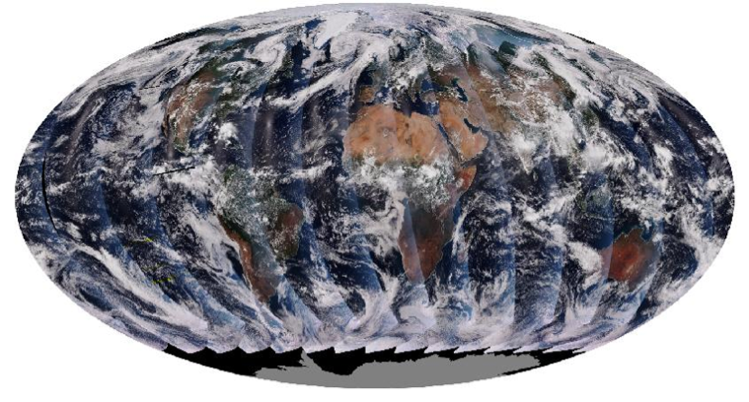
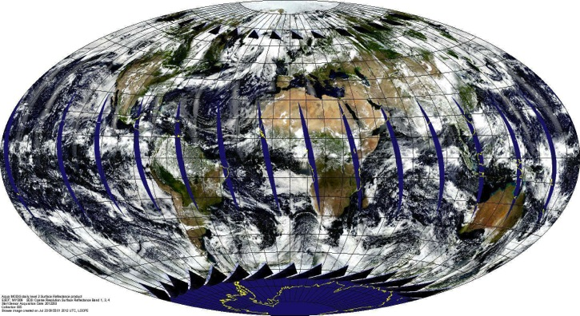
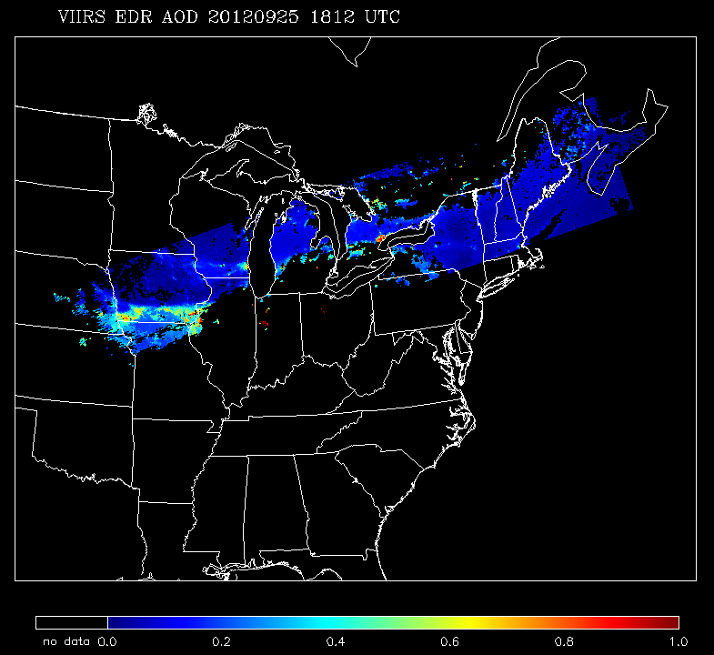
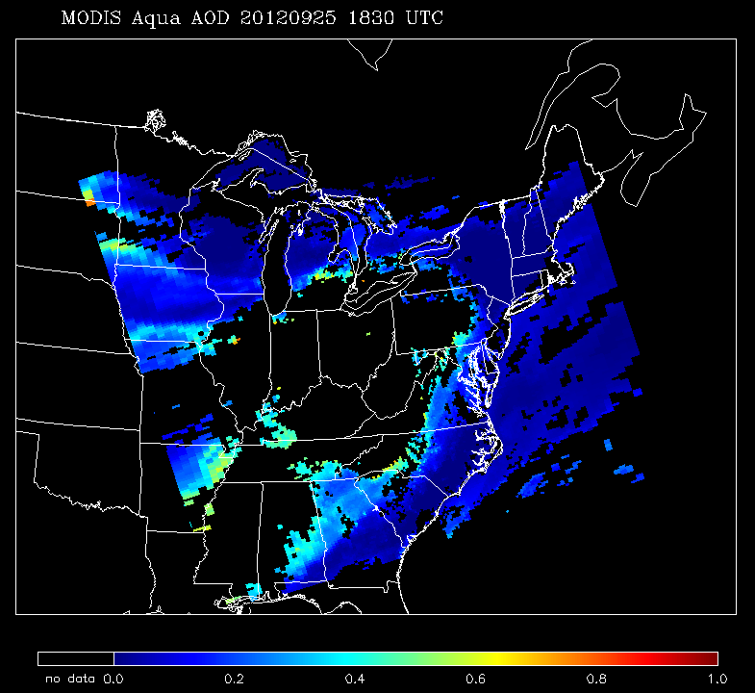
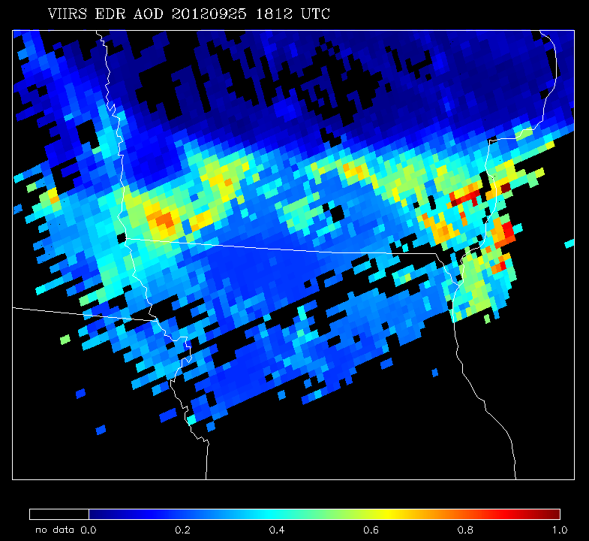
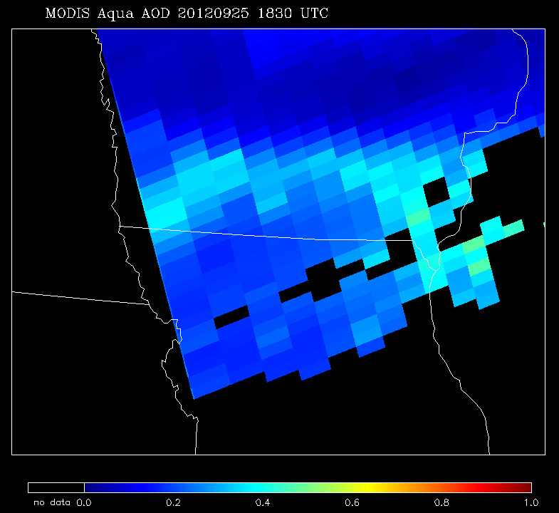
VIIRS versus MODIS
Suomi-NPP (13:30 Local Time, Ascending)
Aqua (13:30 Local Time, Ascending)
VIIRS
MODIS

Slide 17
AOT & APSP Products Timeline
Initial instrument check out; Tuning cloud mask parameters | Beta status | Error | Beta status | Provisional status
28 Oct 2011
2 May 2012
15 Oct 2012
28 Nov 2012
*No reprocessing at this moment
23 Jan 2013
Red periods: | Product is not available to public, or product should not be used.
Blue periods: | Product is available to public, but it should be used with caution, known problems, frequent changes.
Green period: | Product is available to public; users are encouraged to evaluate.
17

Slide 18
What is the difference between VIIRS and MODIS?

Slide 19
The AOT retrieval between VIIRS and MODIS
VIIRS AOT EDR at 550nm (τ₅₅₀) (~6 km resolution)
The Level 2 Aqua MODIS Dark Target τ₅₅₀ (~10 km resolution)
In-situ AOT (τ) Measurement as Reference Data
Near-real time Level 1.5 AERONET (The Aerosol Robotic Network) direct-sun measurements
Level 2 MAN (The Maritime Aerosol Network) series average data
Evaluation Periods
Over ocean, from 05/02/2012 to 09/01/2013
Over land, from 01/23/2013 to 09/01/2013 (after a critical update)
Exclude the data processing error period
See Liu et. al. (2014) for detail

Slide 20
VIIRS versus MODIS
Time series of the daily mean τ₅₅₀ retrieval bias (solid lines) and standard deviation (whiskers) of all VIIRS-AERONET and MODIS-AERONET match-up over ocean (a) and land (b).
Comparable performance of the two satellite retrievals over ocean (excluding the VIIRS processing error period) and land (after the PCT update on 01/22/2013)
Liu et al, 2014

Slide 21
τ₅₅₀ Comparisons for Collocated
VIIRS-AERONET and MODIS-AERONET Data
Over ocean, the accuracy of VIIRS and MODIS are both less than 0.01. Over land, the accuracy of VIIRS is ~ -0.03 and for MODIS is ~ -0.01.
For the reset of statistics, the scores of VIIRS are similar to those of MODIS.

Slide 22
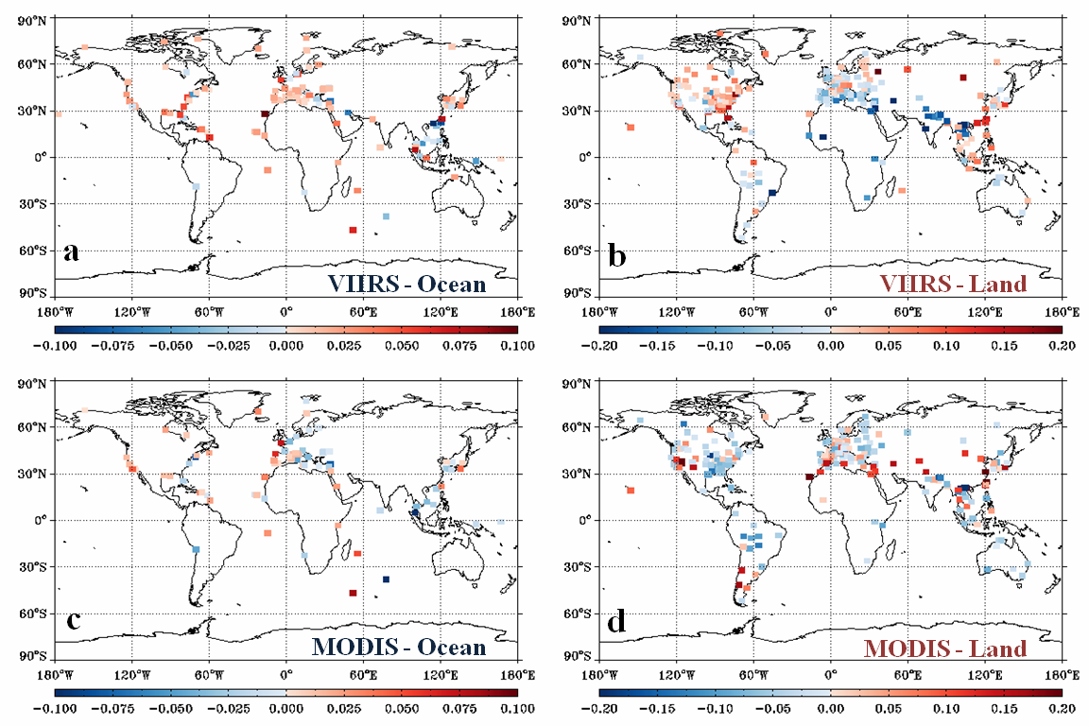
τ₅₅₀ retrieval error over individual AERONET sites
Higher positive bias in Southeast Asia
Positive bias in Northern America
Slightly overestimation over costal area
Higher negative bias in Northern India
Negative bias in Eastern US
Liu et al, 2014

Slide 23
The AOT retrieval performance of VIIRS versus AERONET and MAN

Slide 24
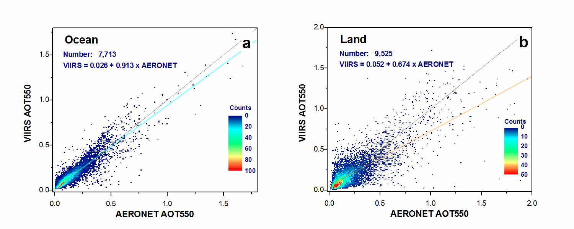
(Coastal or island)
Scatter plots of τ₅₅₀ of individual VIIRS-AERONET match-ups over ocean (a) and land (b). Each scatter covers a width of 0.01 AOT, and the number of match-ups falling within is represented in color. The 1:1 line and linear regression are displayed.
Positive and negative bias of ~ 0.01 is found for over ocean and land, respectively. Precision and uncertainty are ~ 0.061 (0.130) for over ocean (land). Correlation is ~0.906 (0.773) for over ocean (land).
Liu et al, 2014

Slide 25
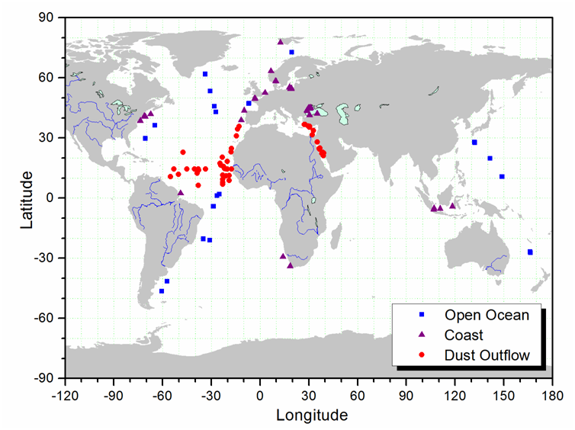
VIIRS-MAN Collocated τ₅₅₀ Comparison
VIIRS τ₅₅₀ retrievals over ocean are in a good agreement with MAN observations (~ 62% of VIIRS retrievals are within the MODIS expected range)
It is comparable to 64-67% MODIS retrievals are within expected range and correlation ~ 0.83-0.85 [Kleidman et al., 2012]
Liu et al, 2014
Notes:
2004-2009

Slide 26
VIIRS AOT Retrieval Performance
 | Land |  | Ocean*
EDR QF | accuracy | precision | accuracy | precision
High | -0.009 | 0.130 | 0.017 | 0.068
Top2 | 0.035 | 0.154 | 0.050 | 0.081
All | 0.063 | 0.195 | 0.084 | 0.125
VIIRS Aerosol AOT retrieval versus AERONET over land (01/24/13-09/01/13) and MAN over ocean (05/02/12-12/21/13). VIIRS AOT EDR quality flag has values of high, medium, and low. Accuracy is the mean of the difference and precision is the standard deviation of the difference.

Slide 27
Future Developments
Investigate surface reflectance relationships with NDVI-dependent relationships (surface vegetation).
Extend AOT reporting range from 2.0 to 5.0.
Update ocean aerosol models (C4) with those from latest MODIS algorithm (C5 to C6).
Improve cloud/heavy-aerosol discrimination, snow/ice detection; add spatial variability internal test.
Add Deep-Blue module (Hsu & Sayer, NASA) to extend retrievals over bright surfaces.

Slide 28
Summary
JPSS/NPP, the US next generation of orbital satellite system, is to provide a continuation of long-term climatic observations.
The VIIRS provides information of atmospheric aerosol for the studies of global radiation budget, weather, air quality, emergency response, and climate.
The VIIRS and MODIS have similar but not the same aerosol algorithms.
VIIRS/MODIS global τ₅₅₀ retrieval are comparable both over land and ocean. But there is a regional difference of retrieval performance over land between VIIRS and MODIS.
The performance of VIIRS τ₅₅₀ retrieval with high quality EDR were compared well with in-situ measurements with accuracy of ~ 0.01 (-0.02) and R of ~ 0.8-0.9 over ocean (land).
The implementation of the deep-blue algorithm over bright surface.

Slide 29
The articles of VIIRS aerosol CAL/VAL team on VIIRS aerosol algorithms and validations.
Jackson, J. M., H. Liu, I. Laszlo, S. Kondragunta, L. A. Remer., J. Huang., H.-C. Huang, 2013, Suomi-NPP VIIRS Aerosol Algorithms and Data Products, J. Geophys. Res., doi: 10.1002/ 2013JD020449.
Liu, H., L. A. Remer., J. Huang., H.-C. Huang., S. Kondragunta, I. Laszlo, M. Oo, J. M. Jackson, 2014, Preliminary Evaluation of Suomi-NPP VIIRS Aerosol Optical Thickness, J. Geophys. Res., accepted.

Slide 30
Information Links
Data (EDR and IP) are available through CLASS: http://www.class.noaa.gov
Gridded data (0.25 degree) http://www.star.nesdis.noaa.gov/smcd/emb/viirs_aerosol/products_gridded.php
ATBD, Users’ guide, README file, and other documents are available through: http://www.star.nesdis.noaa.gov/smcd/emb/viirs_aerosol/documents.php

Slide 31
Obtain VIIRS Data Online Demonstration

Slide 32
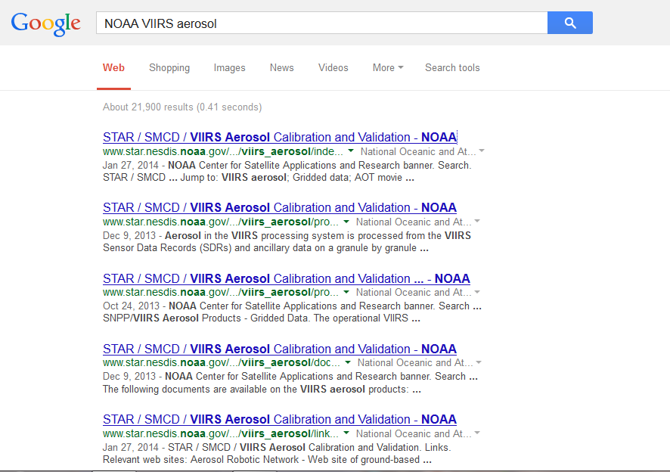
http://www.star.nesdis.noaa.gov/smcd/emb/viirs_aerosol/index.php

Slide 33
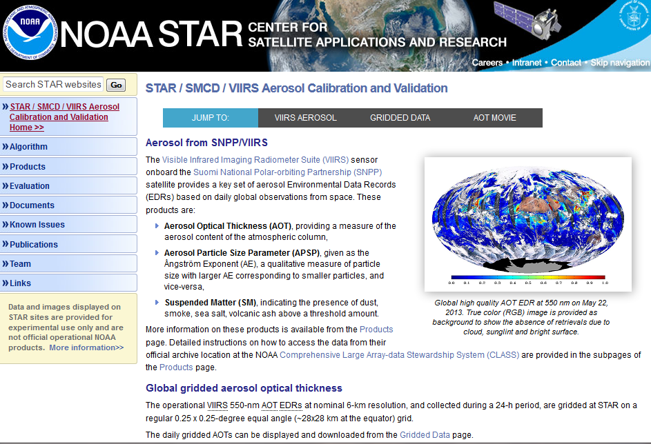

Slide 34
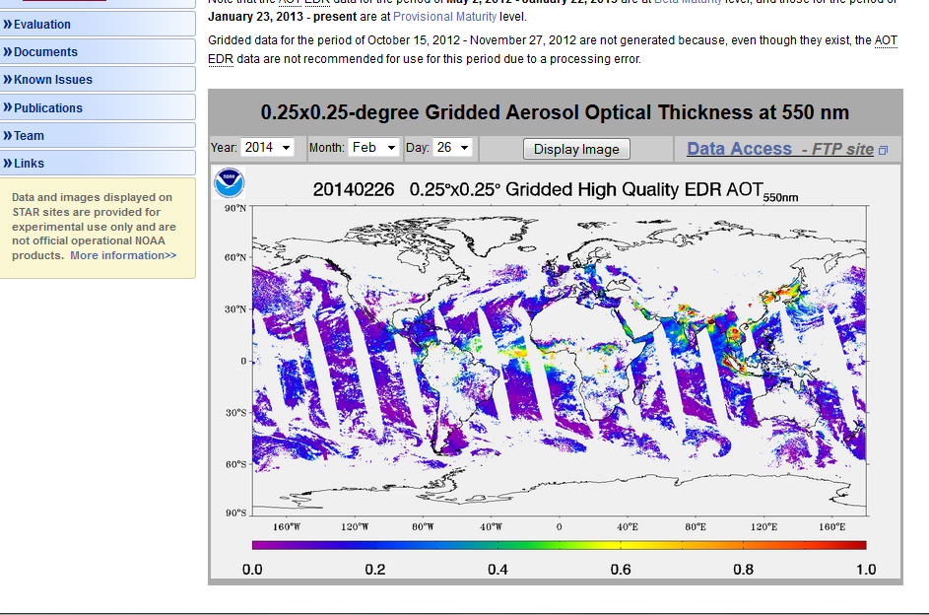

Slide 35
Sample Reader

Slide 37
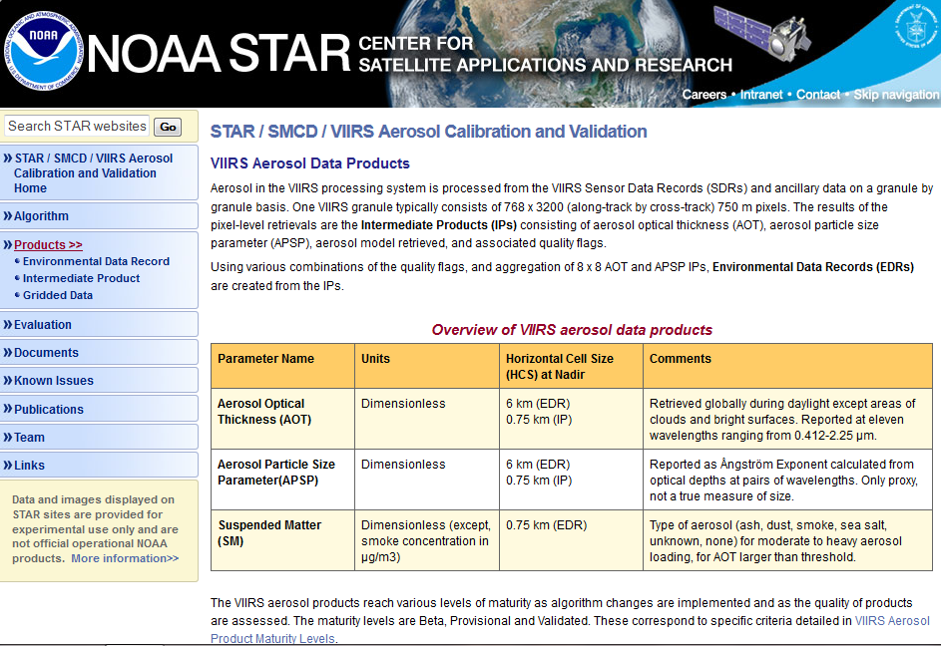

Slide 38
Data Description
Data Access Instruction

Slide 39
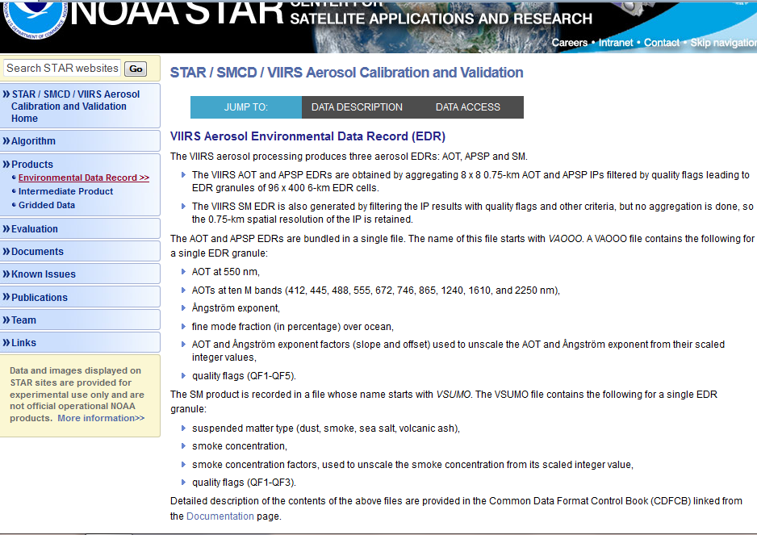

Slide 40
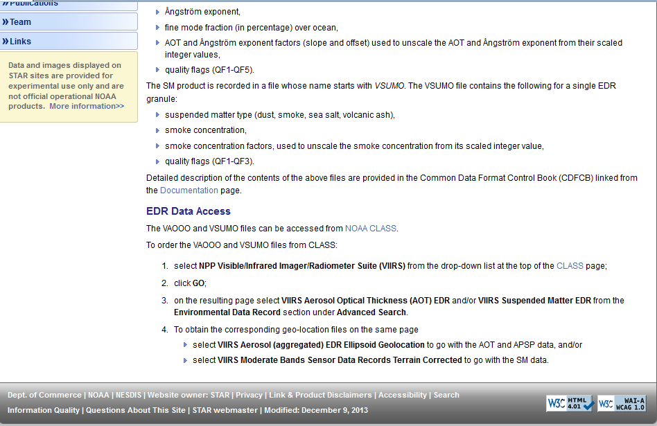

Slide 41
http://www.class.ncdc.noaa.gov/saa/products

Slide 42
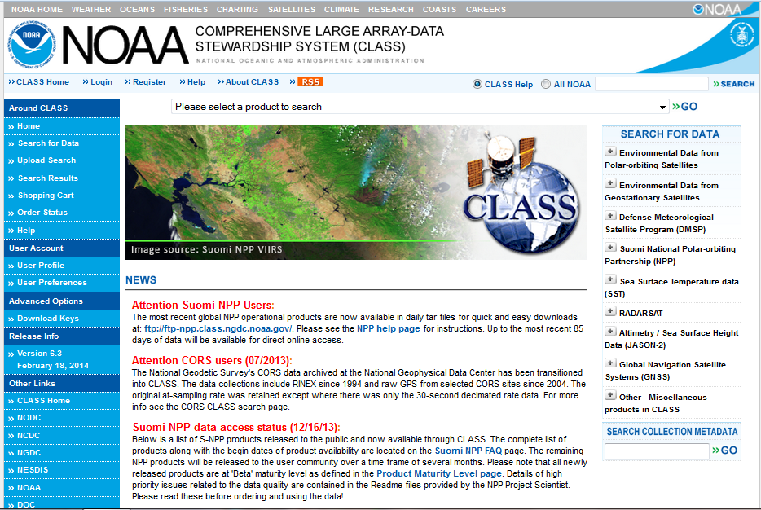

Slide 43
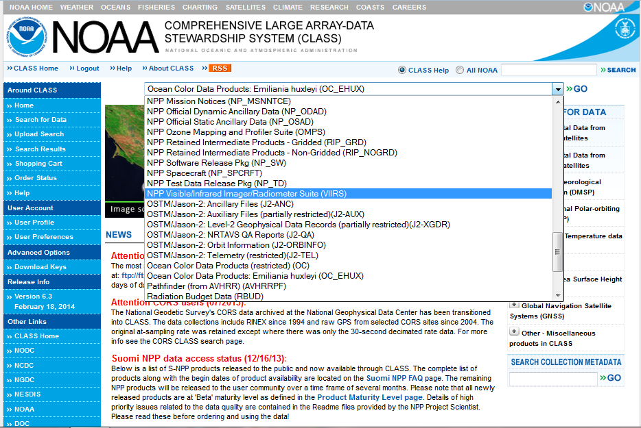

Slide 45
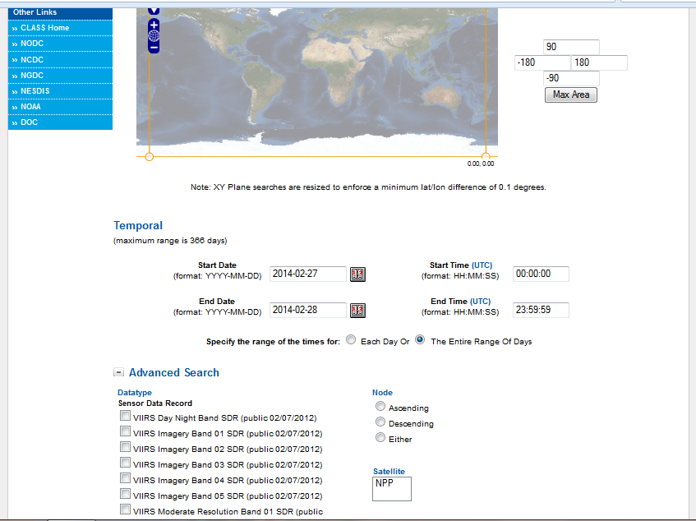
Define Area
Define Time Period
Select Data

Slide 46
Follow NOAA STAR Aerosol Web Page For Selection

Slide 47
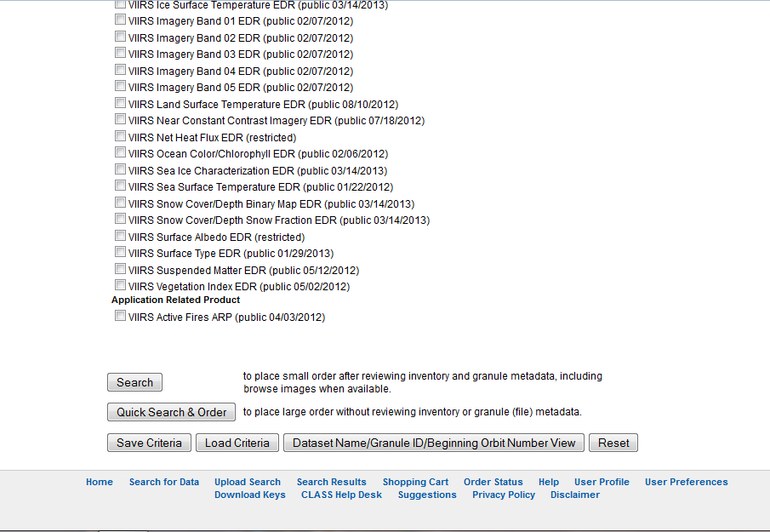

Slide 48
