Slide 1
Vertically pointing radar studies of
precipitation
Dong-Kyun Kim
National Institute of Meteorological Research
25 January 2013

Slide 2
Outline
Backgrounds: past radar researches of precipitation
National center for intensive observation of severe weather
Wind profiler radar
Retrieval methods: raindrop size distribution and related
parameters, horizontal divergence
Ground-based measurements of storms and typhoons
Results
: vertical structure and RSD retrieval properties
characteristics of mean vertical profiles
histograms of rainfall parameters, etc.
Summary

Slide 3
Backgrounds (1)
Retrieval of raindrop size distributions (RSDs) and related parameters (rain rate, mass-weighted mean diameter, intercept parameter, etc.) is essential for improving the understanding of microphysical properties and dynamic processes within precipitating systems.
During the past decades, wind profiler radars have been increasingly used as an effective tool to examine vertical characteristics of microphysics at high time resolution (e.g., rainfall parameters) and dynamics (e.g., vertical air motion) from Doppler spectra observed at UHF and VHF frequencies (Wakasugi et al., 1986; Balsley et al., 1988; Rajopadhyaya et al., 1993)
By using data from dual polarimetric radars and vertically pointing Doppler radars (i.e., wind profiler radar), characteristics of rainfall parameters in convective and stratiform rain have been much studied (Cifelli et al., 2000; Maki et al., 2001; Testud et al., 2001; Bringi et al., 2009).
By using data from RHI scans of a C-band polarimetric radar over the profiler location, Bringi et al. (2009) compared rainfall parameters such as median volume diameter (D_{o}) and rain rate (R) estimated from C-band polarimetric radar and dual-frequency profiler measurements in Darwin and showed good agreement between the profiler and polarimetric radar retrievals. Bringi et al. (2006) conducted a comparison study of rainfall parameters using a C-band polarimetric radar, a 2D-video disdrometer (2DVD), and a 400 MHz wind profiler during a passage of a Baiu front in Okinawa, Japan and indicated that the D_{o} and R retrievals from the 400 MHz profiler were in better agreement with those from 2DVD in a stratiform rain period than in a convective period.

Slide 4
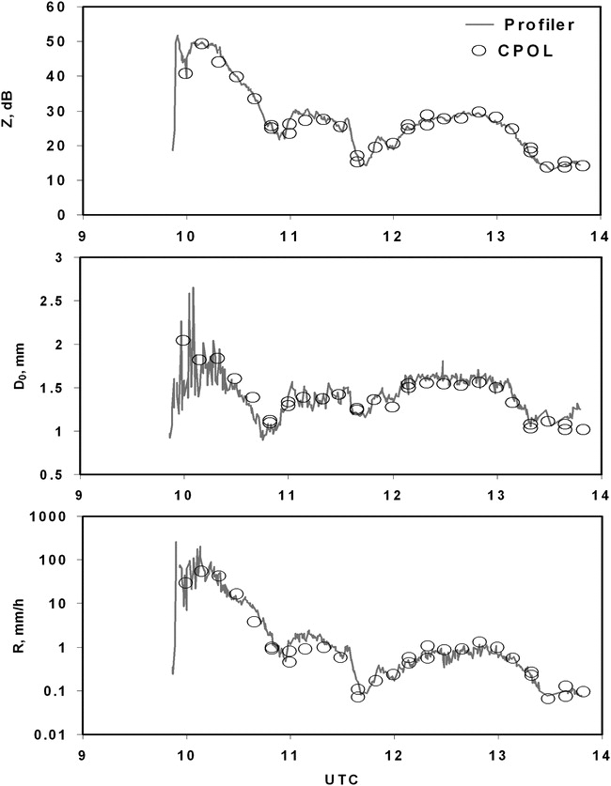
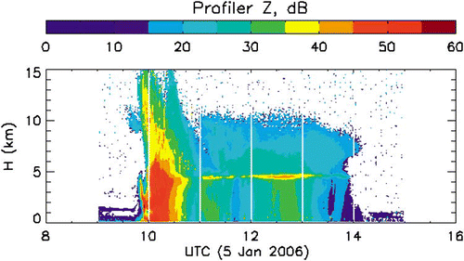
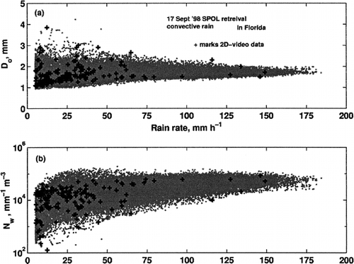
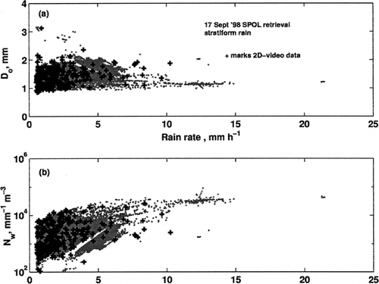
Backgrounds (2)
C-POL
Rainfall parameter comparison between C-POL and profiler
(Bringi et al. 2009)
10 min resolution
Z
Dm
920-MHz wind profiler
~1 min resolution
R
* Rain attenuation correction is needed for C-POL.
Convective
Stratiform
Scatterplots of Do and Nw with regard to R retrieved from S-POL (Zh, ZDR, Kdp) in convective and stratiform region
(Bringi et al. 2002)

Slide 5
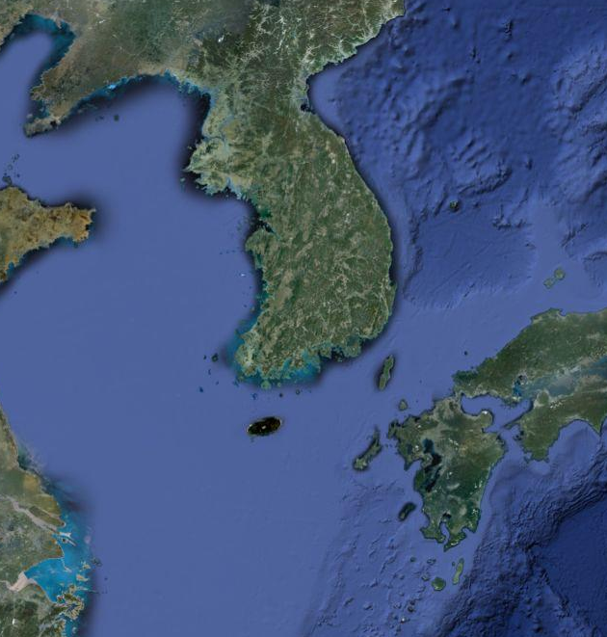
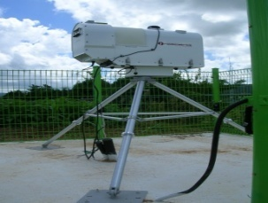
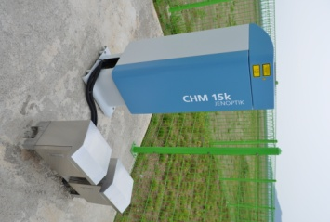
National center for intensive observation of severe weather (NCIO)
Purposes: Observe severe weather phenomena (e.g., storms and typhoons), understand their mechanisms by investigating vertical structures and microphysical characteristics, and enhance the predictability of high impact weather over the Korean peninsular
Seoul
1290-MHz wind profiler : SNR, Doppler velocity, Doppler power spectra, wind, etc.
K-band micro rain radar : Z, R, W_{dop}, DSD, etc.
Parsivel disdrometer : Z, R, V_{f}, Drop size spectra, etc.
Optical rain gauge : R
22-channel microwave radiometer : T, RH, PWV, LWP, etc.
Ceilometer : cloud base height, etc.
K-band cloud radar (installed by March 2013) : Z, R, Doppler power spectra and velocity, LDR, etc.
NCIO

Slide 6
Micro rain radar & PARSIVEL disdrometer
Instrument | Micro rain radar (MRR) | PARSIVEL (Particle size and velocity) Disdrometer
Manufacturer | Metek (Germany) | OTT
Variables | Reflectivity, Rain rate, Drop size distribution, Doppler velocity, Liquid water content | Drop size spectra, reflectivity, fall velocity, rain rate, etc.
Frequency | 24.1GHz (K-band) | 650nm (laser beam)
Height resolution | 200 m (up to ~6 km) | Sampling area: 180 mm x 30 mm
Time resolution | 1 minute | 1 minute
Particle size range | 0.249 ~ 4.53 mm | 0.2 ~ 5 mm (liquid type) 0.2 ~ 25 mm (solid type)

Slide 7
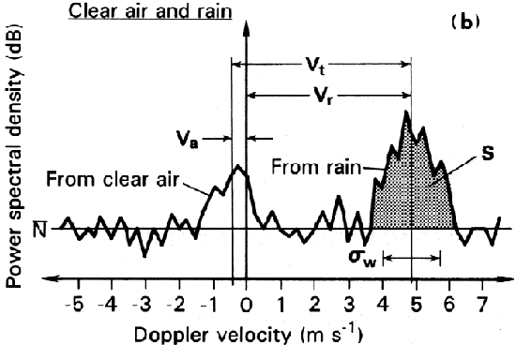
wind profiler radar
North
Observed Doppler power spectrum
West
Zenith
15º
East
South
Sampling
volume
From clear air
From rain
Wind profiler radar detects Bragg echoes backscattered from turbulence in the upper air and Rayleigh echoes from hydrometeors (ices and raindrops).
More sensitive to Rayleigh echoes at UHF frequencies (λ=23 cm, 33 cm) than VHF.
Wind profiler radar

Slide 8
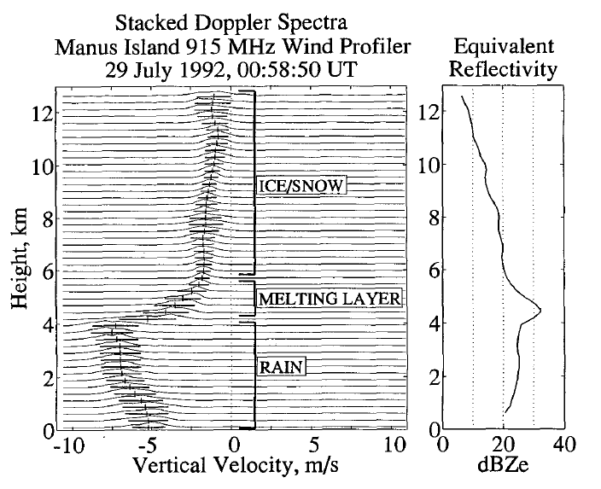
Profiler Doppler spectra in stratiform region
Ice/snow
Melting layer
Rain
Height resolution
: 100 m
Gage et al. (1994)

Slide 9
Vertical properties of spectral power densities
Weak stratiform
Convective
Stratiform

Slide 10
Drop size distribution
We use a gamma DSD of the form:
: can describe the fluctuations of the DSDs on small time scales and spaces.
: To retrieve the DSDs, we must obtain three unknowns : N₀, μ (shape), Λ (slope),
which are called DSD parameters.
μ < 0
D_{m} (mass-weighted
mean diameter)
μ=0
μ > 0
Decrease of Λ
Increase of Λ

Slide 11
Spectra method (SAM model)
→ A profiler-observed spectrum consists of clear-air spectrum, Rayleigh spectrum, and Noise.
: Gaussian shape
: Convolution
Raindrop size spectra
(i.e., hydrometeor size distribution)

Slide 12
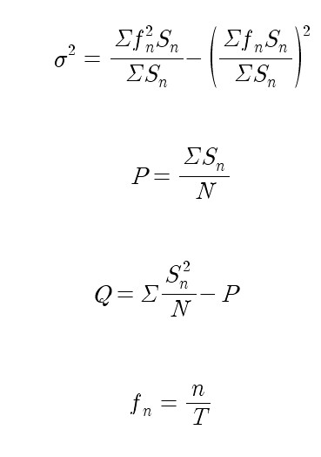
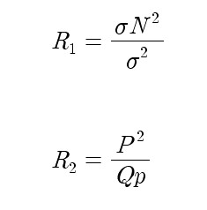
Noise level estimation
Spectral values
Noise level
0th moment :
Signal to Noise
Ratio
1st moment :
Doppler velocity
2nd moment :
Spectral width
Hilderbrand and Sekhon (1974) method was used for detecting the noise level.

Slide 13
Retrieval flowchart (SAM model)
Important constraint: Reflectivity, Doppler velocity, and spectral width are conserved during iterative steps between the observed and modeled spectrum.

Slide 14
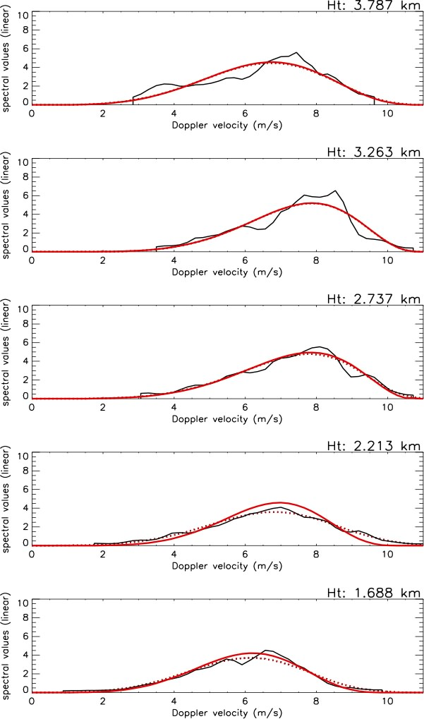
Retrieved spectrum with height
Observed spectrum
Convolved spectrum
Hydrometeor spectrum

Slide 15
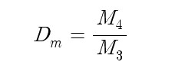
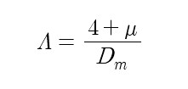
Moment method
(mm/hr)
The moment method was applied to MRR and PARSIVEL spectra to retrieve the DSD parameters.

Slide 16
Kinematics: horizontal divergence profile
Mean horizontal convergence and divergence profiles provide representative kinematic properties in various types of precipitation.
• EVAD (the Extended Velocity Azimuth Display)
: Scanning radar data
• Q-VAD (Quasi-Velocity Azimuth Display)
: Doppler velocity data of wind profiler observed at four off-zenith beams.
• Divergence theorem
: Radar data at highest elevation sweep
Retrieve mean profiles of horizontal divergence
Divergence profiles are integrated vertically to yield vertical velocity or heating profiles. (Heating profiles tend to look similar.)

Slide 17
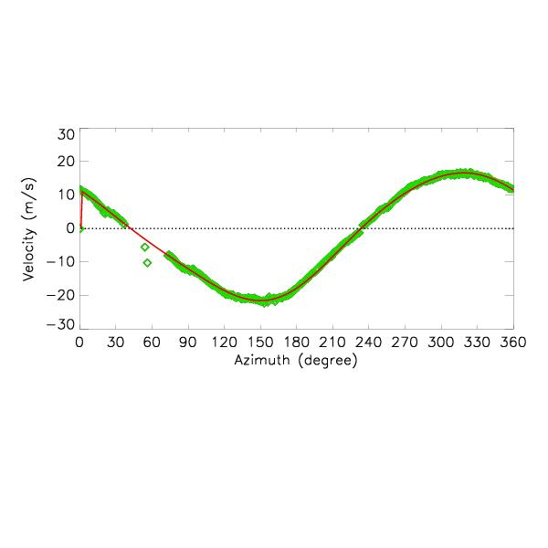
The Extended VAD (EVAD)
applied to scanning radar volumes (C-band radar data were used.)
analyzes horizontal rings belonging to all elevation cones in each layer (w constraints at the top and bottom condition)
yields W_{p}, divergence, and w profiles in relatively uniform wind fields (i.e., stratiform region with melting layer)
a_{o} = zeroth Fourier coeff.
α = elevation angle
W_{p} = hydrometeor fall velocity
Time: 060226 UTC Elevation: 3.9 deg. Ht: 2.142 km
Velocity (ms⁻¹)
Outbound
Inbound

Slide 18
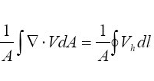
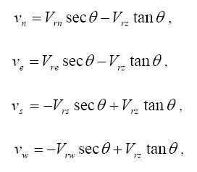
Quasi-VAD & divergence theorem
Q-VAD and divergence theorem were used for obtaining divergence
(and vertical air motion) profiles.
Q-VAD
Divergence theorem
N
E
W
D:19.5 km
At 10 km
D:8.7 km
S
At 5 km
D:4.4 km
D:9.8 km
66.4º
44.3º
Wind profiler
C-band radar
(Highest elevation sweep)

Slide 19
Horizontal divergence comparison
0ºC level
Frequency (%)
The convergence-divergence couplet which is associated with melting-driven dynamics across the melting layer is well shown from the Q-VAD of the smallest scale. The level of Z_{peak} is located at a center of the conv-div couplet.
The divergence profile from the divergence theorem validates that the conv-div couplet from the Q-VAD is not an artifact.

Slide 20
Cases
Wind profiler measurements and analyses
of the following cases
1) Frontal precipitation system (22 March 2012)
2) Typhoon Meari (25 June 2011)
3) Typhoon Bolaven (27-28 August 2012)

Slide 21
Time-height sections of Z, V_{dop}, & SW
Radar reflectivity
Ice
BB
High Z above strong bright band (BB)
Rain
Doppler velocity
Presence of
large drops below strong BB
Spectral width

Slide 22
Comparisons of Z, R, and D_{m} time series
Overall, there exists good agreement in reflectivities and rain rates among profiler, PARSIVEL, and MRR.
Profiler rain rates tend to be underestimated during strong precipitation and are close to those from PARSIVEL and MRR during weak precipitation.
Good agreement in D_{m} among PARSIVEL, MRR, and profiler despite the differences in sampling volume, frequency, and height.
Reflectivity(dBZ)
Rain rate(mm/hr)
Mean diameter(mm)
PARSIVEL
MRR (200m)
PROFILER (800m)

Slide 23
Time-height sections of Z, R, D_{m}, and N₀
Reflectivity
Overall, rain rate is positively correlated with reflectivity, particularly in the high Z streaks.
Rain rates tend to be negatively
correlated with D_{m} in regions of downdrafts particularly at lower levels.
D_{m} is negatively correlated with N₀. D_{m} tends to be overestimated by downdrafts.
Rain rate
D_{m}
D_{m} time series

Slide 24
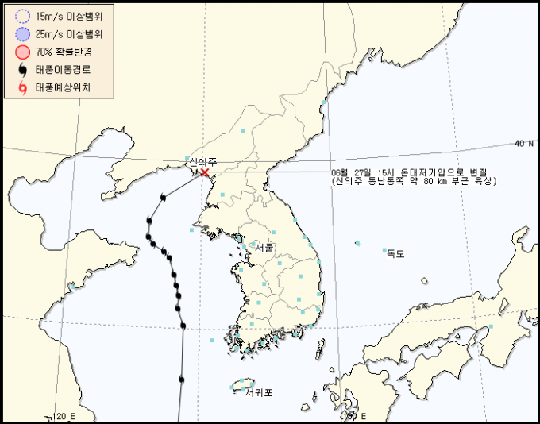
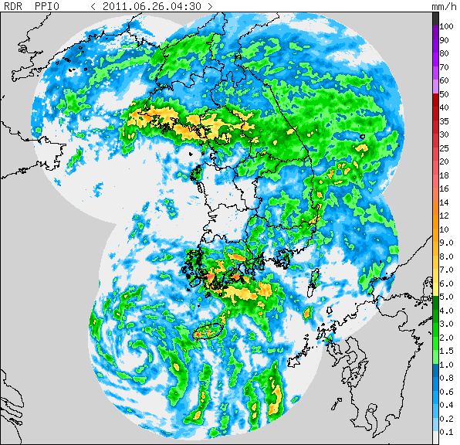
Typhoon Meari (2011)
Track of Meari
Presence of large drops
Radar bright band
Frontal system
Ice
Rain
NCIO
Vortex center
0100
The “Changma (Meiyu)” frontal system has pre-existed for 2~3 days before Typhoon Meari started to affect the southern coast area directly. Typhoon Meari moved north over the Yellow sea and dissipated on 27 June.
Vertical structure in the successive rainbands of Typhoon Meari (about 250 km away from the vortex center) was observed by the wind profiler radar at NCIO from 1400 UTC 25 June.

Slide 25
Retrieved rainfall parameters
Z
Gray-colored regions indicate rain rates greater than 80 mm/hr
R
D_{m}
The good agreement in the D_{m} time series between the profiler and MRR suggests that the profiler-retrieved parameters are valid up to ~4 km AGL below the melting layer (although we need to think about the effects of vertical air motion).

Slide 26
Retrieved rainfall parameters
Strong Z streaks (high R)
Z
R
w
w = W – V_{f ,}
V_{f}=2.6Z^{0.107}
Large updrafts
Relatively large updrafts were found in the regions of high Z and R values. Also, high Z values were observed in the weak downdraft regions.

Slide 27
Power-law relation studies
R vs. D_{m}
R vs. N₀
Updraft (w > 0.5 m/s)
Neutral
Downdraft (w < -0.5 m/s)
small drop spectra
N₀ vs. μ
Similar !
large drop spectra
PROFILER (moment)
MRR (moment)
R vs. D_{m}

Slide 28
Comparison of DSDs bet. the profiler and MRR
In stratiform regions, the DSD shapes (and Dm values) between the wind profiler and MRR are similar each other. During the convective period (R > 10 mm hr⁻¹), the difference in the DSDs is larger.
Compared to the “Changma” period, there are more small drops in the rainbands of Meari.

Slide 29
Comparison of mean DSDs
There is good agreement between the profiler and MRR for stratiform precipitation (0 < R < 10 mm/hr). There is a comparatively larger difference in the range of R > 10 mm/hr
The differences in the ranges of R > 10 mm/hr are due to the limited dynamic range of the profiler.

Slide 30
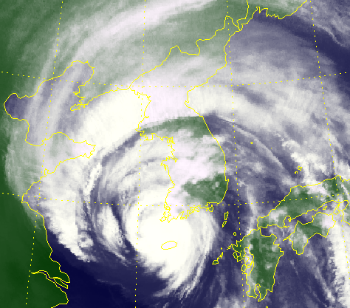
Typhoon Bolaven (2012)
Track of Bolaven
2000 UTC 0827
NCIO
The wide rainband of Typhoon Bolaven was observed by the wind profiler at NCIO from 0800 UTC 27 August. (Analysis period: ~8 hrs)
At around this time, Bolaven showed a broken eyewall structure in a weakening stage.

Slide 31
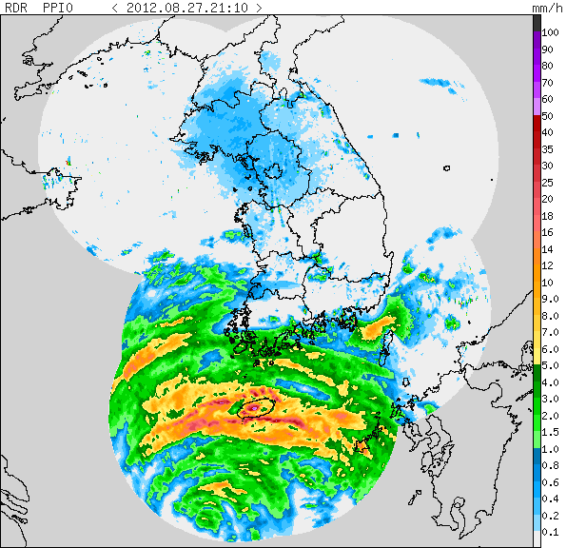
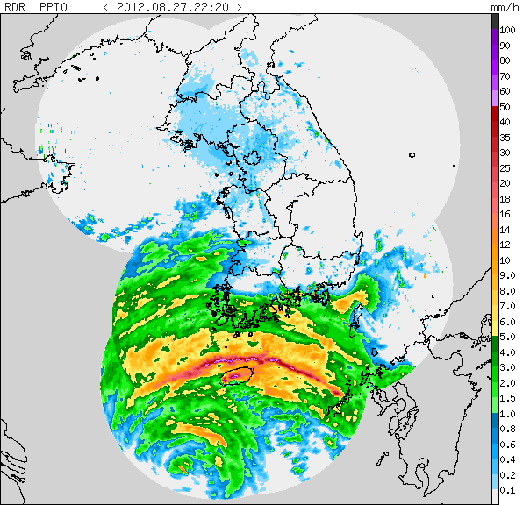
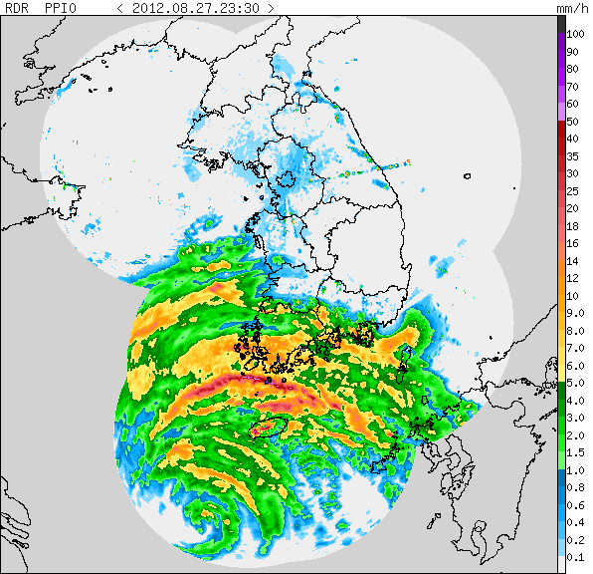
Composite radar images
a
b
c
NCIO
Vortex center
Arc-shaped high Z region
a
b
c

Slide 32
Wind profiler measurements
Strong BB
Elevated BB
Large Doppler velocities (downdrafts!)
As the typhoon center approaches, the surface rain rates increase and the bright band intensity gets weaker.
Strong and thick bright band was observed on ~1450 UTC(i.e., melting of larger ice particles).
The bright band level was raised by ~500 m on around 1530 UTC.

Slide 33
Time-height sections of winds
Strong wind speeds reaching ~50 m/s
E
SE
As the typhoon center gets closer to the NCIO, the winds become stronger at lower levels near 2~4 km AGL and the bright band intensity gets weaker.
The elevated BB on ~1530 UTC may be associated with the strong southeasterly winds below the melting layer (even near the melting layer level !!)

Slide 34
Time-height sections of the parameters
Z
As the typhoon center gets nearer, vertical air motion (i.e., updrafts) at lower levels (2~4 km AGL) became to be stronger.
Rain rates were higher in the regions of stronger updrafts, showing a positive correlation between R and updrafts in this case. The high rainfall rates could be overestimated by the updrafts.
Vertical air motion(w) was estimated from w = W – V_{f} where V_{f}=2.6Z^{0.107}.
R
D_{m}
N₀
large
drops
small
drops
w
updrafts
downdrafts

Slide 35
Two categories by BB intensity
Strong BB
Weak BB
Elevated BB
Strong BB
Weak BB
Updrafts !!
Increased Z
in low levels
Strong (thick) BB : stratiform structure
Weak (narrow) BB: mixed stratiform-convective structure

Slide 36
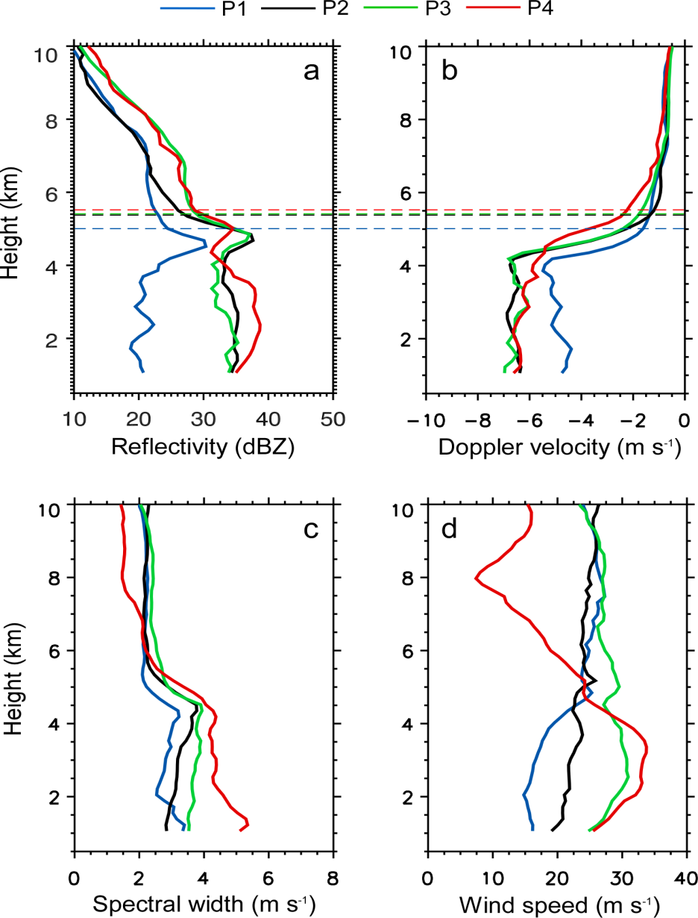
Mean vert. profiles in Typhoon Kompasu (2010)
Stratiform
Inner rainband
Outer rainband
Rise of melting layer
levels with time is notable
Eyewall
Drop growth associated with updrafts within the eyewall
Strongest winds and largest spectral widths in the eyewall

Slide 37
Histogram comparison (1)
Higher mean Z and R in the mixed stratiform-convective region (weak BB)

Slide 38
Histogram comparison (2)
Smaller mean Dm and larger N0 in the mixed stratiform-convective region

Slide 39
Contoured frequency distributions by height
Basically both the rainbands had a stratiform structure with a bright band near the melting layer.
The frequency distributions of reflectivity and Doppler velocity were broader in the rainbands of Meari, compared to those of Bolaven. This indicates wider size distributions of raindrops for Meari.
Higher mean reflectivity and Doppler velocity profiles below the melting layer are observed in the rainbands of Bolaven.

Slide 40
Comparison of mean vert. profiles
w = W – V_{f ,}
V_{f}=2.6Z^{0.107}
There were higher reflectivity and Doppler velocity profiles in the rainbands of Bolaven, compared to those of Meari.
The larger spectral width profile in Bolaven is attributed to stronger horizontal wind speeds.
Mean updraft profiles of about 2 m s⁻¹ below the melting layer were analyzed in both the rainbands.

Slide 41
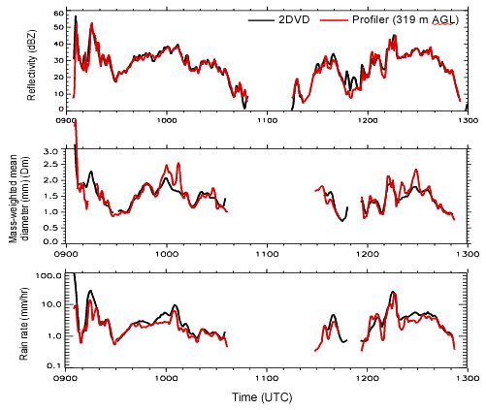
Validation with 2-Dimensional Video Disdrometer
The 8 April 2010 case
Instrument | 2-dimensional Video disdrometer (2DVD)
Variables | Particle size, fall velocity, axis ratio, reflectivity, rain rate, etc.
Measuring area | 10 cm x 10 cm
Scan | 2 orthogonal line-scan cameras (with light sheets 6.2 mm apart in the vertical)
- | 512 pixels in line scan
Z (dBZ)
D_{m}(mm)
N₀(m⁻³ mm^{-1-μ})
Note that profiler retrievals at 319 m AGL are more affected by vertical air motion than 2DVD at the surface.

Slide 42
Summary (1)
Rainfall parameters have been retrieved from the profiler Doppler spectra and MRR data using the spectral method and moment method. There were good agreements in retrieved parameters such as Dm and R between the profiler and MRR, indicating that the profiler retrievals are reliable below melting layer.
The RSD comparisons between the MRR and profiler showed better agreement in stratiform precipitation ( R < 10 mm hr⁻¹) but showed difference in strong precipitation.
Doppler spectra observed by the profiler can be used for classifying different types of precipitation (i.e., stratiform/mixed/convective).
Vertical structure and rainfall properties within Typhoon Meari and Bolaven were investigated primarily from wind profiler measurements and retrievals. For Bolaven, the changes, that is, the decrease in bright band intensity and increase in reflectivities (rain rates) and wind speeds at lower levels as the typhoon center gets closer were observed similarly to those in previous hurricane observations.
Basically both the rainbands had a stratiform structure with a bright band near the melting layer. The frequency distributions of reflectivity and Doppler velocity were broader in the rainbands of Meari, compared to those of Bolaven. This indicates the wider size distributions of raindrops in the rainbands of Meari.

Slide 43
Summary (2)
With the higher Z and R profiles , the higher D_{m} profile indicates that there were relatively larger raindrops in the rainbands of Bolaven, compared to those of Meari.
In the Bolaven rainbands, rain rates and low-level winds in the mixed precipitation category (weak BB) became higher and stronger than in stratiform category (strong BB) as the typhoon center gets close.
Vertical air motion plays an important role on producing such different drop size distributions for a given same Z (or for a given same R).
The use of vertically pointing radars (i.e., wind profiler) is quite useful since Doppler spectra observed at vertical mode with high time and height resolution can be effectively used to examine vertical changes in raindrop size distributions and precipitation processes.
Joint observations and studies of rainfall retrieval using wind profiler, 2DVD, Parsivel, MRR, and polarimetric radar are necessary for understanding rainfall microphysics and dynamic processes in more details within storms and typhoons as well as improving rainfall estimation algorithms (i.e., QPE) for hydrological and numerical applications.

Slide 44
Thank you for your attention !!

